Slide 1
8 Series EPIRB Battery Replacement Guide

Slide 2
EPIRB Battery Replacement Guide
Welcome to the Battery Replacement Guide. Information provided in this Guide will advise on the following:
Eight Series beacons types
Required Hardware and Software
Replacement of Batteries
Self-Test
Leak Test
Connecting to beacon via Configurating Software
Updating Battery Expire Date on the Beacon
Examples of printed documents
Applying the newly printed labels
EPIRB Battery Replacement Guide
Oct-24

Slide 3
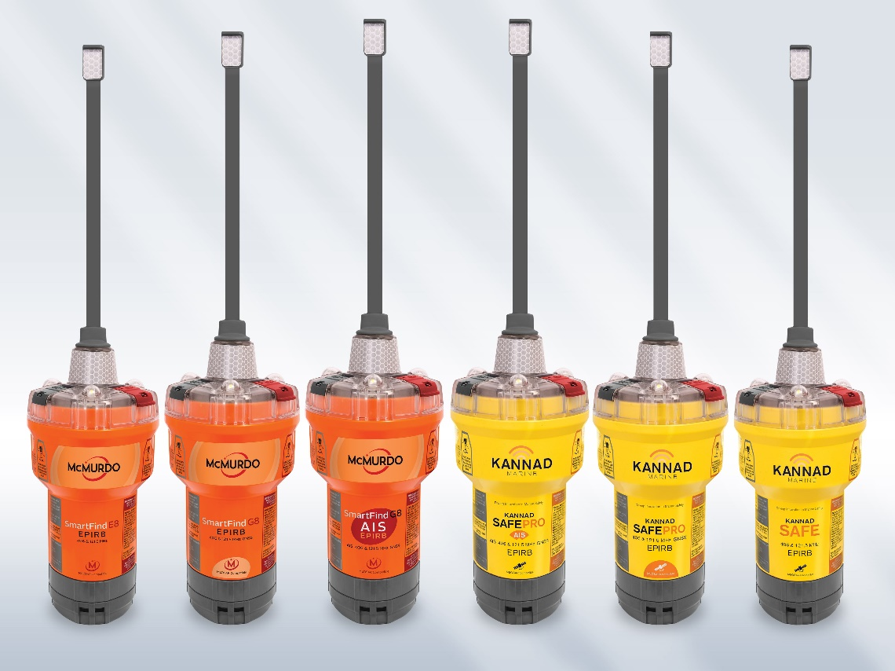
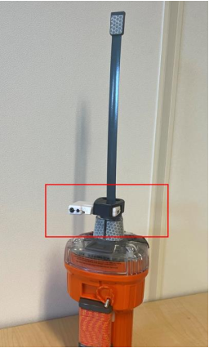
Eight Series EPIRB are programmed with FPROG3 SOFTWARE AND IRDA USB PEN
Kannad Safe EPRIB
Kannard Safe Pro EPRIB
Kannard Safe Pro AIS EPRIB
McMurdo E8 EPRIB
McMurdo G8 EPRIB
McMurdo G8 AIS EPRIB
EPIRB Battery Replacement Guide
Oct-24

Slide 4
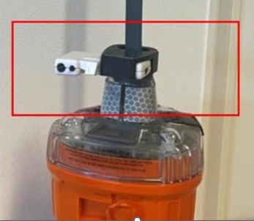
Required hardware and software
ESD Work Station
Torque Driver (Number 4 Hex bit, 30cNm)
Leak Testing Station (Hot Water Method)
Computer (Windows 7, 8, 10, 11)
Free USB port on selected computer
USB Ir/IrDA programming Pen
Pen Holder (1002665)
FPROG 3 Software downloaded from McMurdo Partner Portal
Label and document Printer
Article no: 1001420 USB programming pen kit incl.
EPIRB Battery Replacement Guide
Oct-24

Slide 5
Replacing Batteries
EPIRB Battery Replacement Guide
Oct-24

Slide 6
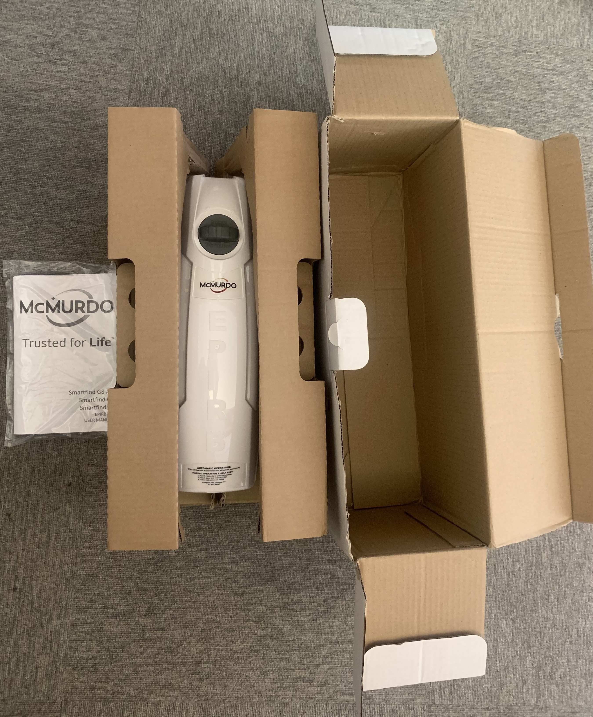
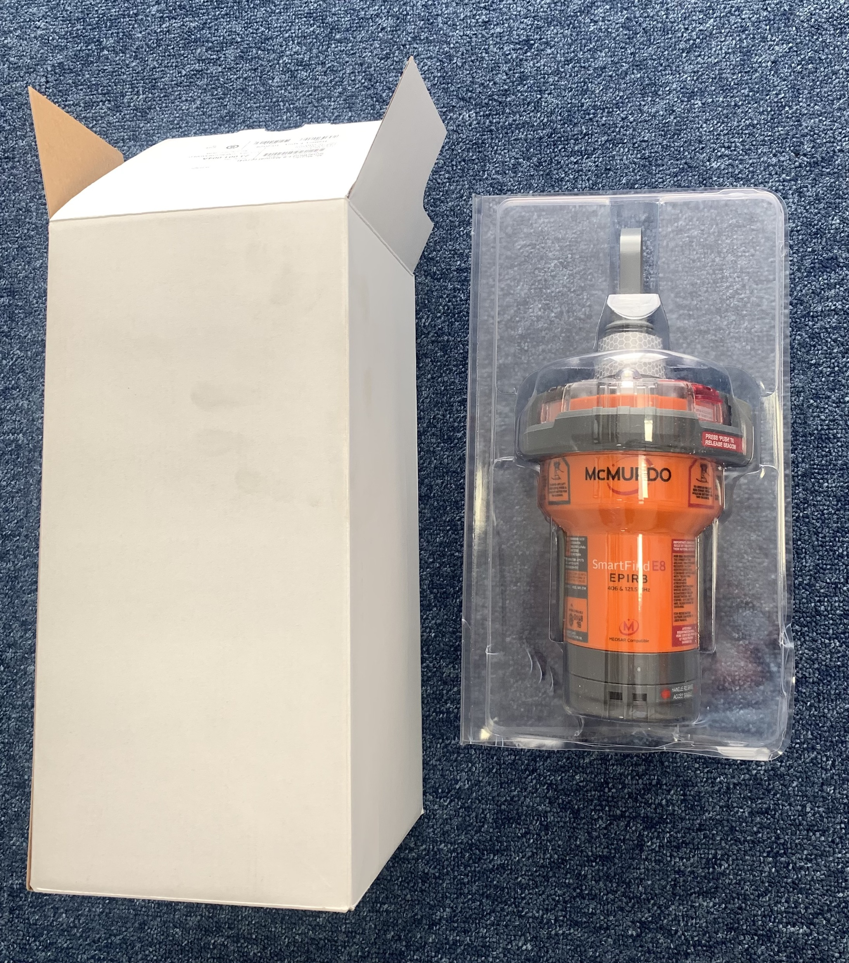
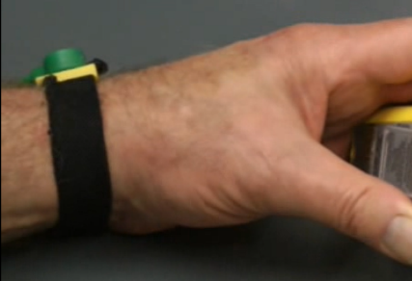
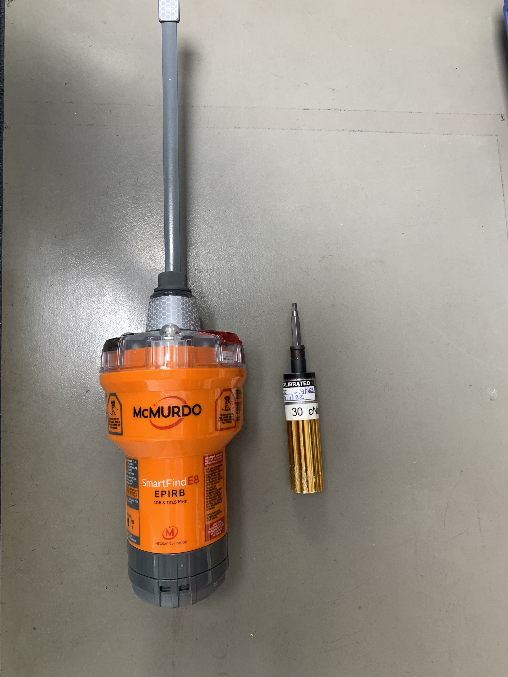
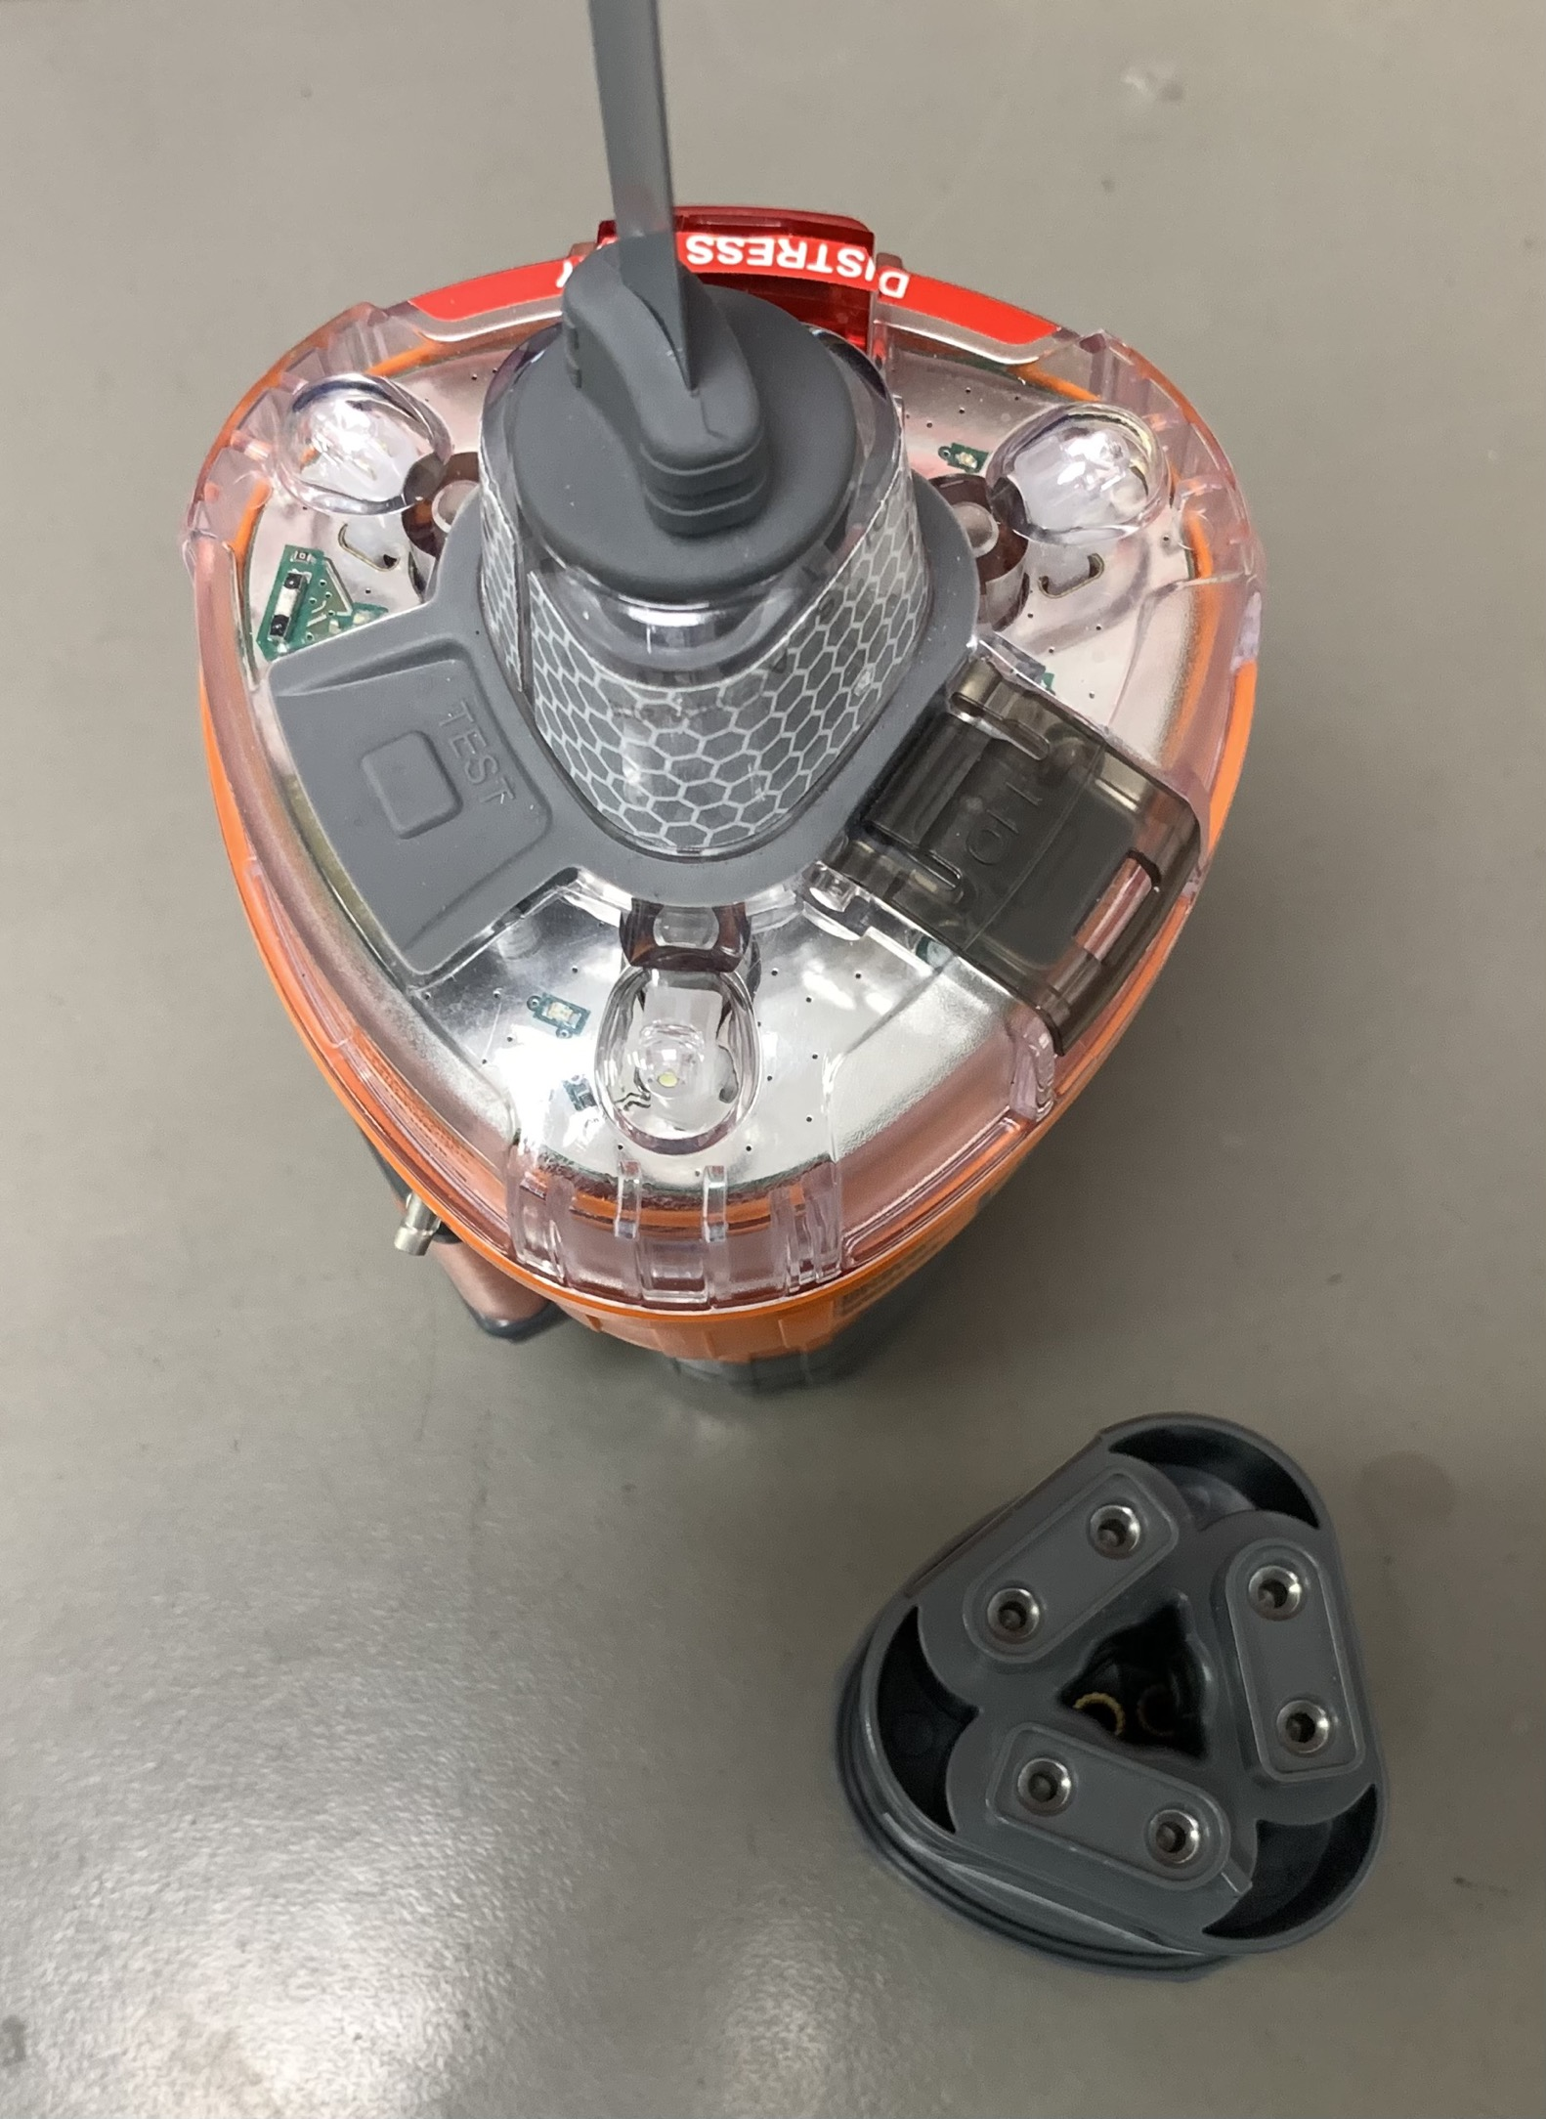
Preparation to Replace Batteries in EPRIB
Step One
Carefully Unpack the EPRIB from its Packaging
Ensure ESD Work Station is used
Ensure Technician is properly grounded via ESD strap while work is undertaken.
Ensure Torque Driver (Number 4 Hex bit, 30cNm) is used.
Ensure correct Battery Replacement Pack is used
Ideally a Series 8 "Battery Replacement Tool" should be used. (Sold Seperately)
(c)
(d)
(e)
(b)
EPIRB Battery Replacement Guide
Oct-24

Slide 7
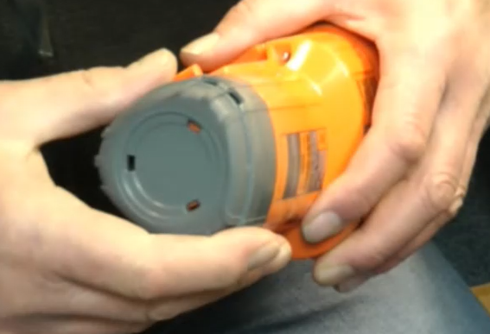
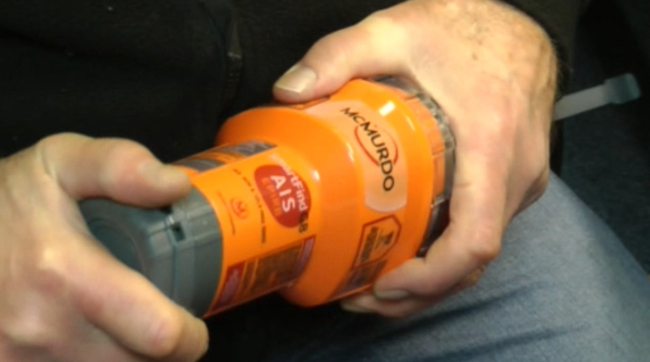
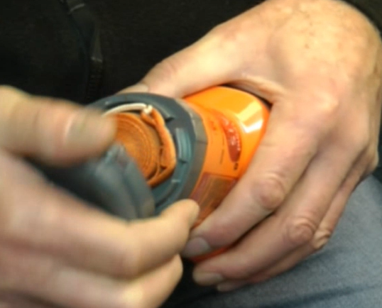
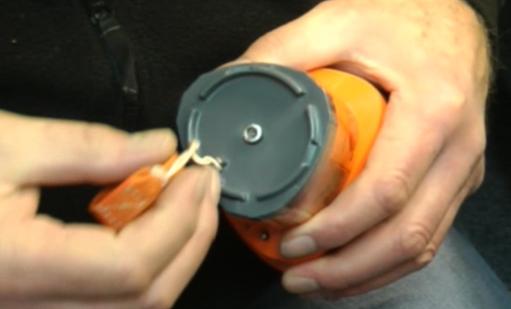
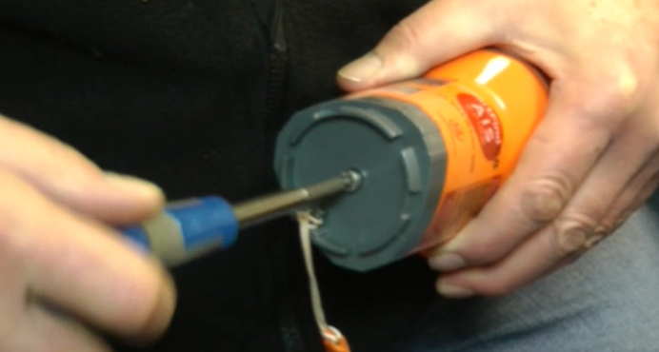
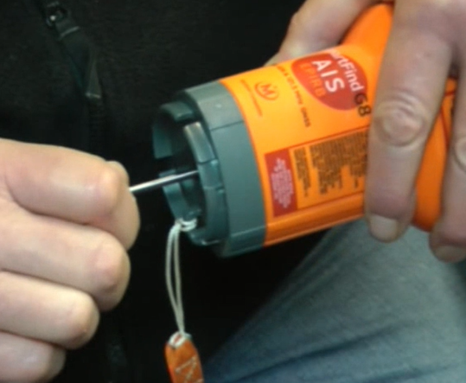
Obtaining Access to Battery Pack
Step Two
Hold the EPRIB horizontally and locate the End Cap at the base.
Unscrew the Plastic End Cap (counter-clockwise)
Remove the End Cap to expose the Lanyard.
Carefully Unwind Lanyard to give access to Retaining Bolt
Using a Number 4 Hex bit driver, Unscrew the Retaining Bolt enough to clear the EPRIB orange body, but not clear of the Gray Battery Pack
Note that when the Retaining Bolt has been unscrewed enough to clear the EPRIB orange body, it can be wiggled side to side. This is important as the Bolt is used to retrieve the Battery Pack
(a)
(b)
(c)
(d)
(e)
(f)
EPIRB Battery Replacement Guide
Oct-24

Slide 8
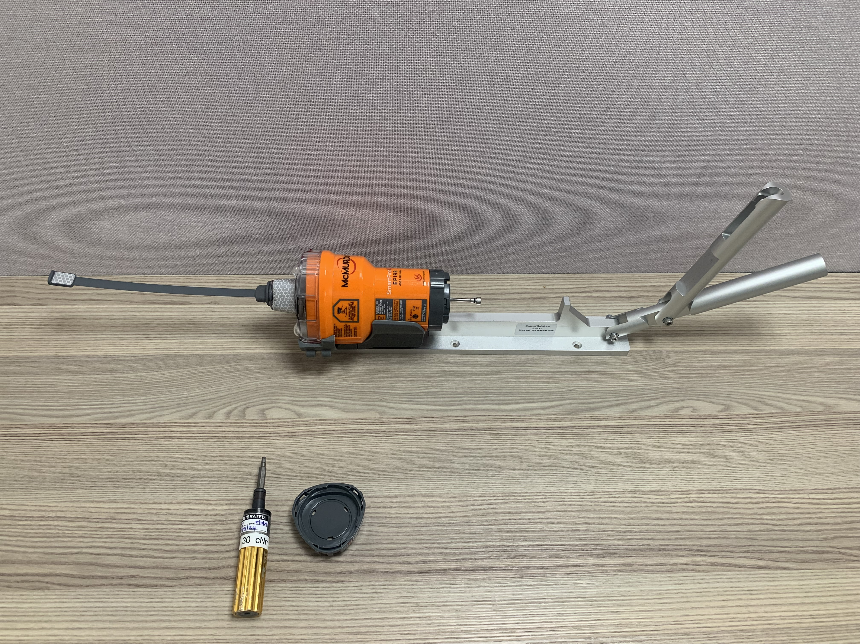
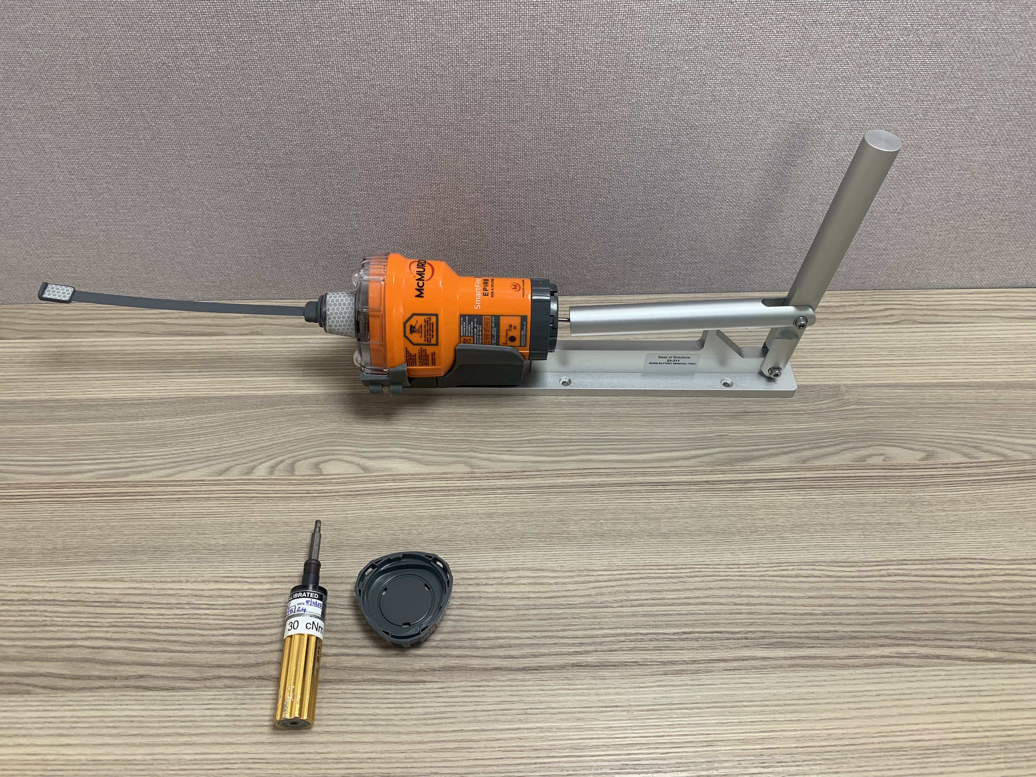
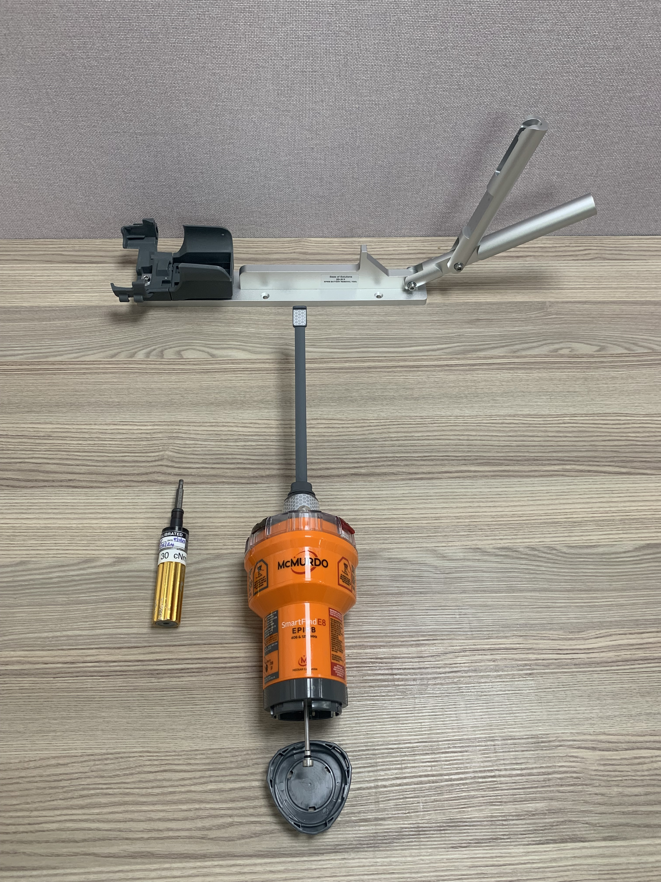
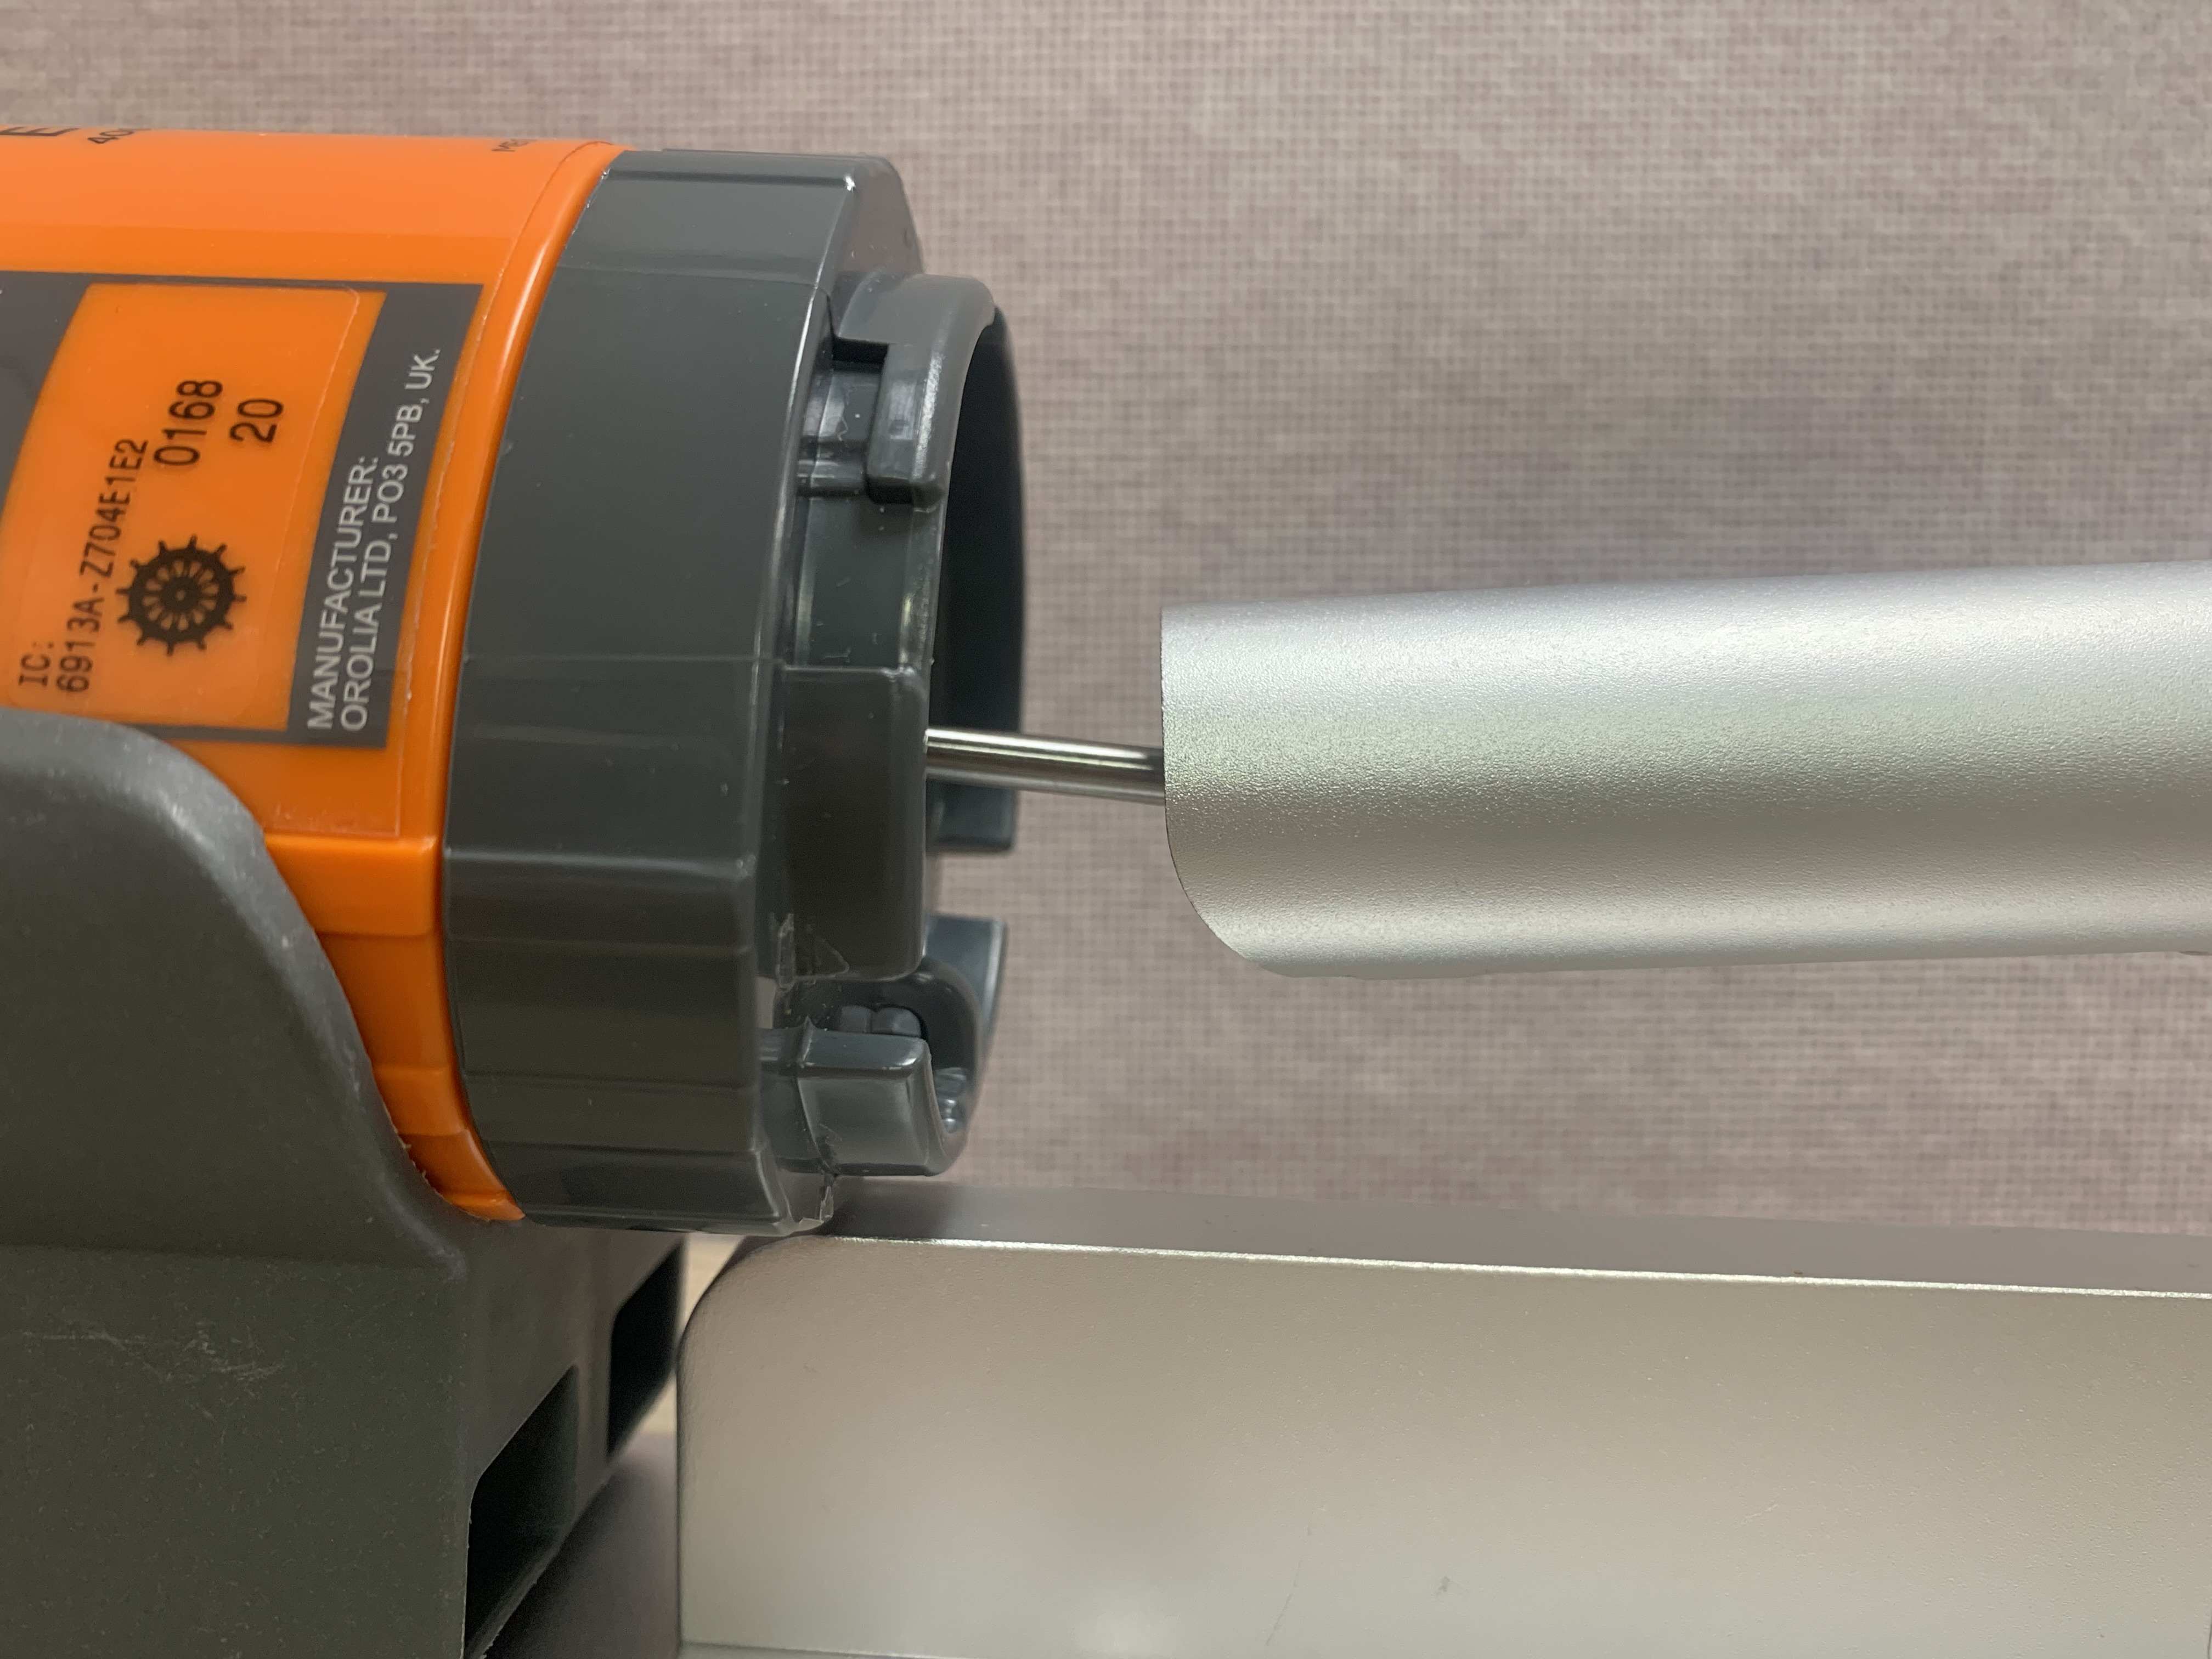
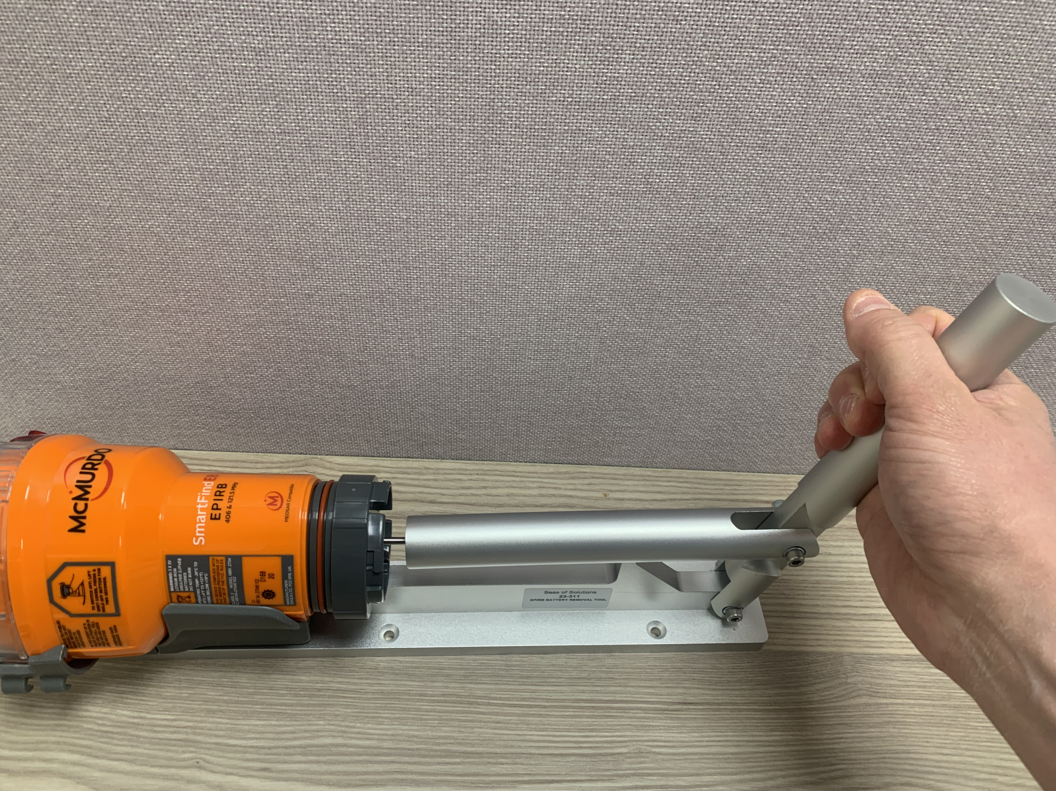
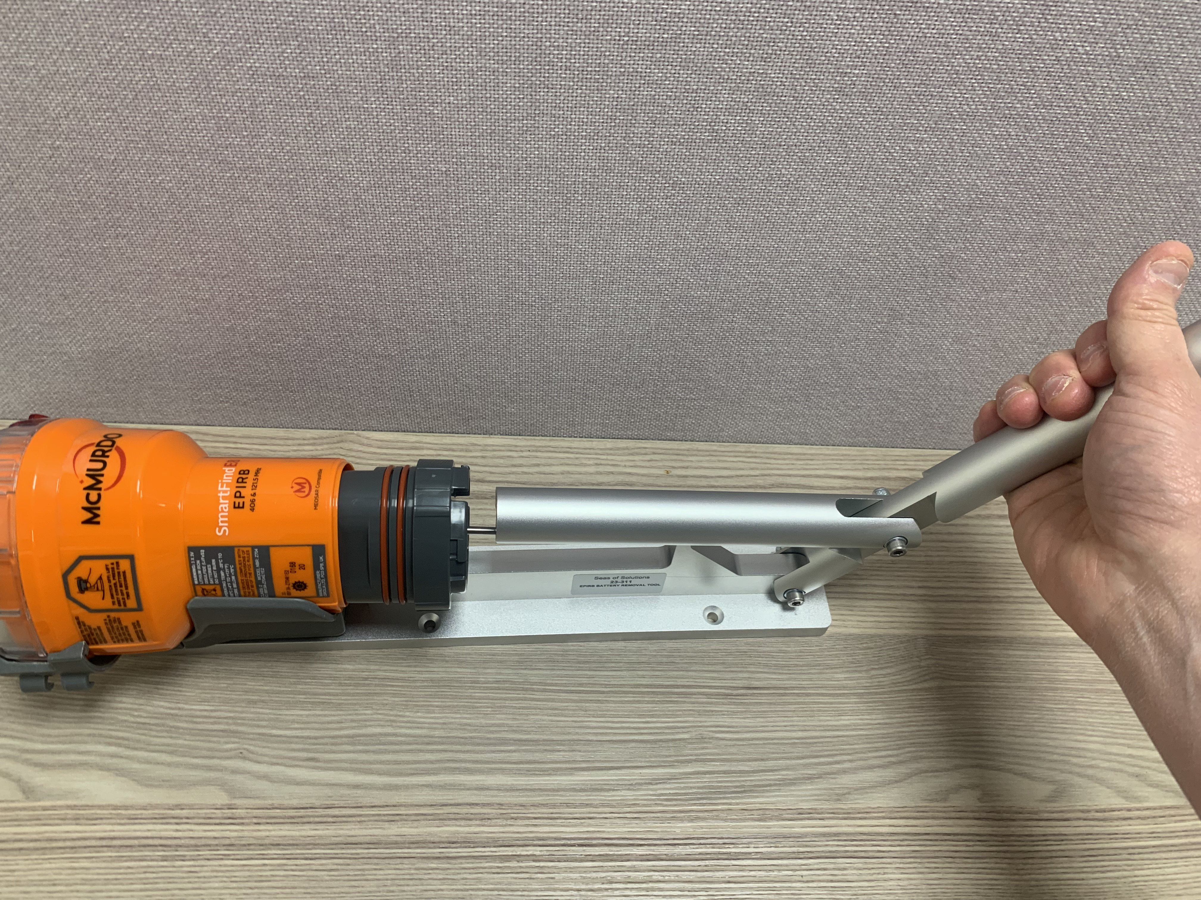
Removing OLD Battery Pack – With Correct Tool (Sold Separately)
(a)
(b)
Step Three
Insert EPRIB Body into holder on Removal Tool, and click to secure.
Gently connect the Restraining Bolt into the respective slot on the removal lever arm
Pull back the gently but firmly on the Removal arm, until the Old Battery Pack is pulled clear of the EPRIB Body.
Once Battery Pack is removed, Check for damage inside the EPRIB Battery Cavity
Unscrew the Restraining Bolt fully to be free of the Battery Pack.
Untie the Lanyard from the Battery Pack (Store lanyard for later use)
Carefully discard Old Battery Pack in accordance with disposal laws for Lithium Metal Batteries
(b)
(c)
(d)
EPIRB Battery Replacement Guide
Oct-24

Slide 9
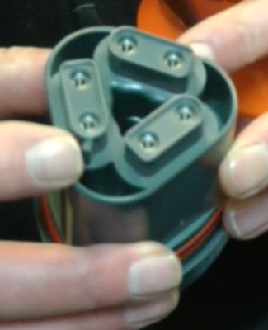
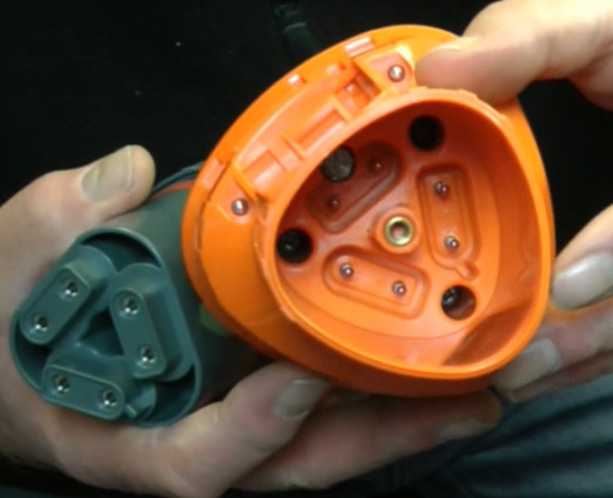
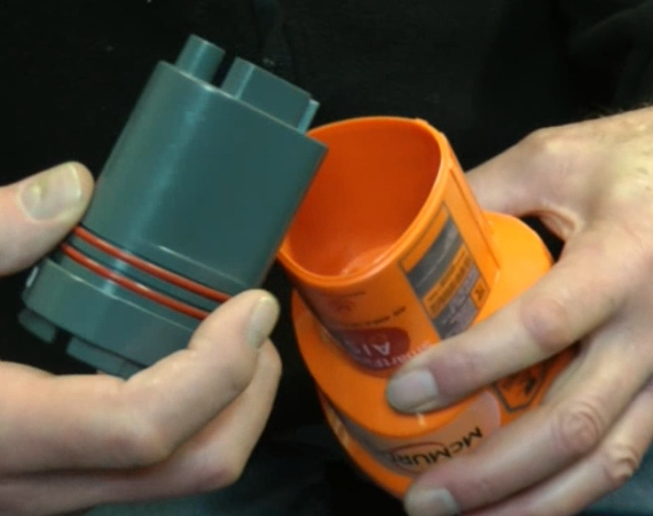
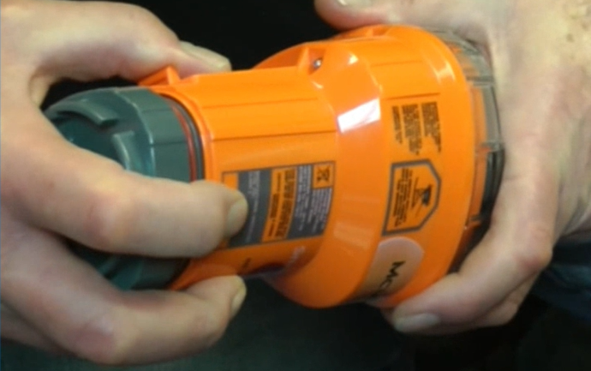
Replace with New Battery pack
(b)
Step Four
Unpack the New Battery Pack.
Examine the inside of the EPRIB main Body and be aware of the location of the Key line recess. On The Battery Pack, Be aware of the location of the Keyline flange
Align Keyline on both the Battery Pack and EPRIB body, and ensure that they can join correctly
Push the New Battery Pack into the EPRIB body up to the seal. Do NOT use the Retaining Bolt to draw the Body and Battery together. This will damage the Internal thread lug and VOID Warranty
(a)
(c)
(d)
EPIRB Battery Replacement Guide
Oct-24

Slide 10
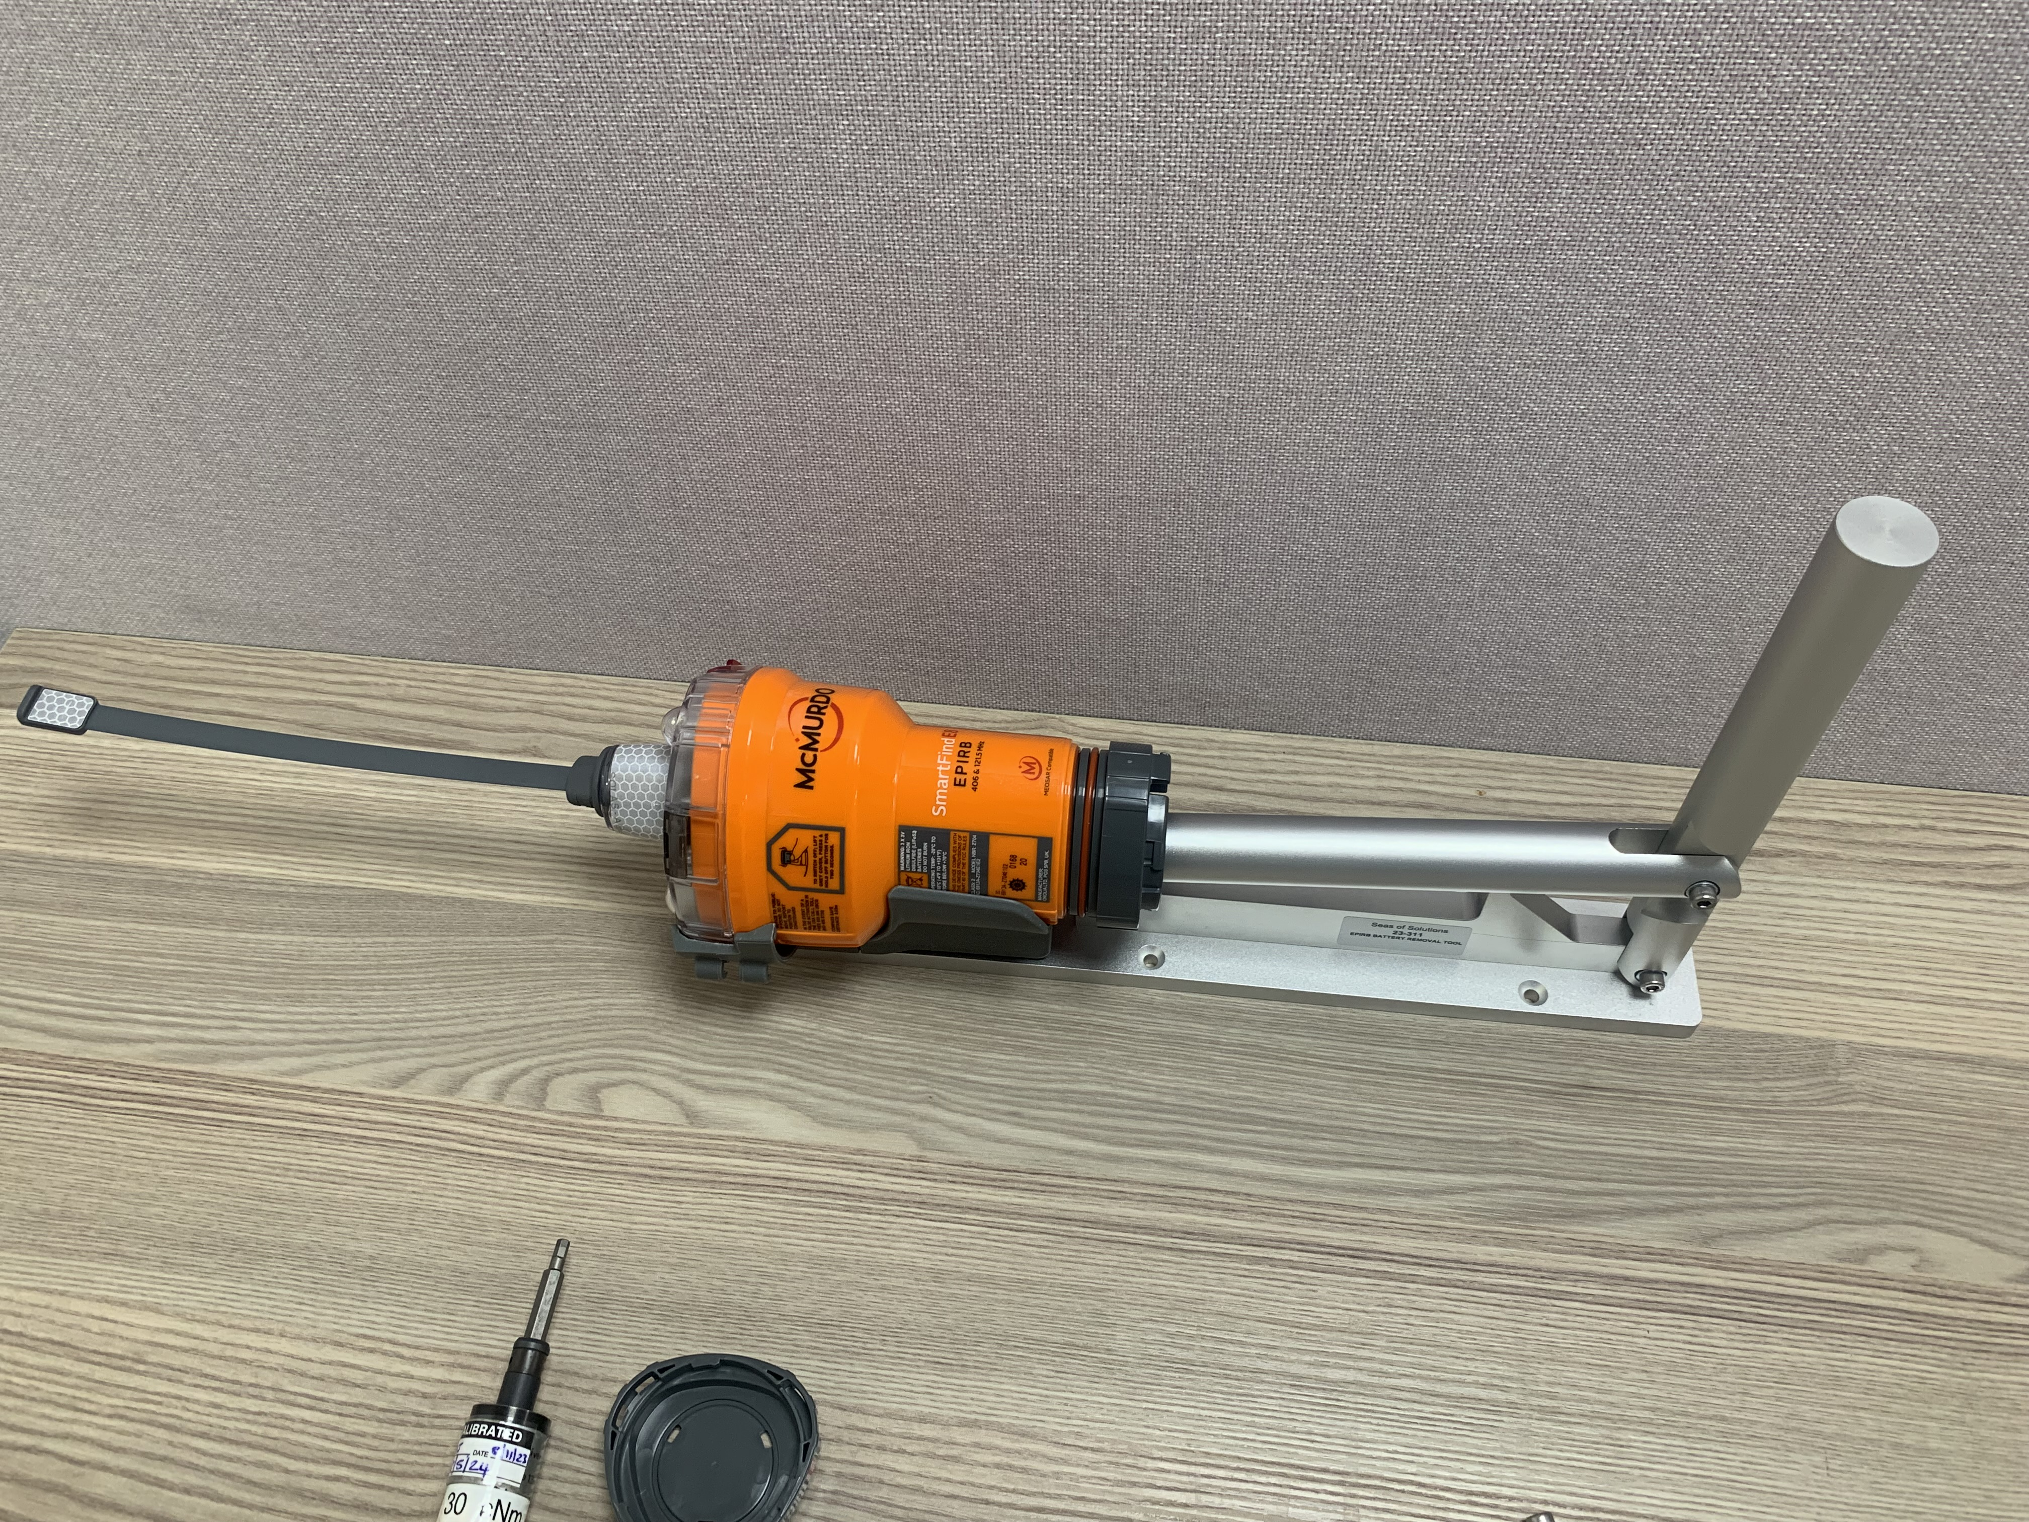
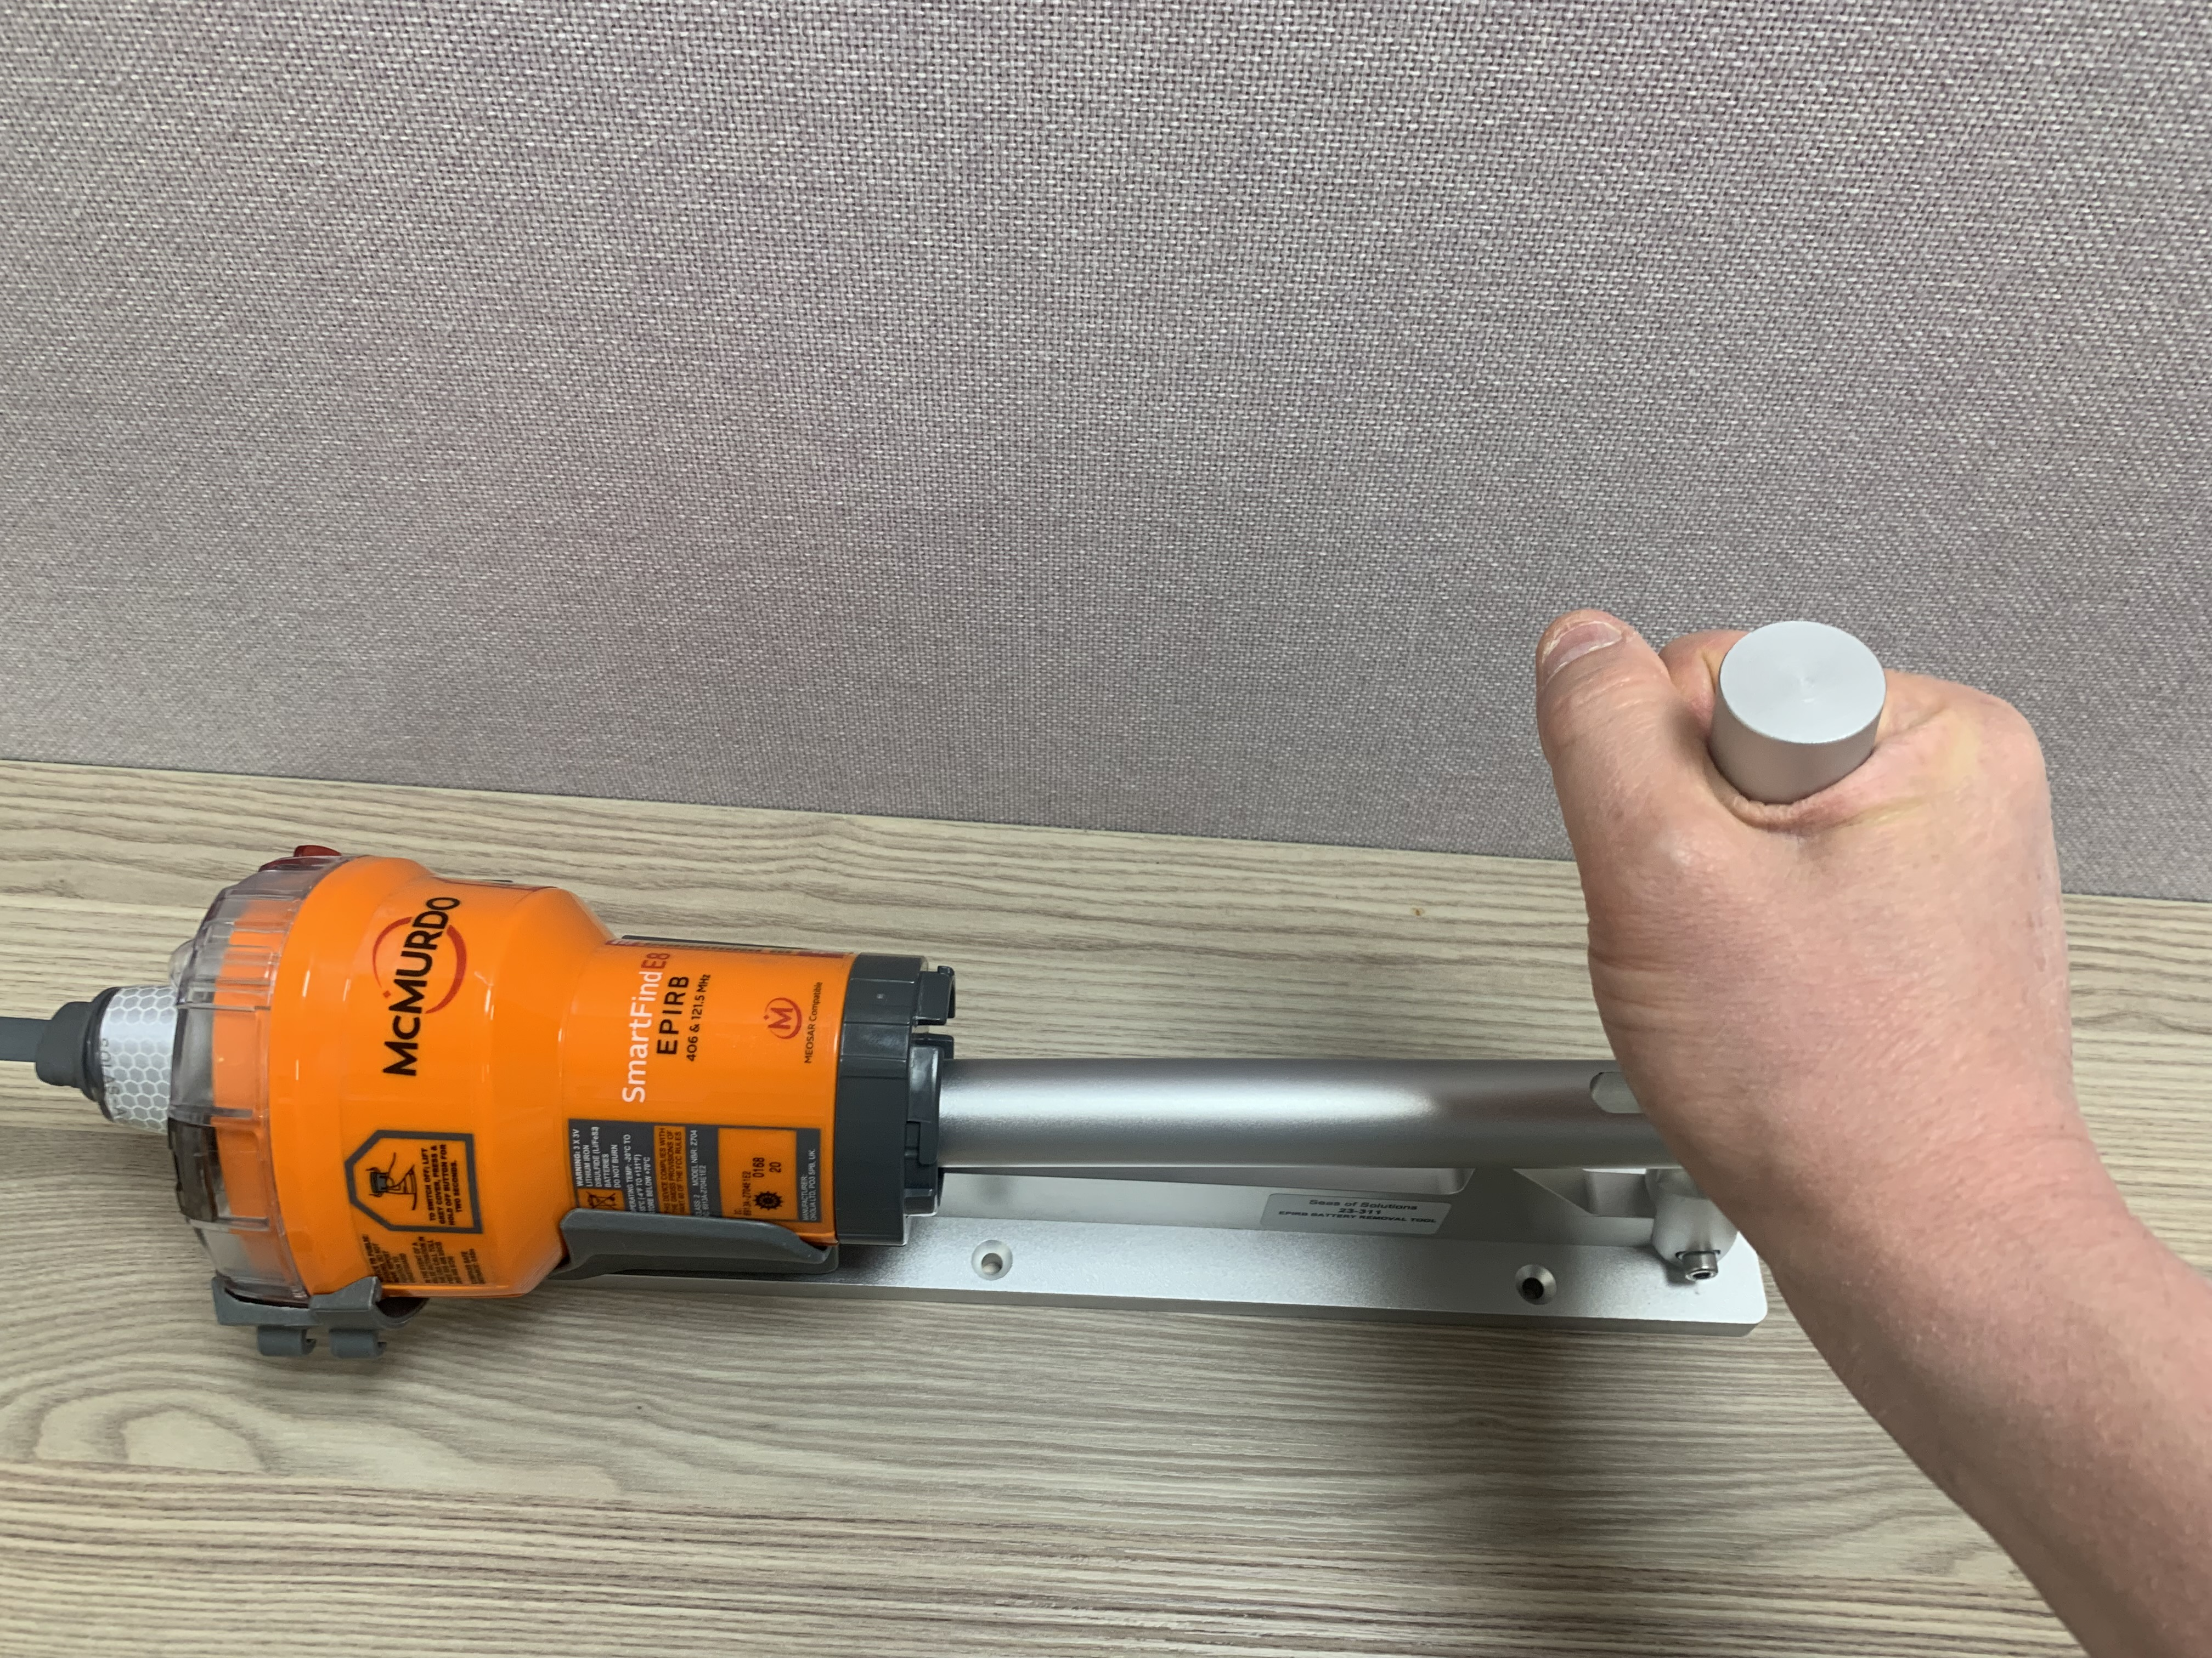
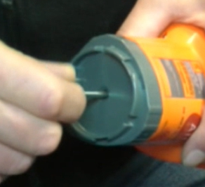
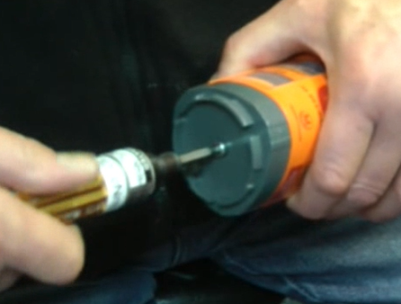
Inserting New Battery pack – WITH CORRECT Tool (Sold Separately)
(b)
(b)
Step Five
Place the Beacon back into the Removal Tool and secure
Use the flat end (or end cap) of the removal lever arm to gently push the New Battery Pack back into the EPRIB Body
After fully inserting the New Battery Pack into the EPRIB Body, remove the EPRIB from the Tooling.
Then gently insert the Restraining Bolt and hand screw it into place. DO NOT use the Restraining screw to pull the New Battery into the body (As this will Void warranty)
Once Restraining Bolt has been screwed into place by hand, continue to tighten it using a Number 4 Hex 30cNm Torque driver ONLY.
Failure to use the correct Torque driver will cause the internal screw socket to break free of its housing. This will be considered as User damage and is Not covered by warranty.
(d)
(e)
(f)
EPIRB Battery Replacement Guide
Oct-24

Slide 11
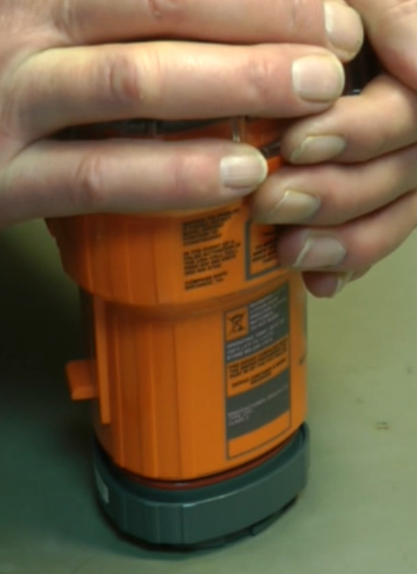
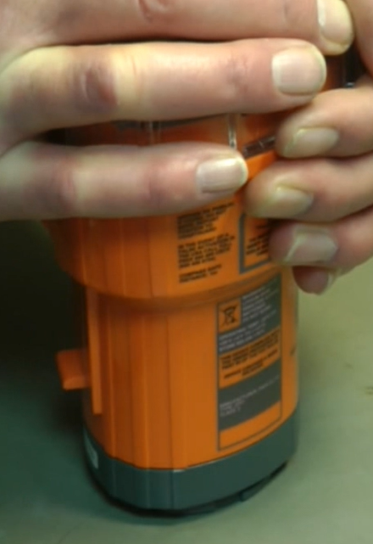
Inserting New Battery pack – WITHOUT Tool
Step Five
Place the Beacon onto a flat surface
Hold the EPRIB Body firmly from the top and Push down onto the battery. Ensure the Battery Pack is fully inserted
After fully inserting the New Battery Pack into the EPRIB Body, insert the Restraining Bolt and hand screw it into place. DO NOT use the Restraining screw to pull the New Battery into the body (As this will void warranty)
Once Restraining Bolt has been screwed into place by hand, continue to tighten it using a Number 4 Hex 30cNm Torque driver ONLY.
Failure to use the correct Torque driver will cause the internal screw socket to break free of its housing. This will be considered as User damage and is Not covered by warranty.
(a)
(b)
(b)
(c)
(d)
(e)
EPIRB Battery Replacement Guide
Oct-24

Slide 12
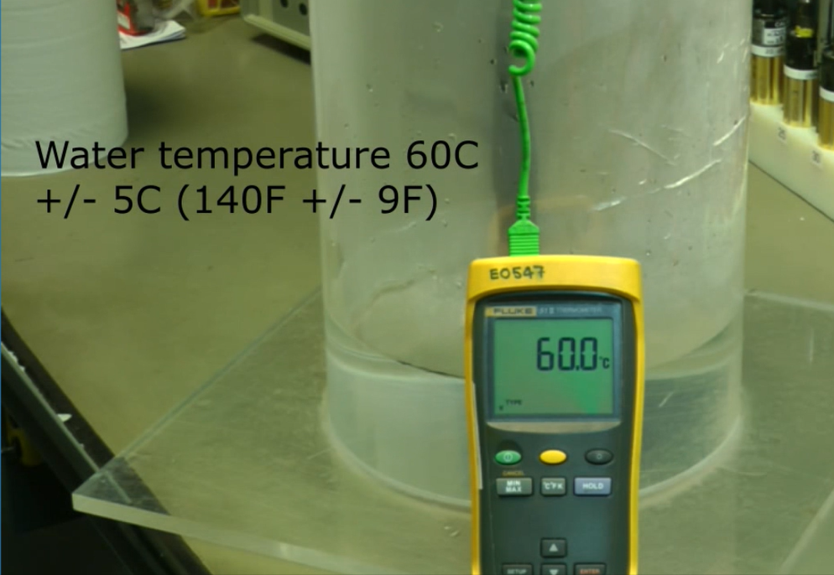
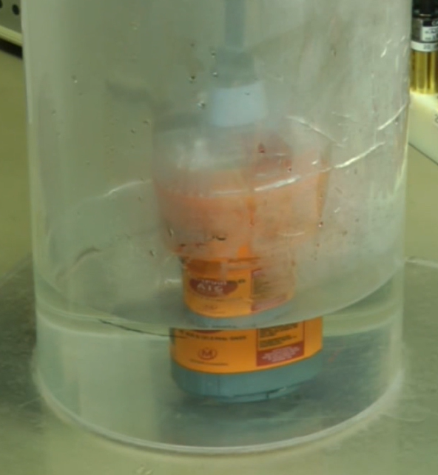
Leak testing EPRIB (Hot water Bath Method)
Step Six
Setup a container containing Hot water at +60 Degrees Celsius (+/- 5 Degrees). Monitored with a Thermometer. Ensure the water level is BELOW the sea contacts on the EPRIB
Inspect the EPRIB to be tested.
Place Sealed EPRIB into the water with the antenna pointing up. Ensure the water level is BELOW the sea contacts on the EPRIB
Dislodge any attached surface bubbles and watch for any “Bubbles Streams” that would indicate a leak.
If leak detected, remove immediately, dry and rework EPRIB to correct leak.
If no Leak detected, remove EPRIB after 5 minutes of submersion and ensure it is dried fully.
(a)
(b)
(c)
(d)
EPIRB Battery Replacement Guide
Oct-24

Slide 13
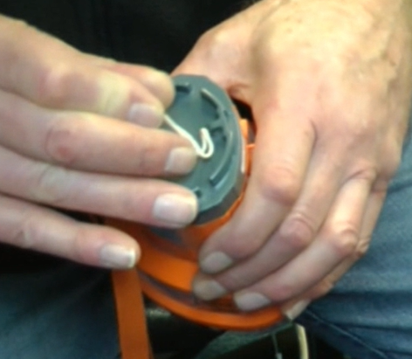
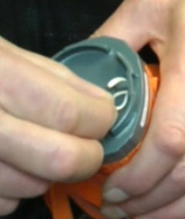
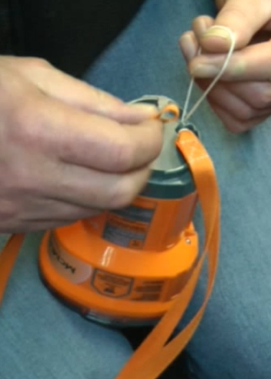
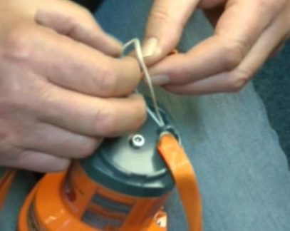
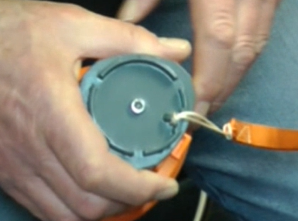
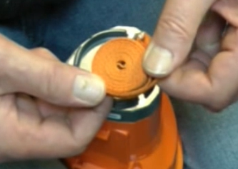
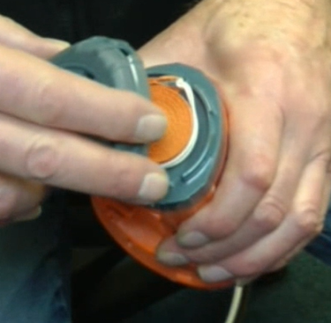
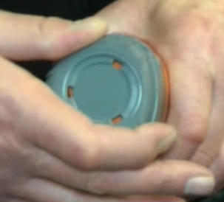
Replace Lanyard and End-Cap
Step Seven
Insert Lanyard tail into its attachment hole on the New Battery
Pull the tail through the hole
Open the Lanyard Tail to form a loop, and collect the Lanyard End
Pull the Lanyard End through the loop made by the Lanyard Tail
Pull tight until Lanyard Tail is tightly knotted to its attachment point on the New Battery Pack
Roll lanyard up into a coil starting from th Lanyard End
Place Lanyard coil into recess of New Battery Pack
Attach End-Cap and lock into place with a Clock-wise turn
(a)
(b)
(c)
(d)
(e)
(f)
(g)
(h)
EPIRB Battery Replacement Guide
Oct-24

Slide 14
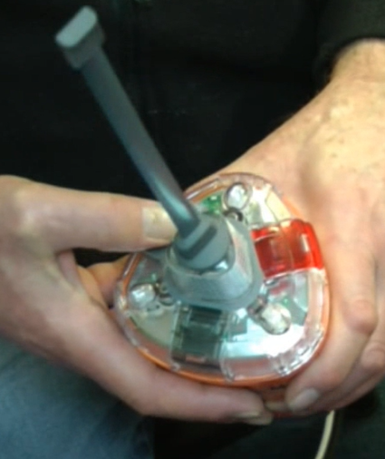
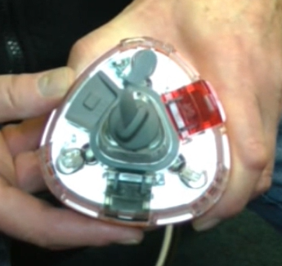
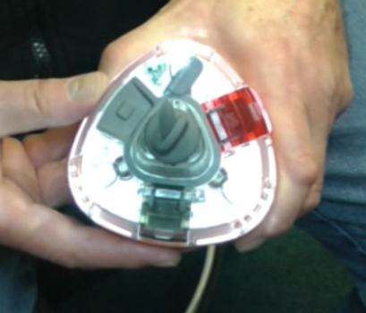
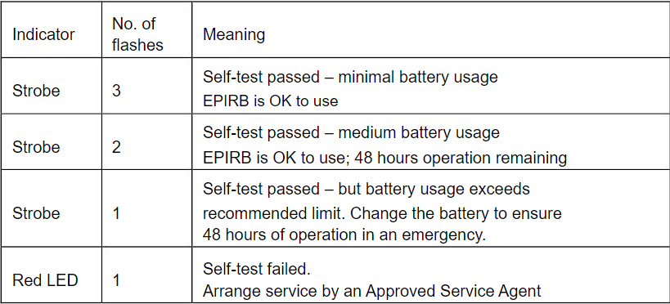
Initiate self-test
(b)
Step Eight
Test functionality of Self-Test feature.
Press and hold the Test button for approximately 2 seconds.
The Green LED will Flash once to confirm the short Self-test has started
EPRIB performs internal checks and results will show as a series of Flashes
Successful Sequence is when the three Strobe LEDs all Flash together 3 times.
Manual also shows correct light Sequence
(c)
(e)
(d)
EPIRB Battery Replacement Guide
Oct-24

Slide 15
Connecting to the EPIRB TO UPDATE THE BATTERY EXPIRY DATE
EPIRB Battery Replacement Guide
Oct-24

Slide 16
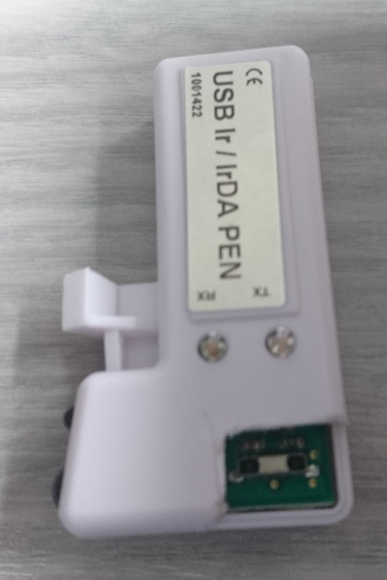
Connecting to the EPIRB
The USB Multi Pen must operate using IrDA programming protocol.
Ir point
IrDA point
IrDA point on the new beacon
EPIRB Battery Replacement Guide
Oct-24

Slide 17
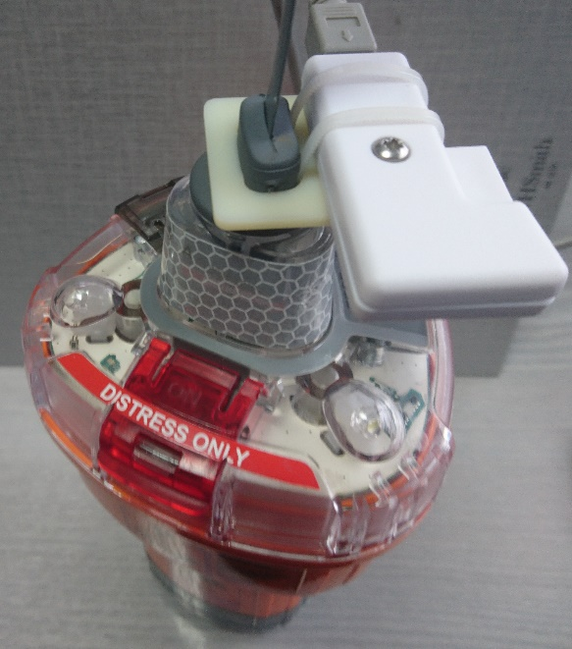
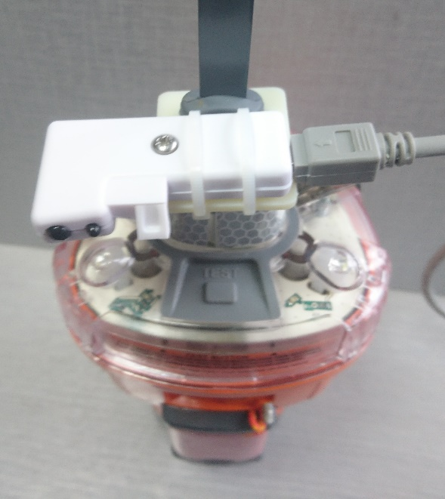
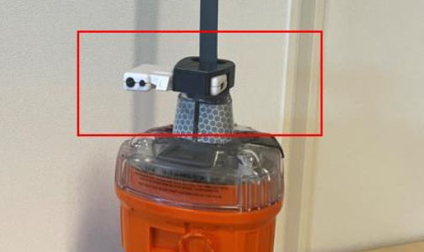
Position the USB PEN (recommended)
Stand the EPIRB on its base.
Locate the pen holder over the Antenna of the EPIRB and slide down the antenna until it engages on the base of the antenna as shown.
The OFF and TEST buttons are accessible.
Place the programming pen as shown. This can be attached in a number of ways
This will make sure the two IrDA points on the Pen and on the EPIRB have the best opportunity of connecting.
Once the connection is established the pen holder and pen must not be removed until the programming is complete and the EPIRB disconnected.
EPIRB Battery Replacement Guide
Oct-24

Slide 18
Connecting to the EIGHT SERIES EPIRB
Once the pen and EPIRB have been lined up using the pen holder as shown on previous slide, open the FPROG 3 program.
Select the correct EPIRB from the Brand drop down list. The options for the new EPIRB is as follows:
McMurdo Smartfind E8 Auto
McMurdo Smartfind E8 Manual
McMurdo Smartfind G8 Auto
McMurdo Smartfind G8 Manual
McMurdo Smartfind G8 AIS Auto
McMurdo Smartfind G8 AIS Manual
Kannad SAFE Auto
Kannad SAFE Manual
Kannad SAFEPRO Auto
Kannad SAFEPRO Manual
Kannad SAFEPRO AIS Auto
Kannad SAFEPRO AIS Manual
EPIRB Battery Replacement Guide
Oct-24

Slide 19
Connecting to the NEW EPIRB
If a Manual EPIRB is selected, then the Mounting drop down list will show accordingly
If an Automatic release EPIRB is selected, the mounting drop down list will show accordingly, however with an additional selection window for the HRU expiry date
EPIRB Battery Replacement Guide
Oct-24

Slide 20
Connecting to the NEW EPIRB
Confirm the correct model has been chosen
click Connect
The TX light on the programming pen will flash Red
It is important NOT to enter any additional information at this stage except the correct model. The Country code, battery expiry and unique CSN/ESN should be left blank at this stage.
EPIRB Battery Replacement Guide
Oct-24

Slide 21
Connecting to the EPIRB
After clicking Connect, the Beacon Connection Bar will start to show progression
As soon as this happens, press and hold the Test and Off button for approximately 2 seconds, until blue led luminates. Use right hand to hold beacon in position when pressing the buttons.
Please note that the above process cannot happen the other way around. The FPROG program needs to tell the beacon that it wants to communicate first. This will then tell the beacon that it needs to go into programming mode when the selected buttons are pressed. If the Test and Off buttons are pressed before the Connect button on the program, the beacon will just go into test mode.
Once the EPIRB initiates the connection the green RX led on the programme pen will begin to flash.
Pen holder removed in photo to clearly show detail.
EPIRB Battery Replacement Guide
Oct-24

Slide 22
Connecting to the EPIRB
After the Blue LED illuminates, the Not Programmed button changes to Beacon Connected with a clear arrow. The program is now trying to connect to the EPIRB.
Please note that this doesn’t mean that a connection with the EPIRB has been established
When a connection with EPIRB has been established, the arrow on the Beacon Connected Button turns green. Additional information now shown are the Serial Number and the Unique CS number of the beacon.
If unit Serial number, CS number and arrow on the button doesn’t turn green, then the connection wasn’t successful. Please reset data and try establish connection again.
EPIRB Battery Replacement Guide
Oct-24
Notes:
If arrow doesn’t go green, then the connection is not in place – troubleshooting, raise point with Yannick.
Point about not moving the pen…what will happen if that does happen.

Slide 23
Updating battery expiry date on the EPIRB
EPIRB Battery Replacement Guide
Oct-24

Slide 24
Programming the epirb
The first step is to select the Beacon Registration Country
Then select the relevant expiry date of the battery by Month and Year. If this information is not entered, then the Program and Print buttons will remain disabled, not allowing the EPIRB to be programmed or documents to be printed after programming
If the EPIRB is the Automatic release type, select the relevant expiry date of the Hydrostatic Release Unit
EPIRB Battery Replacement Guide
Oct-24
Notes:
Shouldn’t be able to change deployment. Cat 1 to cat 2 and visa versa – Yannick

Slide 25
Programming the epirb
With the Battery expiry date now entered, the Program and Print buttons will now be enabled
Enter the relevant vessel information in the following fields –
Vessel Name
MMSI number, or
Radio Call Sign, or
Coded Serial Number (will automatically be entered)
Confirmation of preferred registration type for Flag can be checked with either the flag administration of the country of registry or on the COSPAS SARSAT website if not sure.
EPIRB Battery Replacement Guide
Oct-24

Slide 26
Programming the epirb
Enter any further information into the tabs Owner information, Contact Information and Other information. Please note that this information is not required to program the beacon, if it is given this information will appear on the printed warranty and registration forms. The registration forms must be sent to the Beacon registration Authority for the relevant country.
EPIRB Battery Replacement Guide
Oct-24

Slide 27
Programming the epirb
After all the relevant information has been entered, please go over the entered information to make sure all has been entered correctly.
Once the check has been done, click the Program button
The following window will appear to confirm information on the beacon. Once confirmed click program to continue
EPIRB Battery Replacement Guide
Oct-24

Slide 28
Programming the epirb
After the programming button has been clicked, the Beacon Connection block will change status to Start Program. Once the beacon has been programmed the Beacon Connection block will change status to Finished Program
The Beacon Connected button will change to Programmed with a Tick when successful
EPIRB Battery Replacement Guide
Oct-24

Slide 29
Programming the epirb
Once programming has been completed, click the Print button
The following window will provide option for documents to be printed.
If it is a new EPIRB, the following will need to be printed: -
Labels, Warranty Form, Registration Form and Programming certificate
If it is an existing EPIRB, the following will need to be printed:
Labels and Programming certificate only
EPIRB Battery Replacement Guide
Oct-24

Slide 30
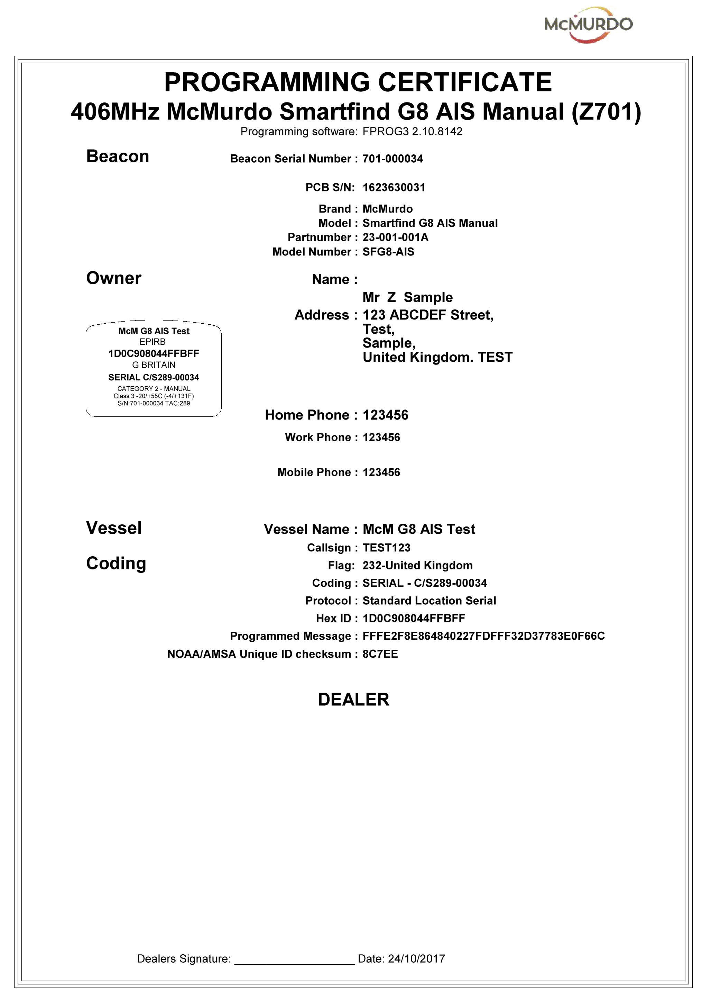
Examples of printed documents
Labels x 2 copies and Programming Certificate
Automatic Release Housing Label
EPIRB Labels Manual Label
EPIRB Battery Replacement Guide
Oct-24

Slide 31
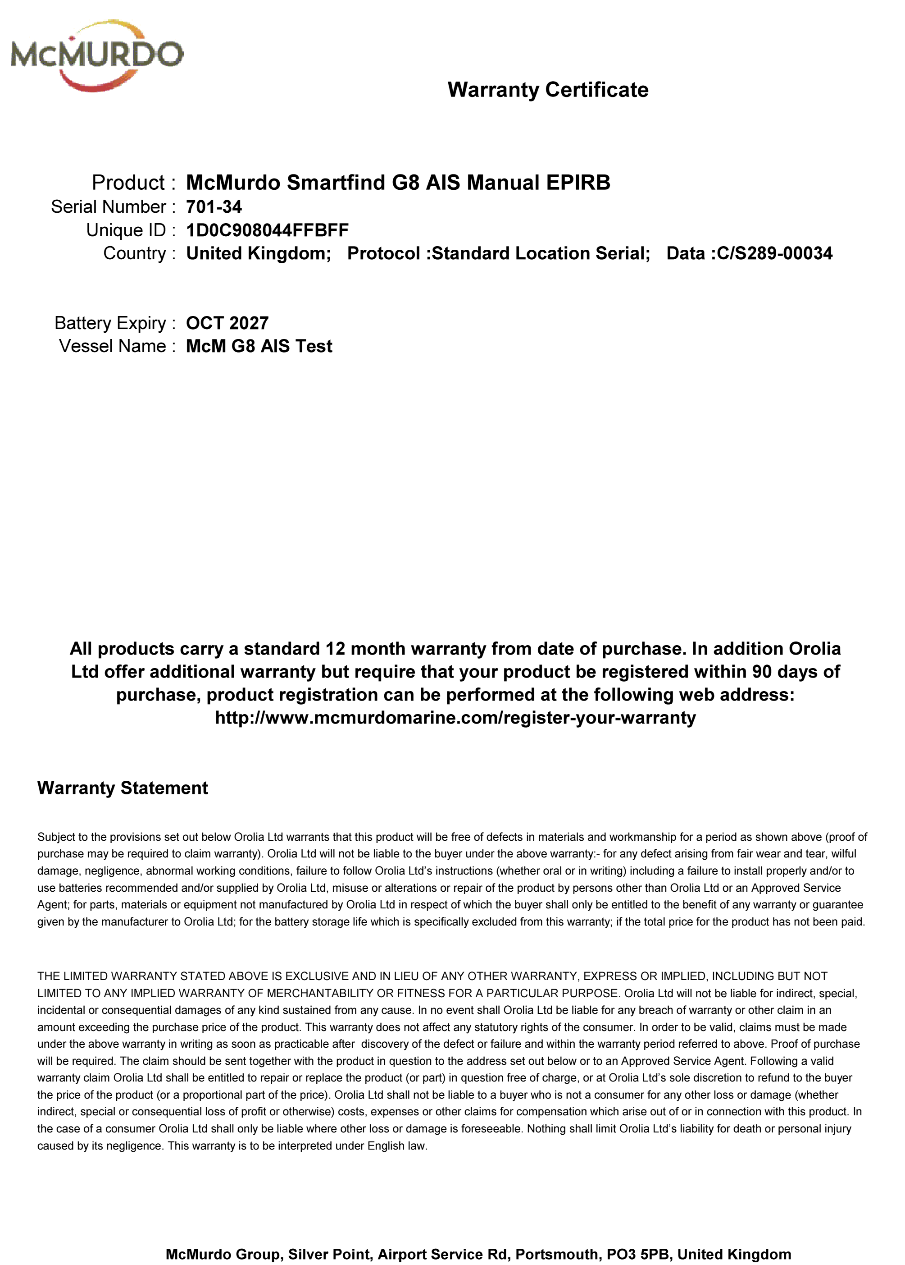
Examples of printed documents
Registration Form and Warranty Form
EPIRB Battery Replacement Guide
Oct-24

Slide 32
Applying the labels
EPIRB Battery Replacement Guide
Oct-24

Slide 33
Labelling the epirb
Remove the Lanyard Holder by pulling on the bottom of the holder to release
Affix a label which has been cut out of the Labels print out with the provided clear media. Make sure the label is aligned so that Clear media can make contact with the EPIRB body all around the label. This will assist in preventing moisture from getting to the label
Attach the Lanyard Holder by inserting the top first then push down on the bottom to clip into position. Make sure the lanyard is not in the way
EPIRB Battery Replacement Guide
Oct-24

Slide 34
Labelling the Auto release housing
Cut out the Automatic Release Housing label from the printed Labels
Stick the Label onto the label recess area either on the side of the Auto Housing or on the bottom of the housing (depending on housing design)
Once in place, mark Hydrostatic Release Unit replacement date with supplied Alpha/numeric labels. Or if unavailable, as shown with a fine tip permanent marker. Then cover with Clear media for Protection.
EPIRB Battery Replacement Guide
Oct-24

Slide 35
Example of labelling - (using alpha/Numeric labels)
EPIRB Battery Replacement Guide
Oct-24

Slide 36
Thank you
EPIRB Programming Guide
Oct-24

