Slide 1
PLB Programming Guide

Slide 2
PLB programming Guide
Welcome to the programming Guide for FPROG 3 and the USB IrDA programming Pen. Information provided in this Guide will advise on the following:
PLB beacons types
Required Hardware and Software
How to install the FPROG 3 software
Installing the USB Pen
Connecting to the beacon
Programming the Beacon
Examples of printed documents
Applying the newly printed labels
PLB Programming Guide
Feb-25

Slide 3
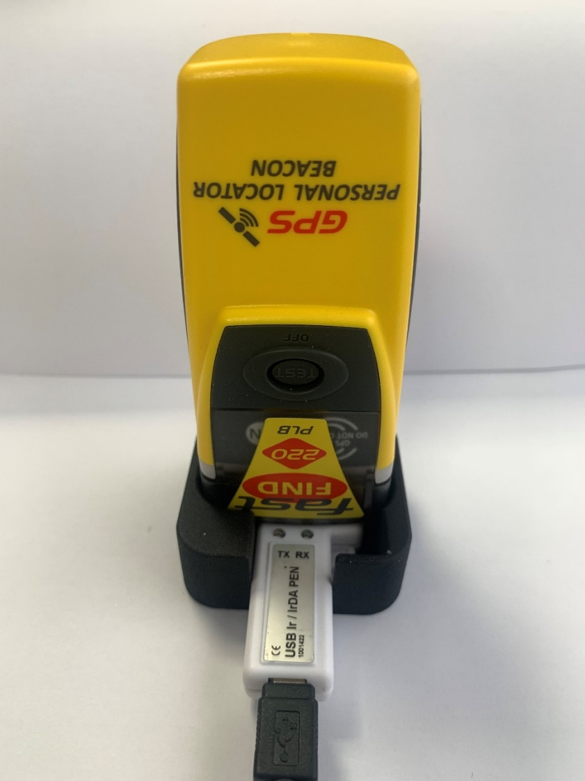
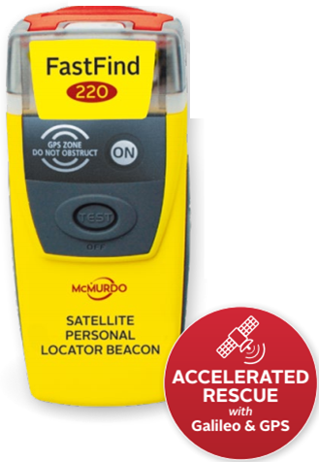
PLBs are programmed with FPROG3 SOFTWARE AND IRDA USB PEN
It is important to NOTE That the RLS PLB can not currently be Programmed via FPROG3. Currently it is only Programmed via Beacon manager.
PLB Programming Guide
Feb-25

Slide 4
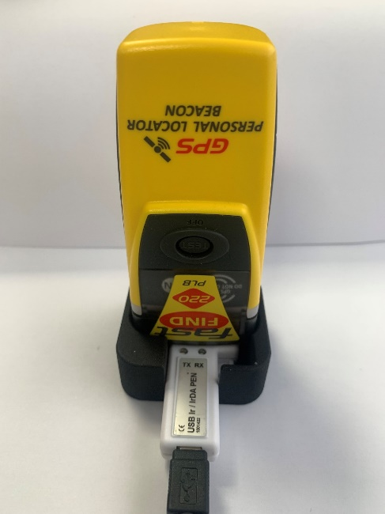
Required hardware and software
Computer (Windows 7, 8, 10 or 11)
Free USB port on selected computer
USB Ir/IrDA programming Pen
Pen Cradle (1002665)
FPROG 3 Software downloaded from McMurdo Partner Portal
Label and document Printer
Article no: 1001420 USB programming pen kit incl.
PLB Programming Guide
Feb-25

Slide 5
Installing FPROG 3 Software
PLB Programming Guide
Feb-25

Slide 6
Installing FPROG 3 programming software
Once the program has been downloaded from the partner portal, the installation process can be launched via the two options shown on the left.
The .msi route will lead straight to installing the programming software.
The Welcome.htm route will lead straight to a html style page with additional information about the installation. Scroll down to the bottom of the page to find the “Install the FPROG3 software (MSI Installer)” Link.
PLB Programming Guide
Feb-25

Slide 7
Installing FPROG 3 programming software
1. Welcome window will appear, click Next.
2. After reading through the agreement, check the accept box and click Next
PLB Programming Guide
Feb-25

Slide 8
Installing FPROG 3 programming software
3. Make sure the destination folder is ok, or change…then click Next
4. To begin the installation process click Install
PLB Programming Guide
Feb-25

Slide 9
Installing FPROG 3 programming software
5. The following progress bar will appear
6. Once the Completed window is viewed click Finish to complete the installation. The program is now ready for use.
PLB Programming Guide
Feb-25

Slide 10
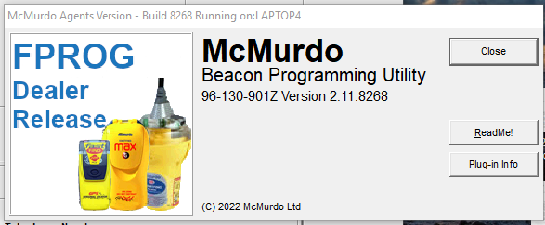
Installing FPROG 3 programming software
Open the FPROG 3 program with either way shown
On first opening the Product Access Check window will open
Enter the provided 16 pin product registration Key Code
Once entered and accepted the Beacon Programming Utility window will open registering all the programming plugins
Please note the Beacon Programming Utility window will open every time FPROG 3 is opened.
PLB Programming Guide
Feb-25

Slide 11
Installing FPROG 3 programming software
Once the Beacon Programming Utility has run its registration, the following window will appear
If it is not required for this window to show on every start up, check the “Do not show this welcome screen again” box at the bottom of the window
Click closed
PLB Programming Guide
Feb-25

Slide 12
Installing FPROG 3 programming software
The following window will open after the Beacon Programming Utility has run
PLB Programming Guide
Feb-25

Slide 13
Installing the new IRDA programming pen
PLB Programming Guide
Feb-25

Slide 14
Irda Programming pen
The IrDA programming pen is easy to install and doesn’t really have any user interfaces for reference.
The driver for the pen will install automatically.
Connect to the pen to an available USB port. This will be the dedicated port for this pen on certain Windows platforms. On Windows 10 for example the pen can be plugged into any available USB port and will maintain the allocated port number
Make sure the green and red LED’s on the pen flash for a second or so when connecting. This will indicate the pen is connected
PLB Programming Guide
Feb-25

Slide 15
Irda Programming pen
Once the pen has been installed open the FPROG3 software to check that the correct port is selected for the pen.
Click on Options button on the right of the user interface
Select Programming COM port from the array of tabs shown
Select the correct port if required
Make sure the hardware is on Multi IrDA pen for PLB’s or 82-950A Legacy IR pen for legacy types.
PLB Programming Guide
Feb-25

Slide 16
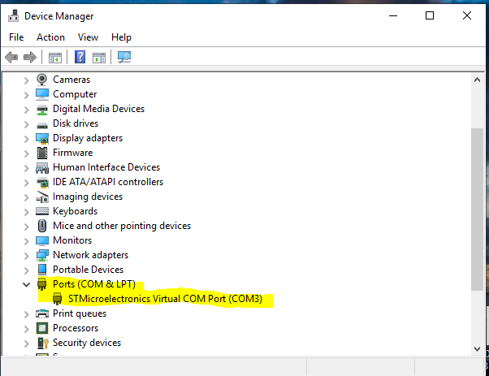
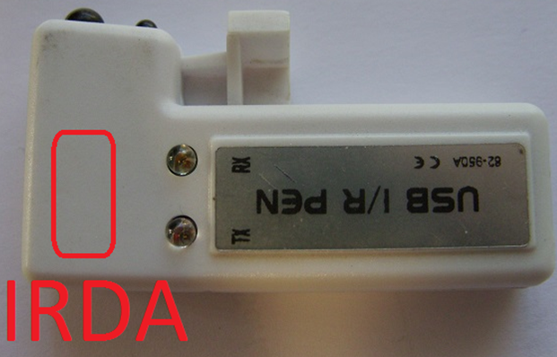
Irda Programming pen – trouble shooting
The IrDA interface device emits and receives through the plastic housing.
Note the correct orientation.
Use Windows Device manager to identify the correct COM Port
PLB Programming Guide
Feb-25

Slide 17
Connecting to the NEW PLB
PLB Programming Guide
Feb-25

Slide 18
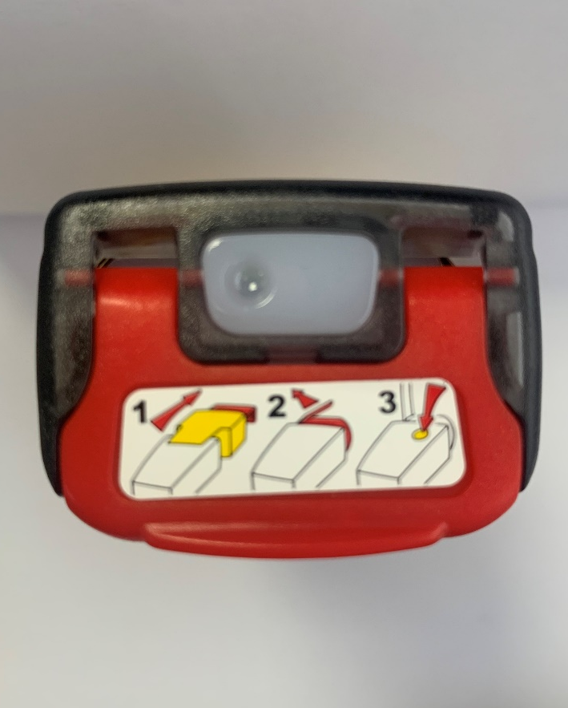
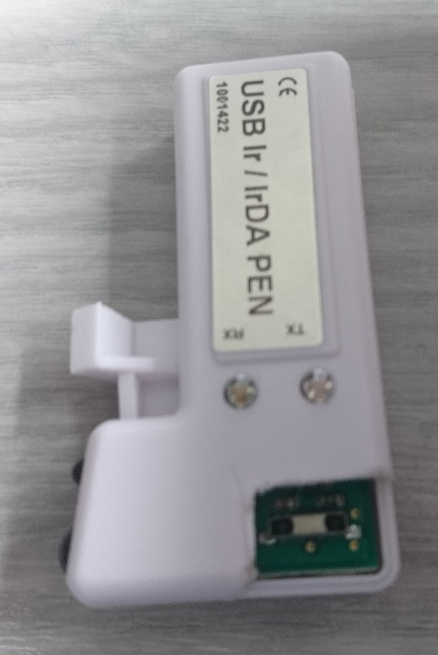
Connecting to the PLB
The USB Multi Pen must operate using IrDA programming protocol.
Place the programming pen in the mould base. There are multiple versions of this base (Solid Plastic and Plastic frame)
Ir point
IrDA point
IrDA point on the PLB beacon
PLB Programming Guide
Feb-25

Slide 19
Position the USB PEN (recommended)
Invert PLB and insert into base directly over the PEN
Ensure the TEST/OFF button is accessible.
This will make sure the two IrDA points on the Pen and on the PLB have the best opportunity of connecting through the case.
Once the connection is established the pen holder and pen must not be removed until the programming is complete and the PLB disconnected.
PLB Programming Guide
Feb-25

Slide 20
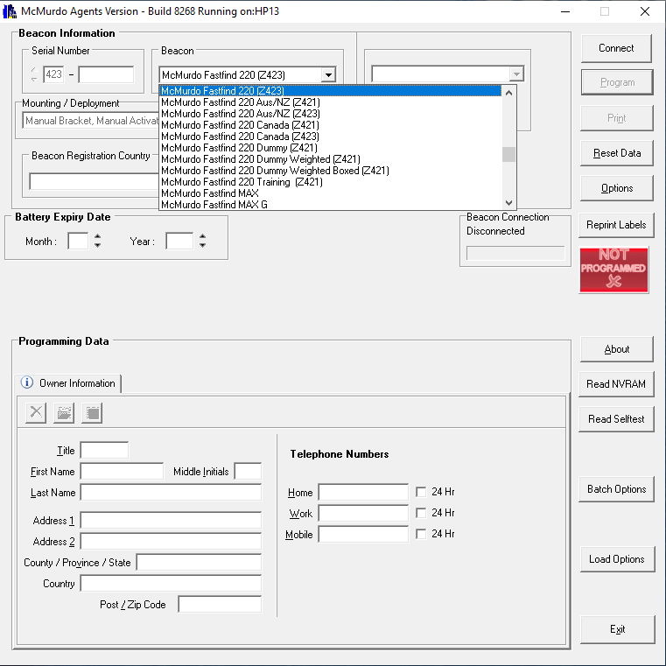
Connecting to the PLB
Once the pen and PLB have been lined up using the pen holder as shown on previous slide, open the FPROG 3 program.
Select the correct PLB from the Brand drop down list. The options for the new PLB is as follows:
McMurdo Smartfind 220
McMurdo Ranger
Kannad Solo
PLB Programming Guide
Feb-25

Slide 21
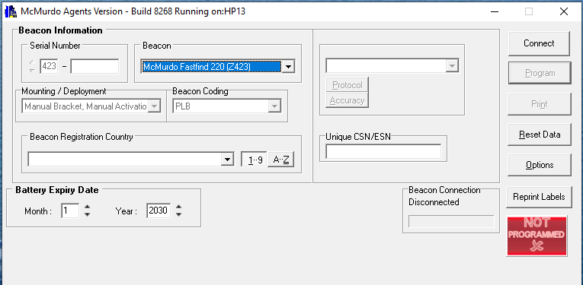
Connecting to the PLB
Confirm the correct model has been chosen
click Connect
The TX light on the programming pen will flash Red
It is important NOT to enter any additional information at this stage except the correct model. The Country code, battery expiry and unique CSN/ESN should be left blank at this stage.
PLB Programming Guide
Feb-25

Slide 22
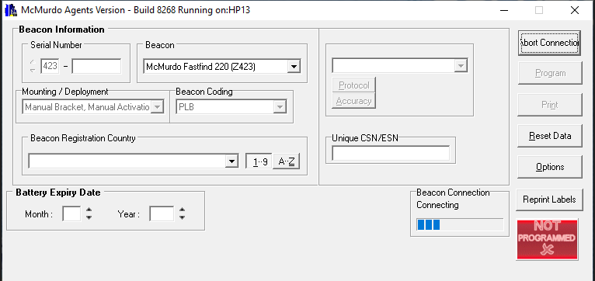
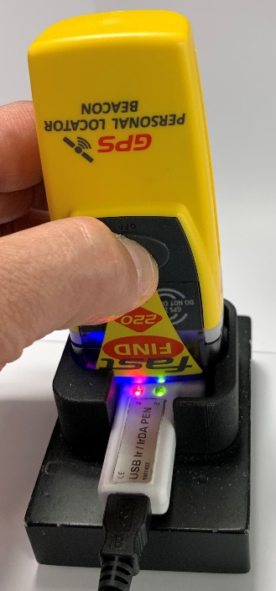
Connecting to the PLB
After clicking Connect, the Beacon Connection Bar will start to show progression
As soon as this happens, press and hold the Test/Off button for approximately 2 seconds, until blue led luminates. Use right hand to hold beacon in position when pressing the buttons.
Please note that the above process cannot happen the other way around. The FPROG program needs to tell the beacon that it wants to communicate first. This will then tell the beacon that it needs to go into programming mode when the selected buttons are pressed. If the Test and Off buttons are pressed before the Connect button on the program, the beacon will just go into test mode.
Once the PLB initiates the connection the green RX led on the programme pen will begin to flash.
Pen holder removed in photo to clearly show detail.
PLB Programming Guide
Feb-25

Slide 23
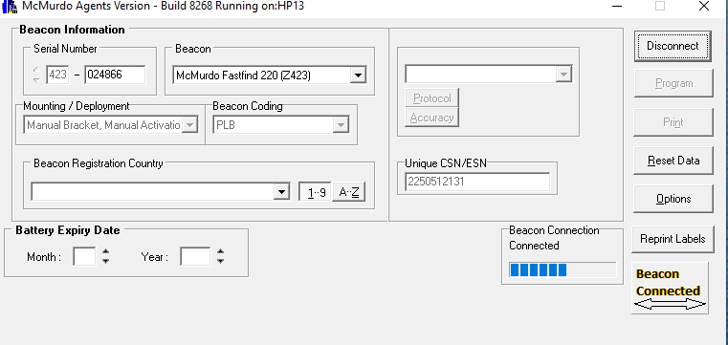
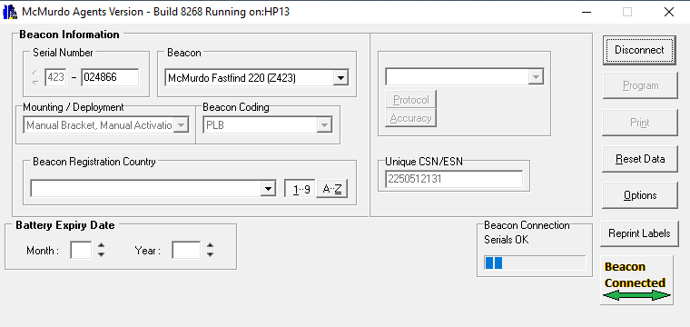
Connecting to the PLB
After the Blue LED illuminates, the Not Programmed button changes to Beacon Connected with a clear arrow. The program is now trying to connect to the PLB.
Please note that this doesn’t mean that a connection with the PLB has been established
When a connection with PLB has been established, the arrow on the Beacon Connected Button turns green. Additional information now shown are the Serial Number and the Unique CS number of the beacon.
If unit Serial number, CS number and arrow on the button doesn’t turn green, then the connection wasn’t successful. Please reset data and try establish connection again.
PLB Programming Guide
Feb-25
Notes:
If arrow doesn’t go green, then the connection is not in place – troubleshooting, raise point with Yannick.
Point about not moving the pen…what will happen if that does happen.

Slide 24
Programming the PLB
PLB Programming Guide
Feb-25

Slide 25
Programming the PLB
The first step is to select the Beacon Registration Country
Then select the relevant expiry date of the battery by Month and Year. If this information is not entered, then the Program and Print buttons will remain disabled, not allowing the PLB to be programmed or documents to be printed after programming
PLB Programming Guide
Feb-25
Notes:
Shouldn’t be able to change deployment. Cat 1 to cat 2 and visa versa – Yannick

Slide 26
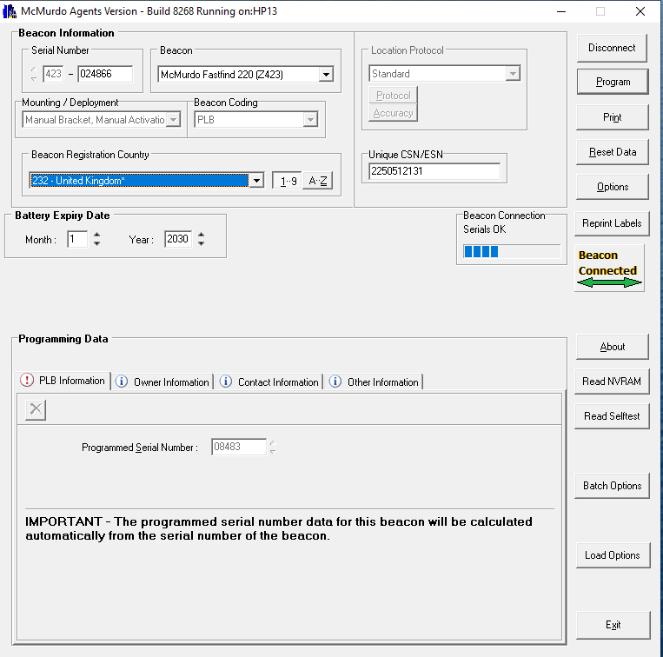
Programming the PLB
With the Battery expiry date now entered, the Program and Print buttons will now be enabled
Enter the relevant information in the following fields –
Coded Serial Number (will automatically be entered)
Confirmation of preferred registration type for Flag can be checked with either the flag administration of the country of registry or on the COSPAS SARSAT website if not sure.
PLB Programming Guide
Feb-25

Slide 27
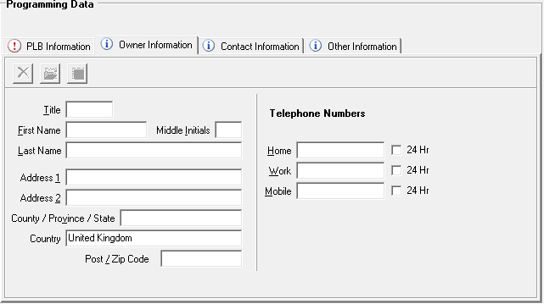
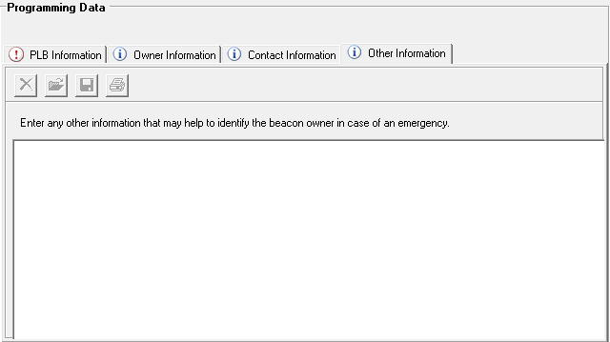
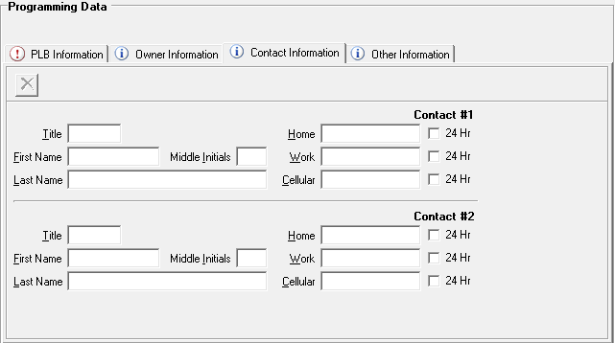
Programming the PLB
Enter any further information into the tabs Owner information, Contact Information and Other information. Please note that this information is not required to program the beacon, if it is given this information will appear on the printed warranty and registration forms. The registration forms must be sent to the Beacon registration Authority for the relevant country.
PLB Programming Guide
Feb-25

Slide 28
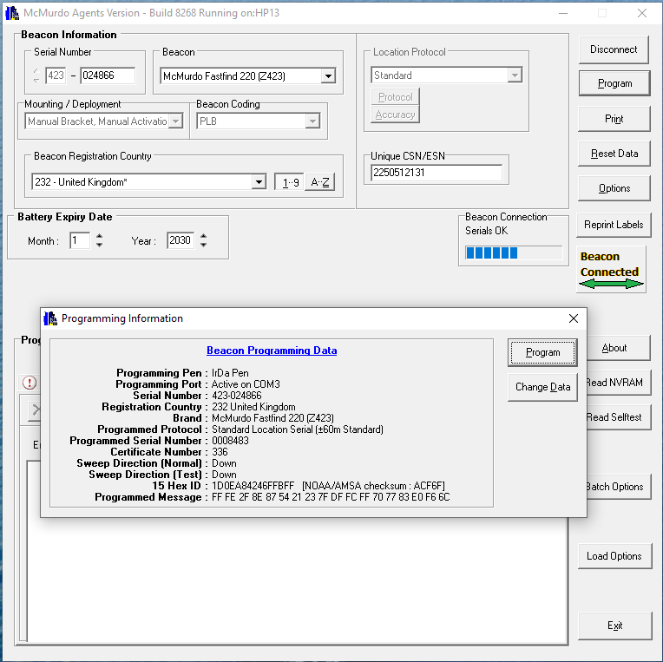
Programming the PLB
After all the relevant information has been entered, please go over the entered information to make sure all has been entered correctly.
Once the check has been done, click the Program button
The following window will appear to confirm information on the beacon. Once confirmed click program to continue
PLB Programming Guide
Feb-25

Slide 29
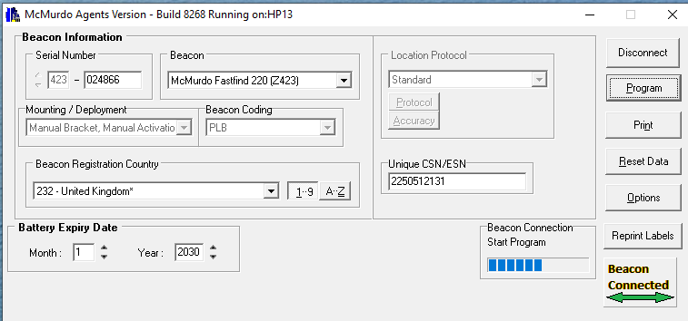
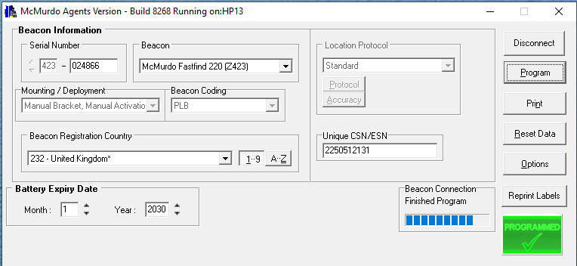
Programming the PLB
After the programming button has been clicked, the Beacon Connection block will change status to Start Program. Once the beacon has been programmed the Beacon Connection block will change status to Finished Program
The Beacon Connected button will change to Programmed with a Tick when successful
PLB Programming Guide
Feb-25

Slide 30
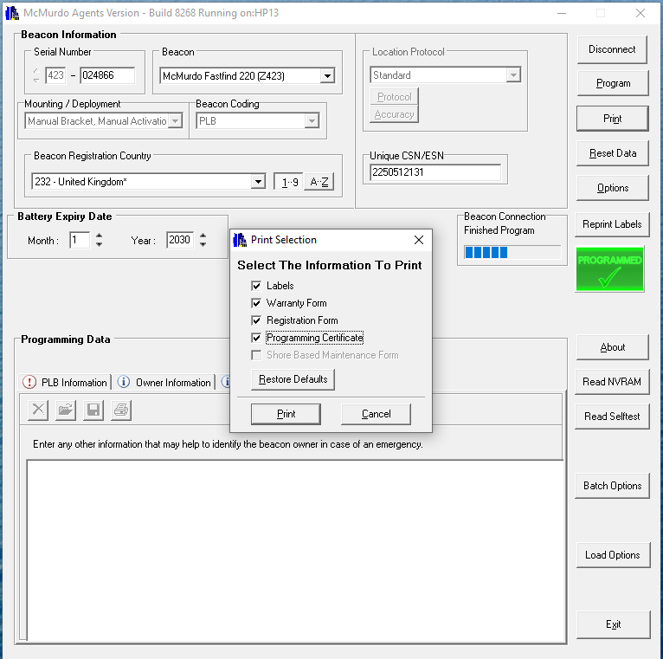
Programming the PLB
Once programming has been completed, click the Print button
The following window will provide option for documents to be printed.
If it is a new PLB, the following will need to be printed: -
Labels, Warranty Form, Registration Form and Programming certificate
If it is an existing PLB, the following will need to be printed:
Labels and Programming certificate only
PLB Programming Guide
Feb-25

Slide 31
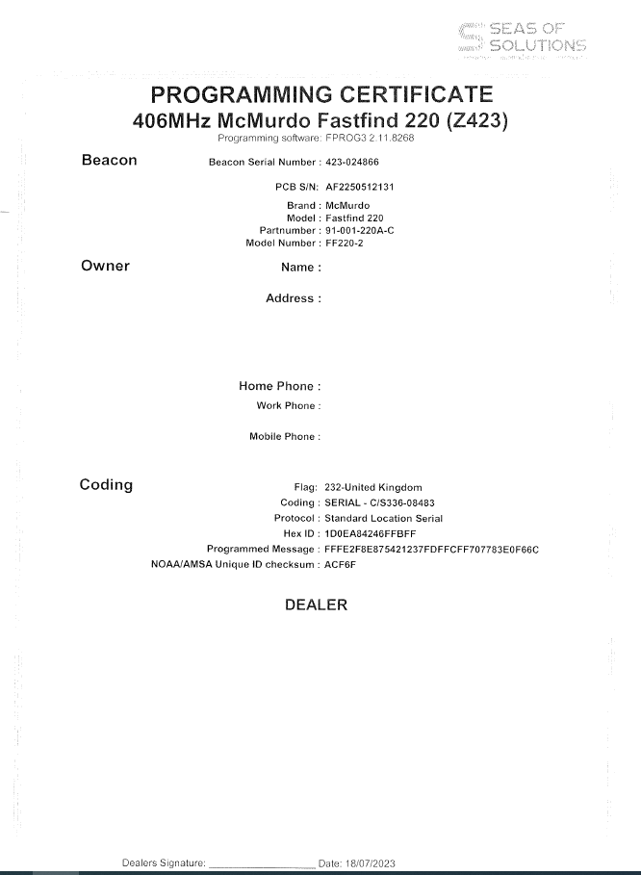
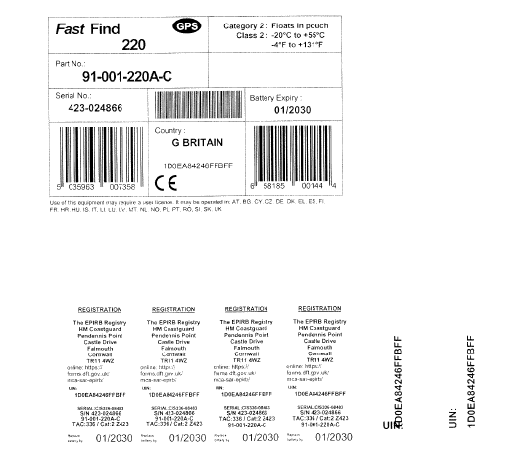
Examples of printed documents
Labels x 2 copies and Programming Certificate
Outer box Label
Manual Labels & Alternate Rear Label
HEX ID
PLB Programming Guide
Feb-25

Slide 32
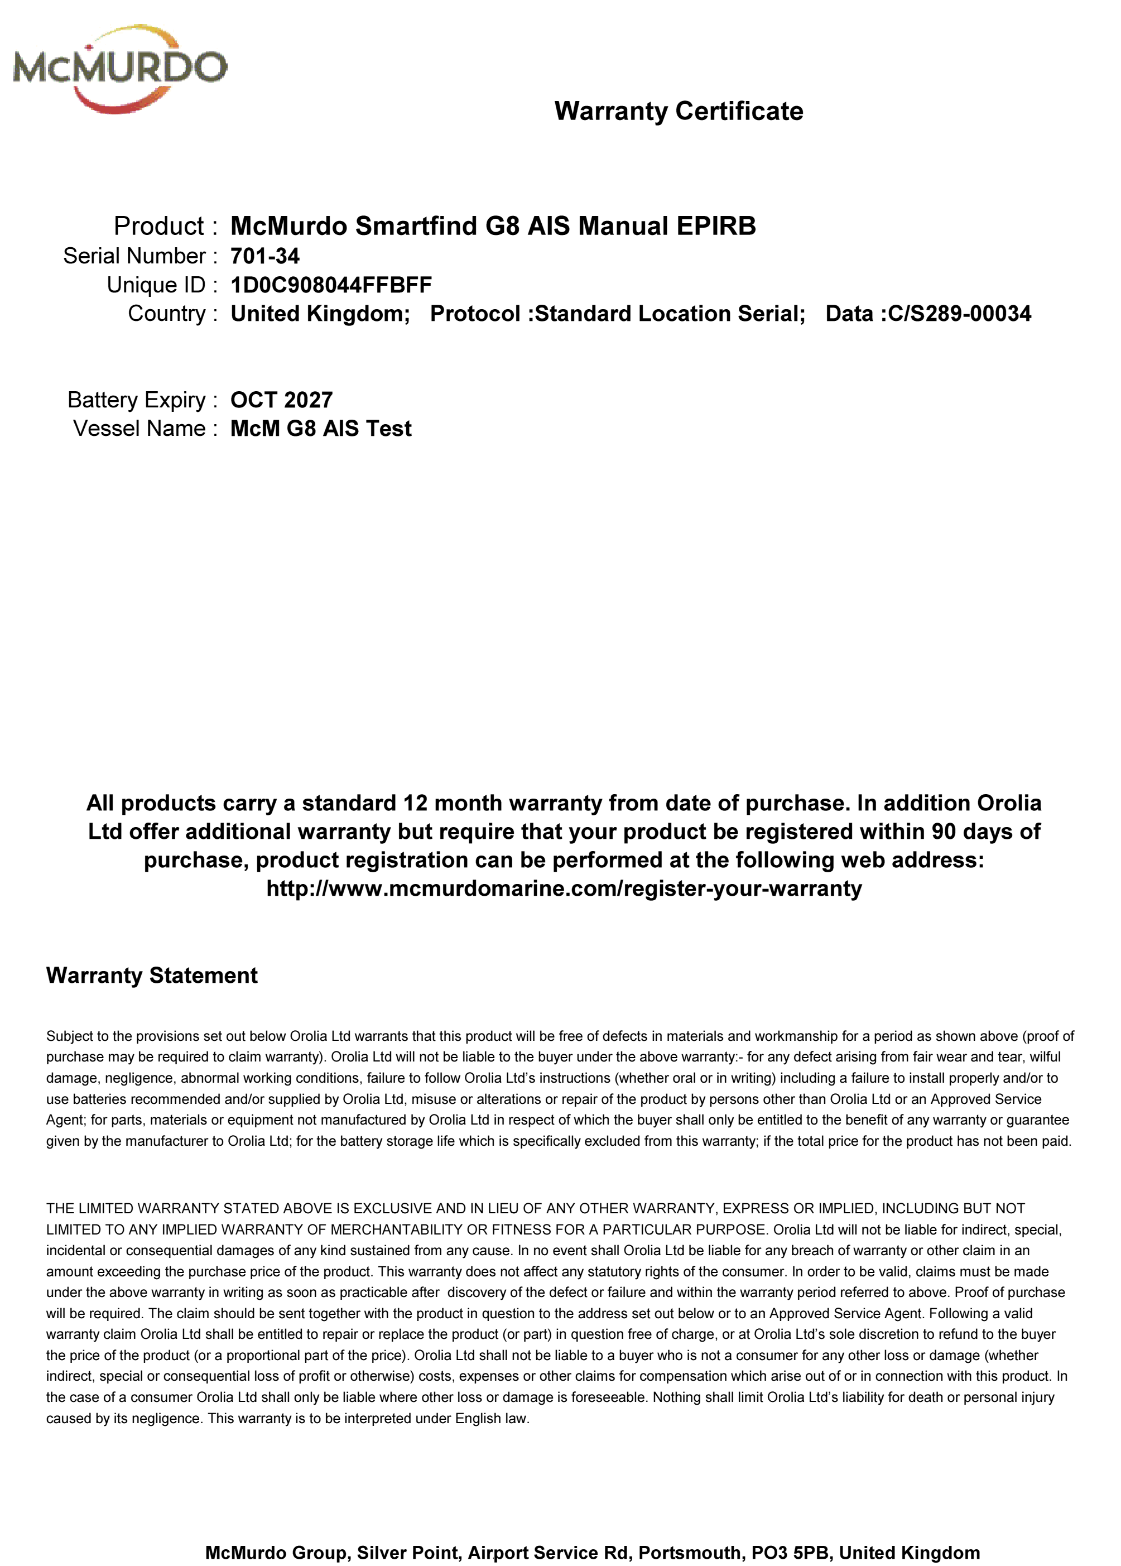
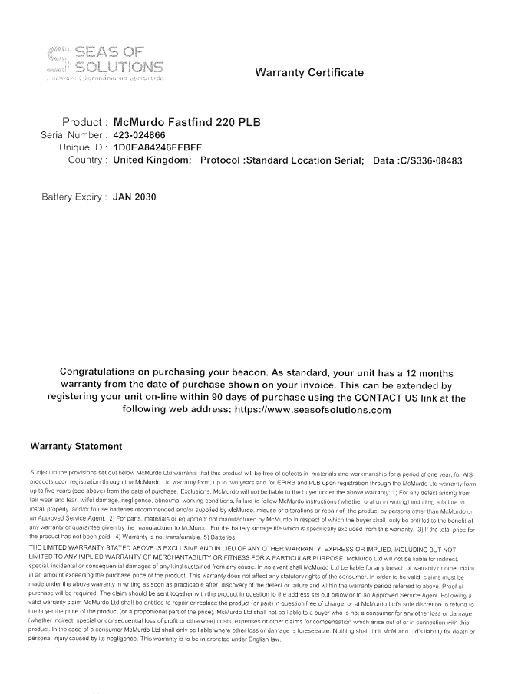
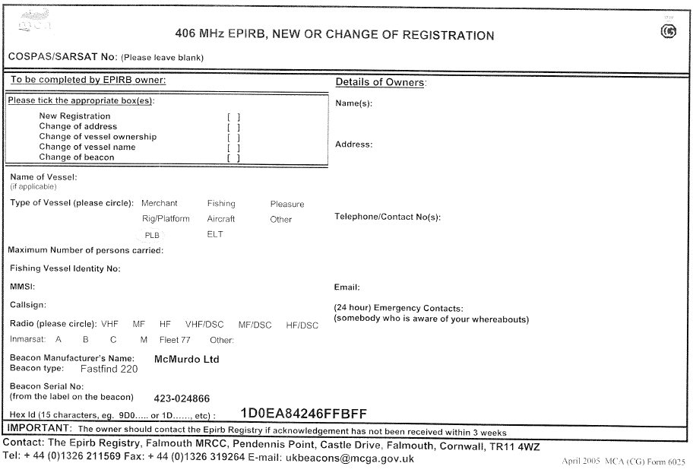
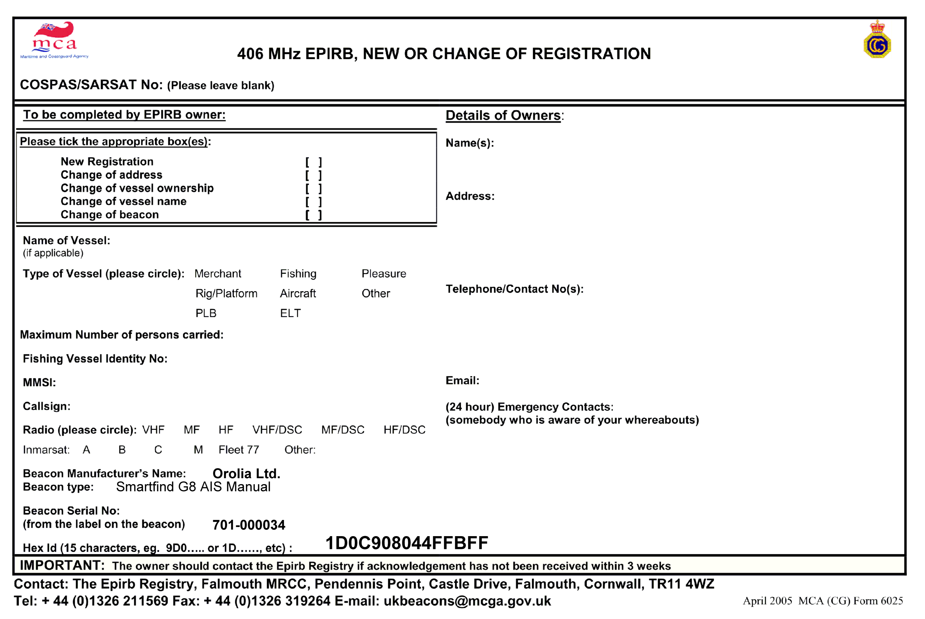
Examples of printed documents
Registration Form and Warranty Form
PLB Programming Guide
Feb-25

Slide 33
Applying the labels
PLB Programming Guide
Feb-25

Slide 34
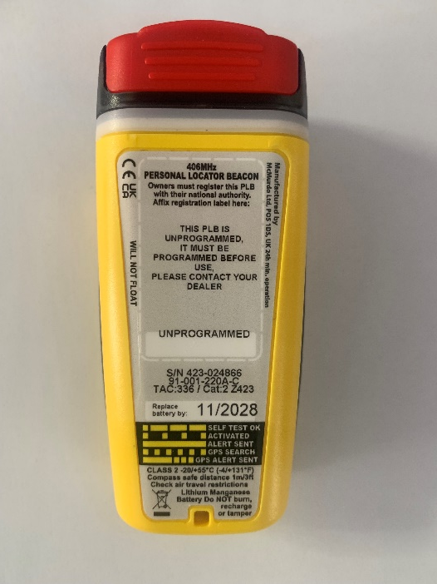
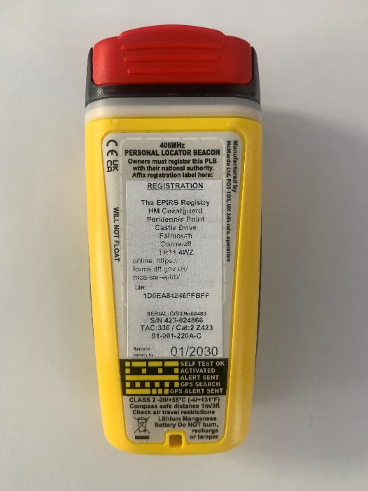
Updating the Rear label on the PLB
Existing Rear Label
New Rear Label
Remove New Rear Label and stick it over the existing PLB Rear label, ensuring that the Old details are covered by the New details
Then cover with the clear over-stick label to ensure longevity of new label
PLB Programming Guide
Feb-25

Slide 35
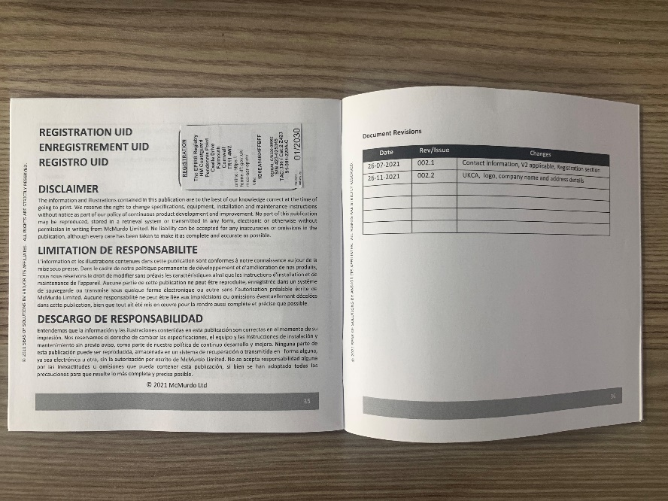
Updating the label in Manual and exterior box
Cut out the External Box label from the printed Labels
Stick the Label on the side of the External box
Cut out the Rear label and over stick this into the Manual, over the Previous Programmed Label
PLB Programming Guide
Feb-25

Slide 36
Thank you
PLB Programming Guide
Feb-25

