Slide 1
PLB Battery Replacement Guide

Slide 2
PLB Battery Replacement Guide
Welcome to the Battery Replacement Guide. Information provided in this Guide will advise on the following:
PLB beacons types
Required Hardware and Software
Replacement of Batteries
Self Test / On-Off Test
Leak Test
Connecting to the beacon via Configurating Software
Updating Battery Expire Date on the Beacon
Examples of printed documents
Applying the newly printed labels
PLB Battery Replacement Guide
Feb-25

Slide 3
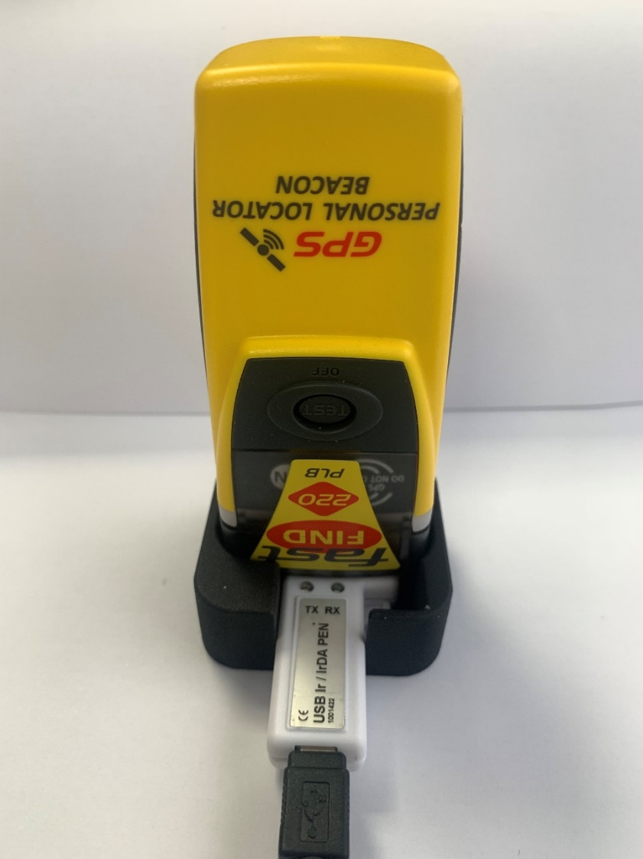
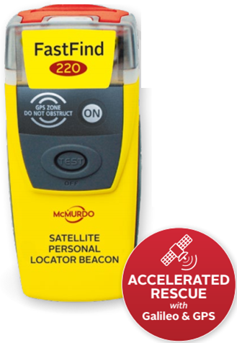
PLBs are programmed with FPROG3 SOFTWARE AND IRDA USB PEN
FastFind 220 PLB
Kannad Solo PLB
Ranger PLB
It is important to NOTE That the RLS PLB can not currently be Programmed via FPROG3. Currently it is only Programmed via Beacon manager.
PLB Battery Replacement Guide
Feb-25

Slide 4
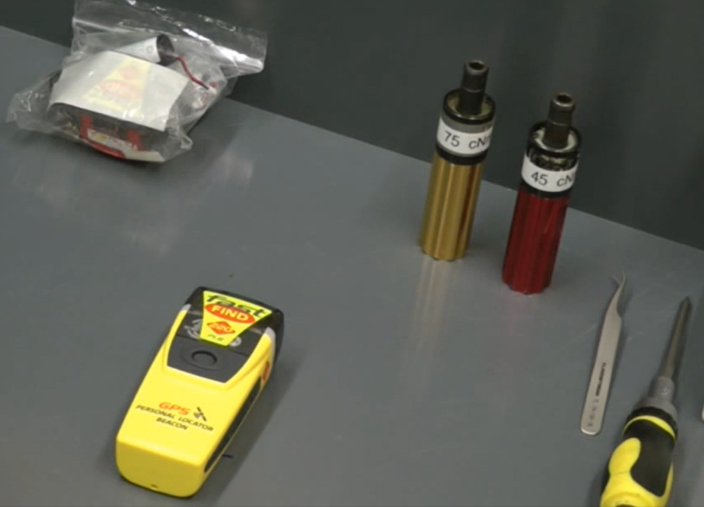
Required hardware and software
Article no: 1001420 USB programming pen kit incl.
ESD Work Station.
Torque Drivers (Cross head, 45cNm & 75cNm)
Leak Testing Station (Hot Water Method)
Computer (Windows 7, 8, 10 or 11)
Free USB port on selected computer
USB Ir/IrDA programming Pen
Pen Cradle (1002665)
FPROG 3 Software downloaded from McMurdo Partner Portal
Label and document Printer
PLB Battery Replacement Guide
Feb-25

Slide 5
Replacing Batteries
PLB Battery Replacement Guide
Feb-25

Slide 6
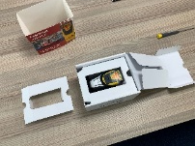
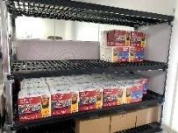
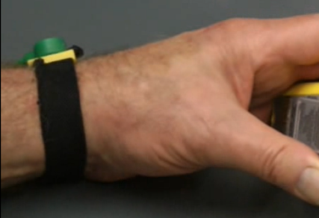
Preparation to Replace Batteries in PLB
Step One
Carefully Unpack the PLB from its Packaging
Ensure ESD Work Station is used
Ensure Technician is properly grounded via ESD strap while work is undertaken.
Ensure Torque Drivers (Cross head, 45cNm & 75cNm) are used.
Ensure correct Battery Replacement Pack is used
(a)
(c)
(e)
(d)
Note:-
The Replacement Batteries in these Photos have been shown as Black (to distinguish them), however in reality they are Still Yellow as the original Batteries were.
(b)
PLB Battery Replacement Guide
Feb-25

Slide 7
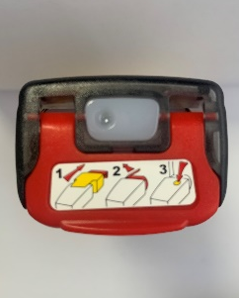
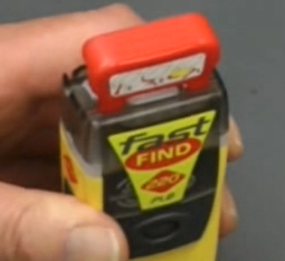
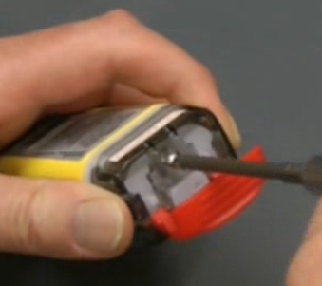
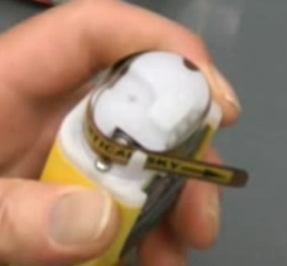
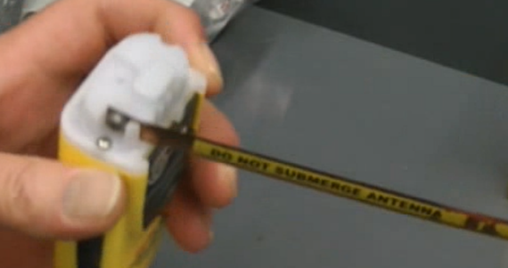
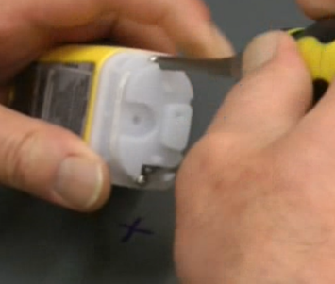
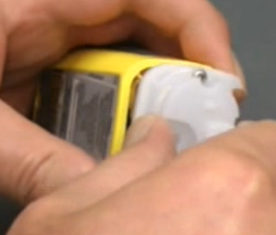
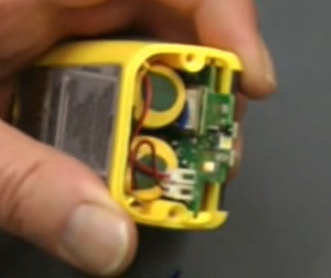
Opening PLB
Step Two
On the PLB, Lift Red Flap on Top-Cap to expose retaining Screw
Unscrew Retaining screw to free Top-Cap
Remove Top-Cap of PLB (& Store) to expose Top Cover of PLB, Antenna and two Retaining Screws.
Carefully Unwind Metal antenna to give access to Retaining Screws
Unscrew Retaining Screws
Carefully Remove Top Cover of PLB (& Store) to expose Printed Circuit Board and Batteries
Visually Check PCB, Antenna spring connector, and Batteries for Damage
(a)
(b)
(c)
(d)
(e)
(f)
(g)
PLB Battery Replacement Guide
Feb-25

Slide 8
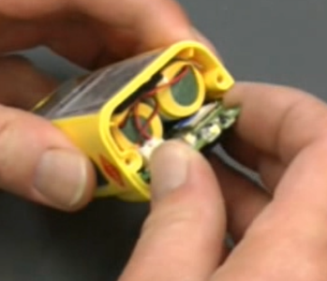
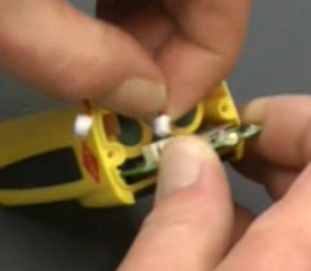
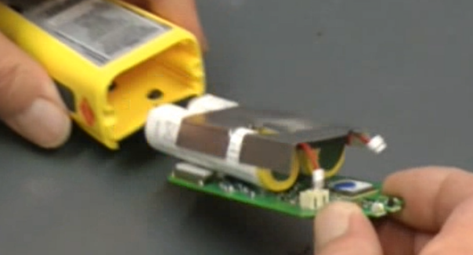
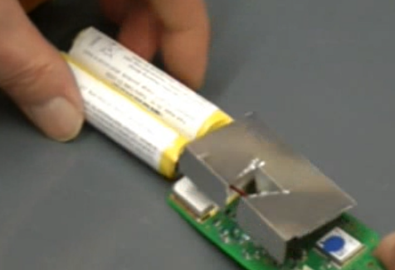
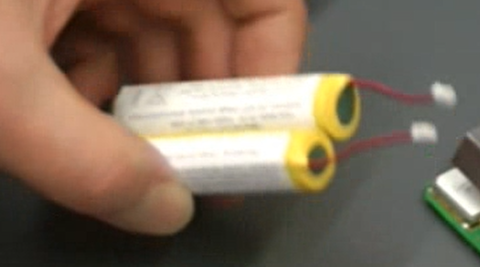
Accessing PCB and Batteries
Step Three
Visually inspect PCB for Damage
Hold the projecting part of the PCB to secure it.
While holding the PCB firmly, carefully Unplug the Battery connections to the PCB (remove the white connectors from their sockets on the PCB).
Hold the projecting part of the PCB and gently extract the whole PCB and Battery arrangement, by pulling.
Lay the PCB/Battery arrangement on the ESD surface and gently pull out the batteries from the rear of the PCB
Carefully discard Old Batteries in accordance with disposal laws for Lithium Metal Batteries
(a)
(b)
(c)
(d)
(e)
(f)
PLB Battery Replacement Guide
Feb-25

Slide 9
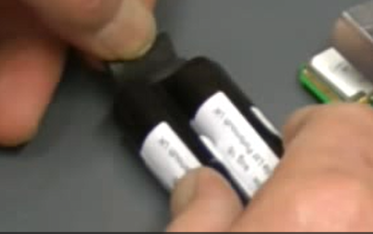
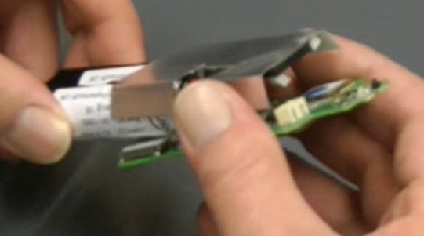
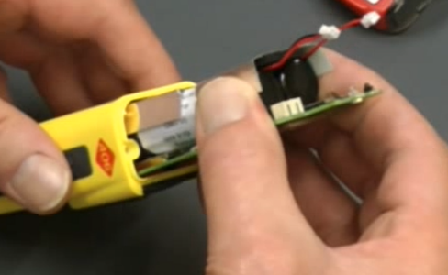
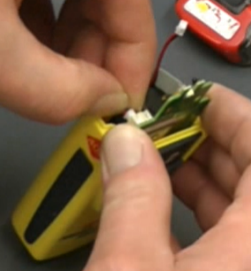
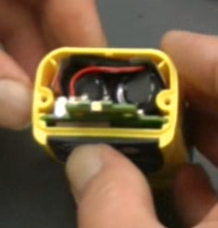
Replace with New Batteries
Step Four
Align New Batteries together with their wires uppermost. Then apply two sponges pad (one on top of the other) to the bottom/rear of Batteries
Reinsert new Battery pair back into the PLB PCB (ensure wires are not entangled during this process.)
While keeping Battery wires from being entangled, re-insert PCB and New Battery Pair into PLB Case (ensure that PCB slides into its correct mounting groove)
Using Gravity and PLB case to support PCB and Battery Pair. Reconnect Battery plugs to their respective sockets on the PCB
Manually adjust Battery wires away from the Centre of the PLB and toward the upper left side of the PLB (this prevents the wires being crushed by the Top Cover when reattached)
(a)
(b)
(c)
(d)
(e)
Note:-
The Replacement Batteries in these Photos have been shown as Black (to distinguish them), however in reality they are Still Yellow as the original Batteries were.
PLB Battery Replacement Guide
Feb-25

Slide 10
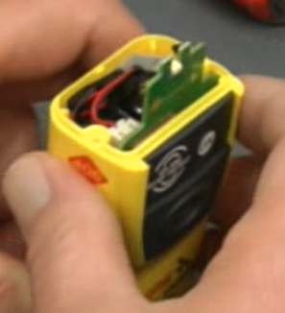
Initiate On/OFF test
Step Five
Before Top-Cover is attached, Test functionality of the ON button
Press the ON button and ensure that the LED starts Flashing.
Immediately after the Flashing has started, Press the TEST/OFF button and ensure the PLB does not continue flashing. (Note: there is 50 Seconds before a “Live” transmission).
If the TEST/OFF button does not cancel the Flashing, disconnect the battery before a “live” transmission occurs. Then Check that the buttons on the PCB is aligned with the exterior Silicon Buttons. Rework if required.
If Test is successful, continue to re-attach Top-Cover
(a)
(b)
(c)
PLB Battery Replacement Guide
Feb-25

Slide 11
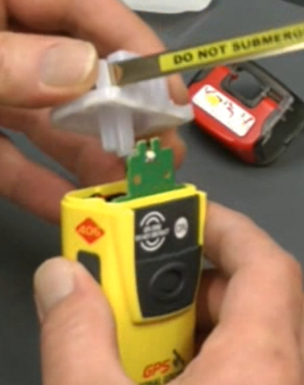
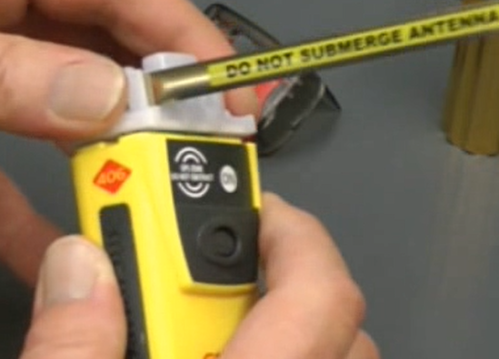
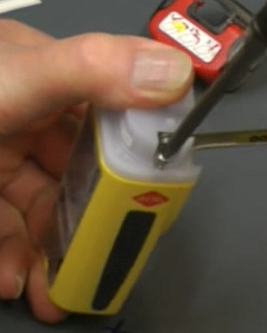
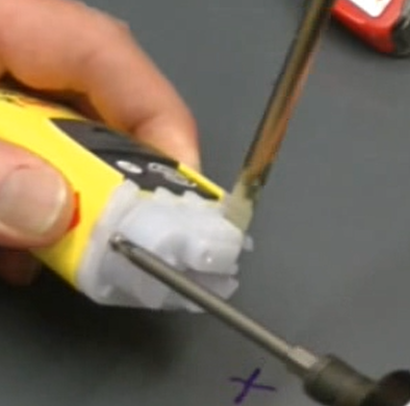
Replace Top-Cover of PLB
Step Six
Align Top-Cover (Antenna extended) over the PLB. Ensure no wires or components on the PCB would be crushed.
Lower Top-Cover carefully onto PLB Body. Ensuring that Seal is Clean and not damaged or tangled.
Hold Top-Cover with Thumb and apply gentle pressure to Mate the Cover with the Body of the PLB. Screw retaining screws evenly into their positions with a 45cNm Torque Driver.
Ensure that the correct torque (45N) is exerted on these retaining screws
(b)
(a)
(b)
(d)
(e)
(c)
(d)
PLB Battery Replacement Guide
Feb-25

Slide 12
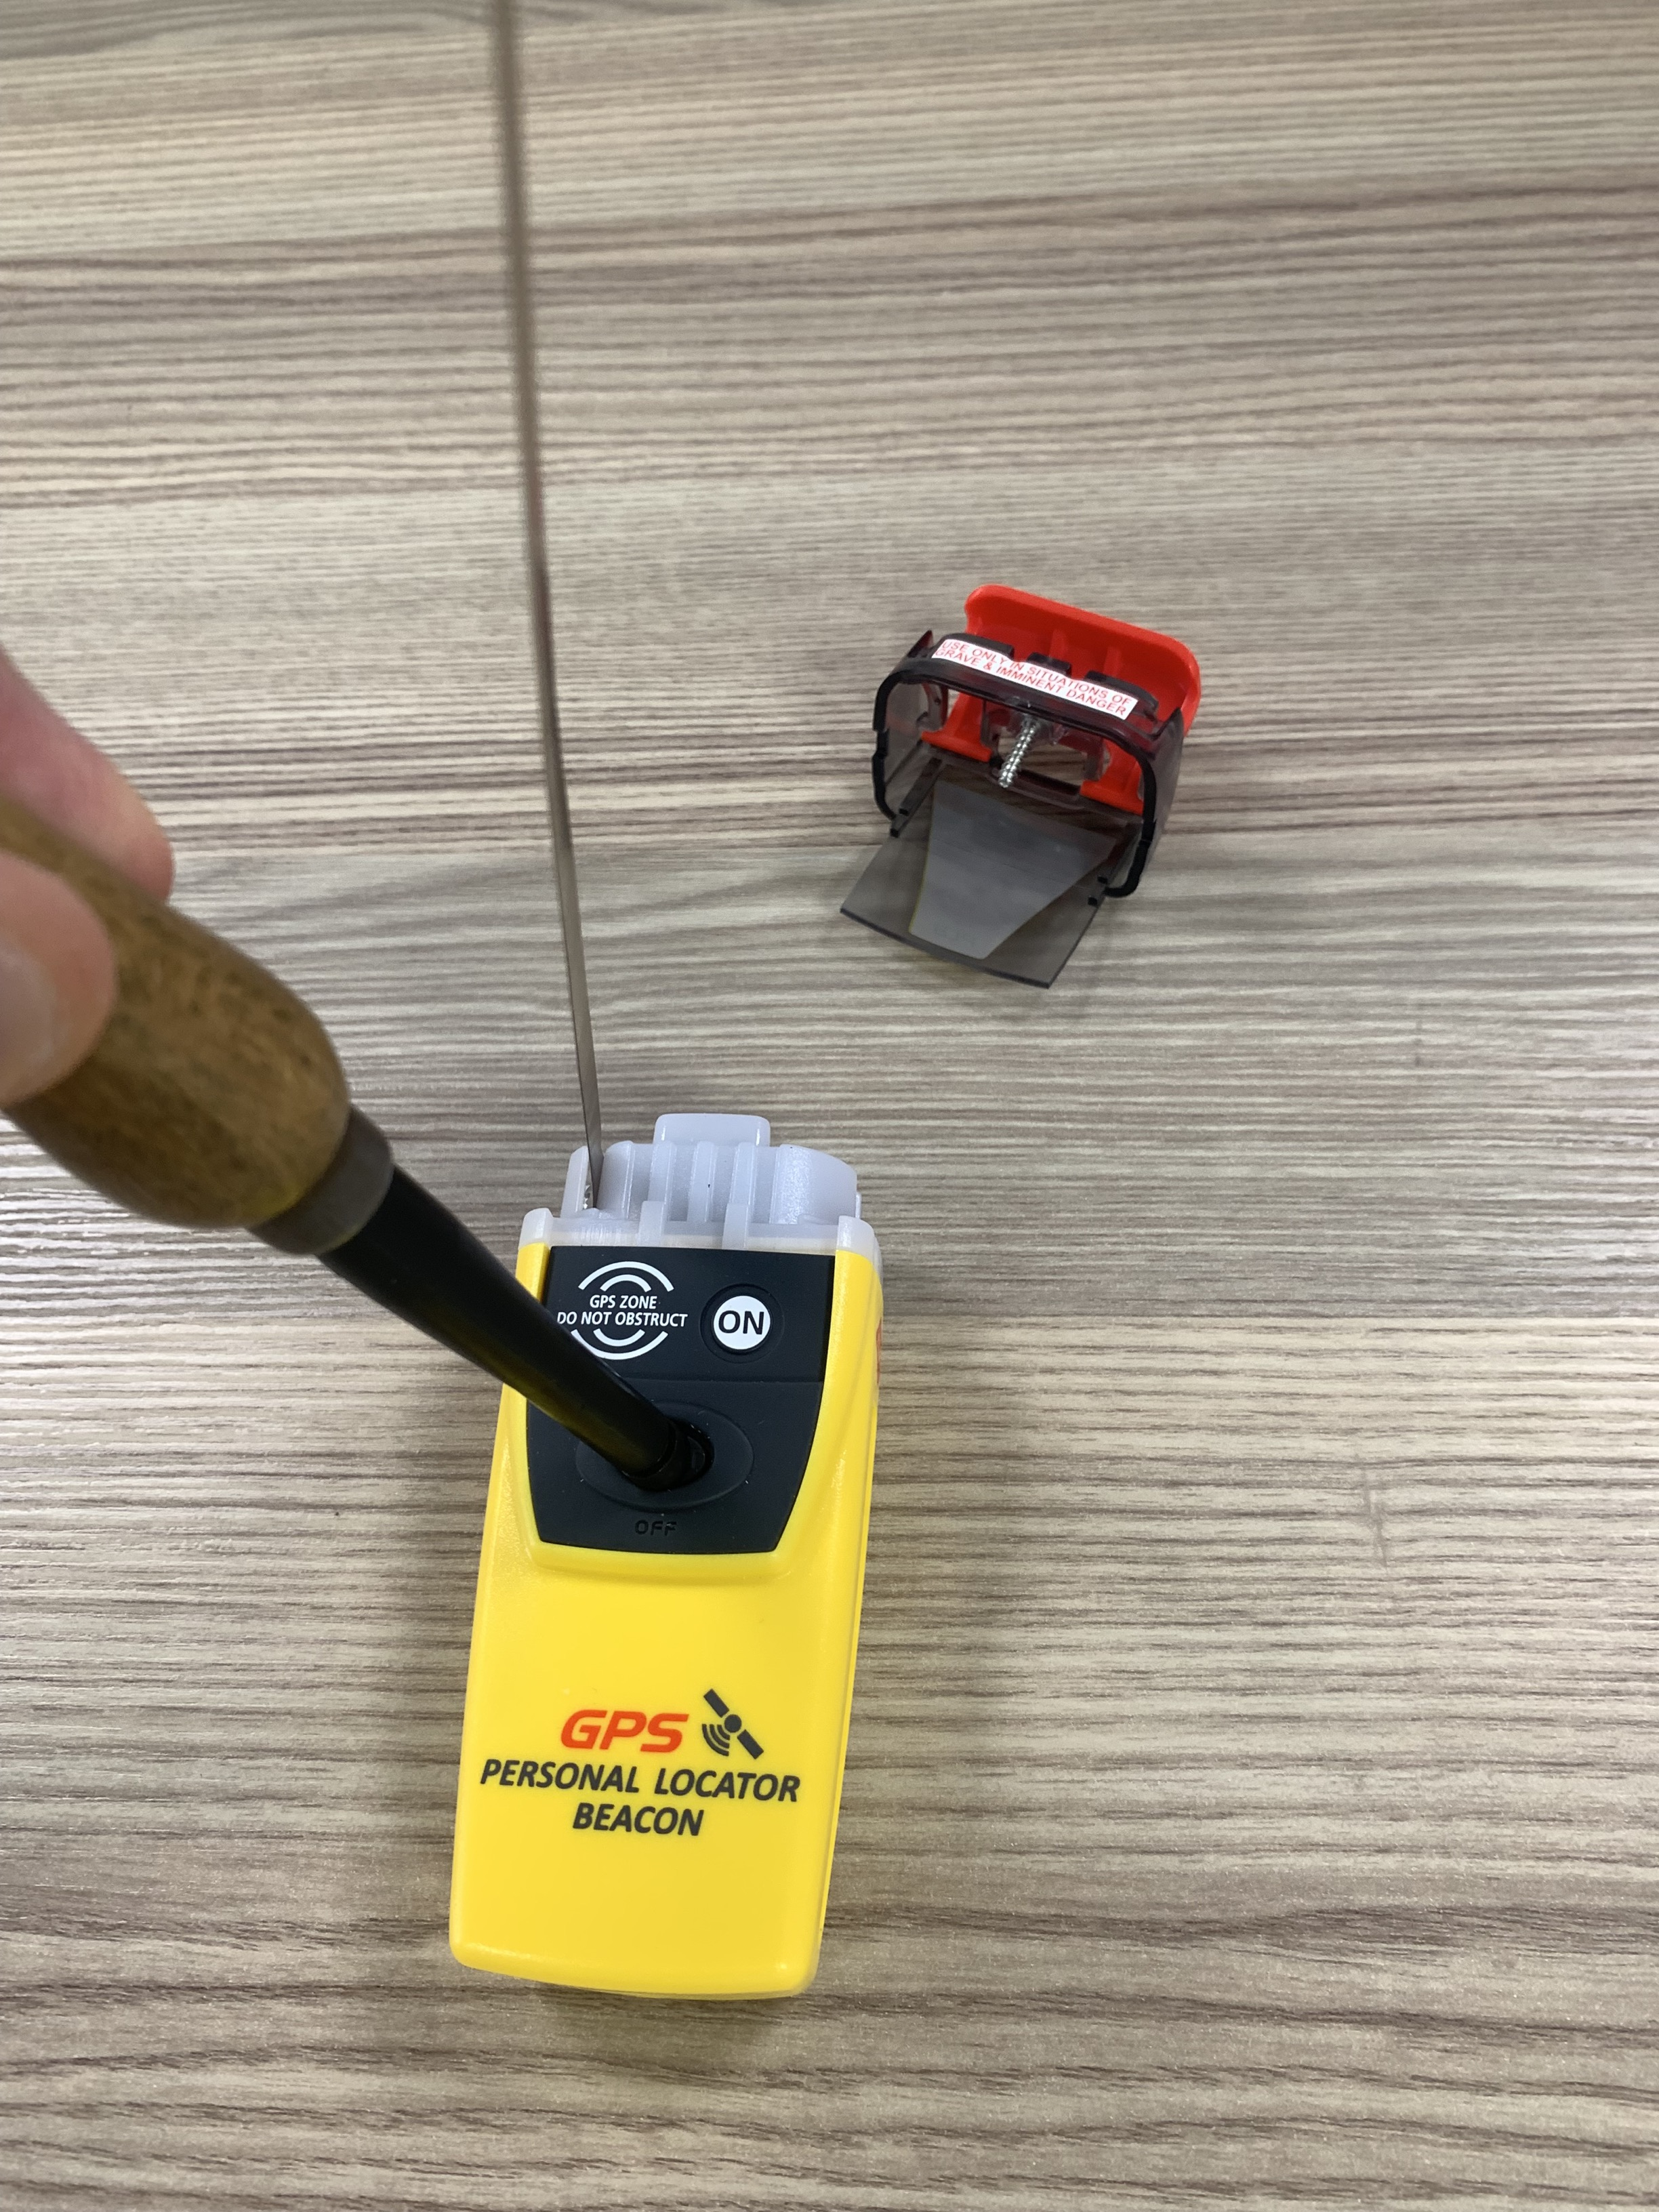
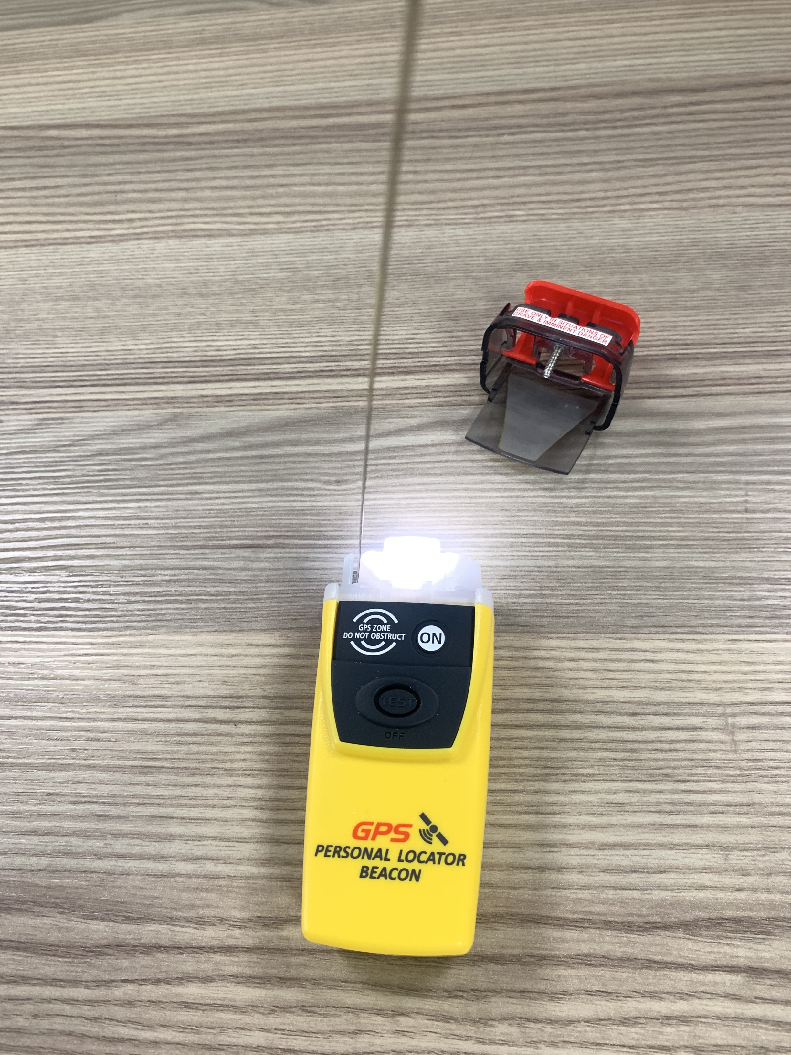
Initiate self-test
Step Seven
Test functionality of Self-Test feature.
Press and hold the Test button for approximately 2 seconds
The PLB should start a sequence of Flashes to confirm that the Self-Test is functionable, and the Battery is full.
Successful Sequence is as follows:-
Press (2 Seconds)
Short Flash (Self-Test Initiated)
Short Flash (Initial 121 MHz pulse)
Long Flash (Initial 406 MHz pulse)
3x Short Flash (Showing full Battery)
Manual also shows correct light Sequence
(b)
(c)
(d) Light Sequence
Self-Test Start
121MHz Pulse
406 MHz Pulse
Full battery
PLB Battery Replacement Guide
Feb-25

Slide 13
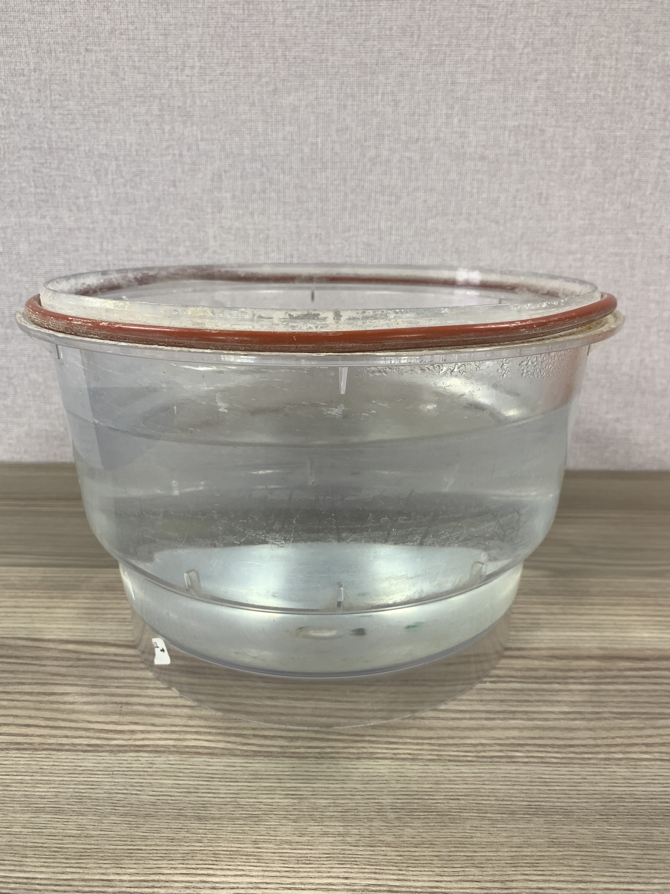
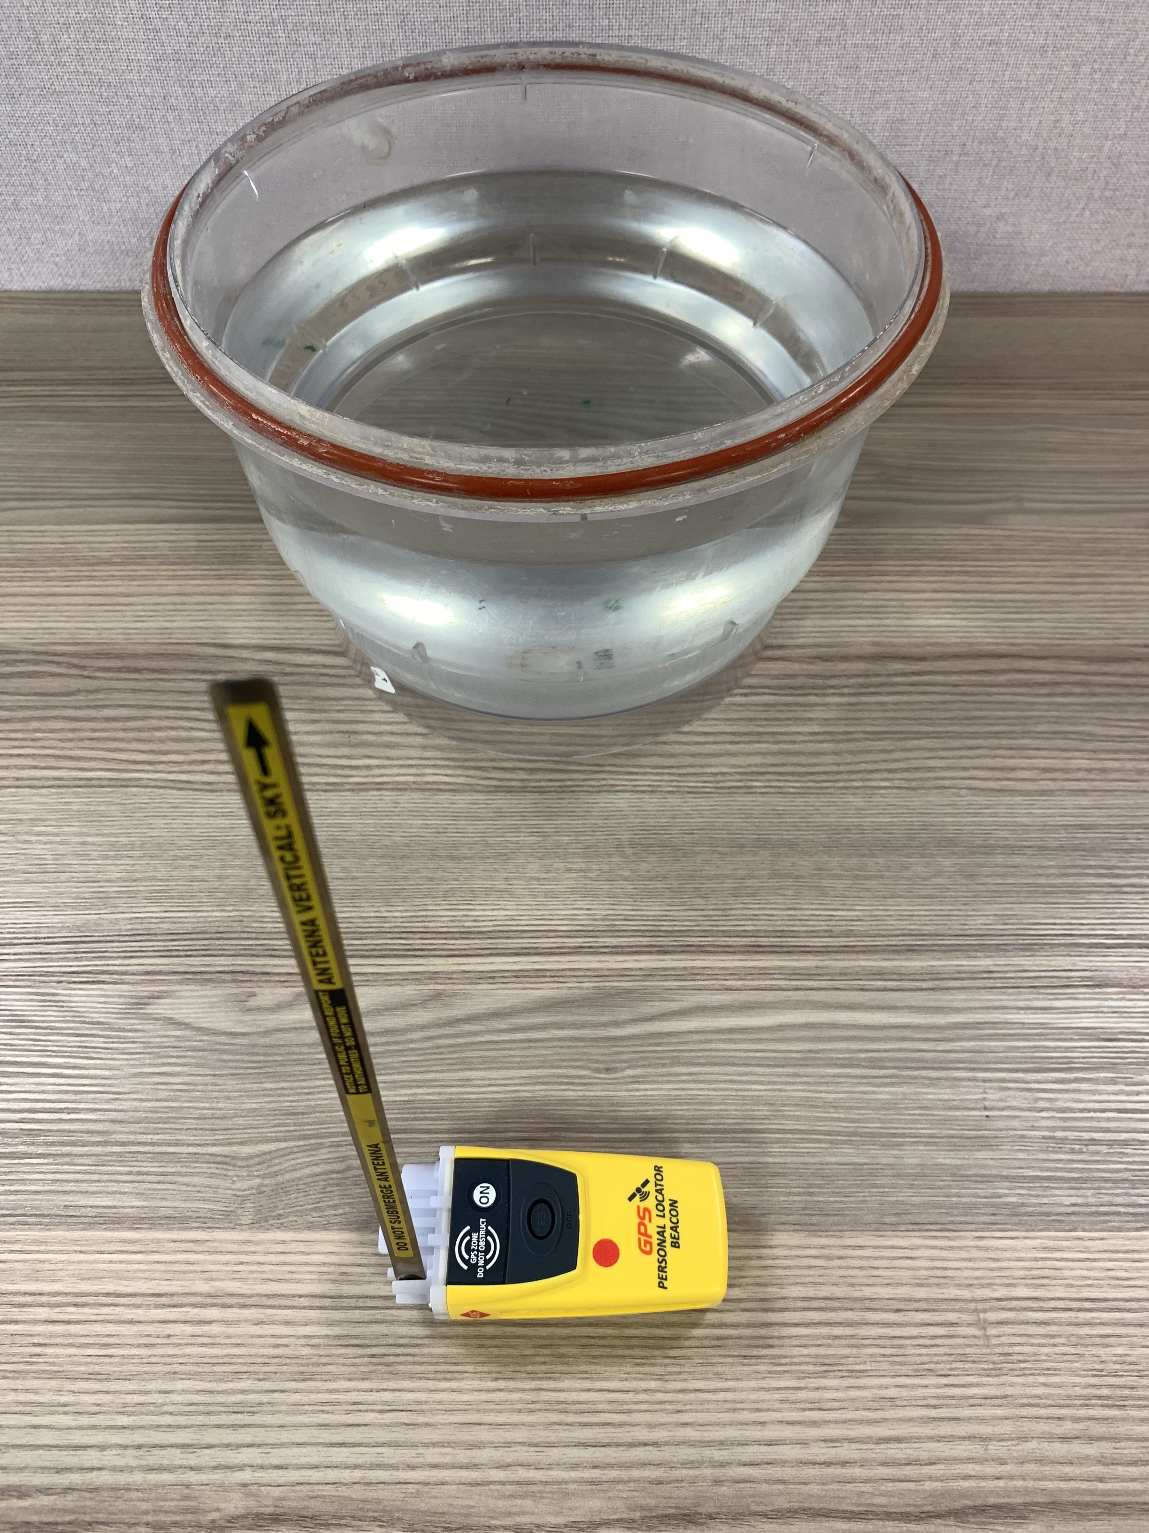
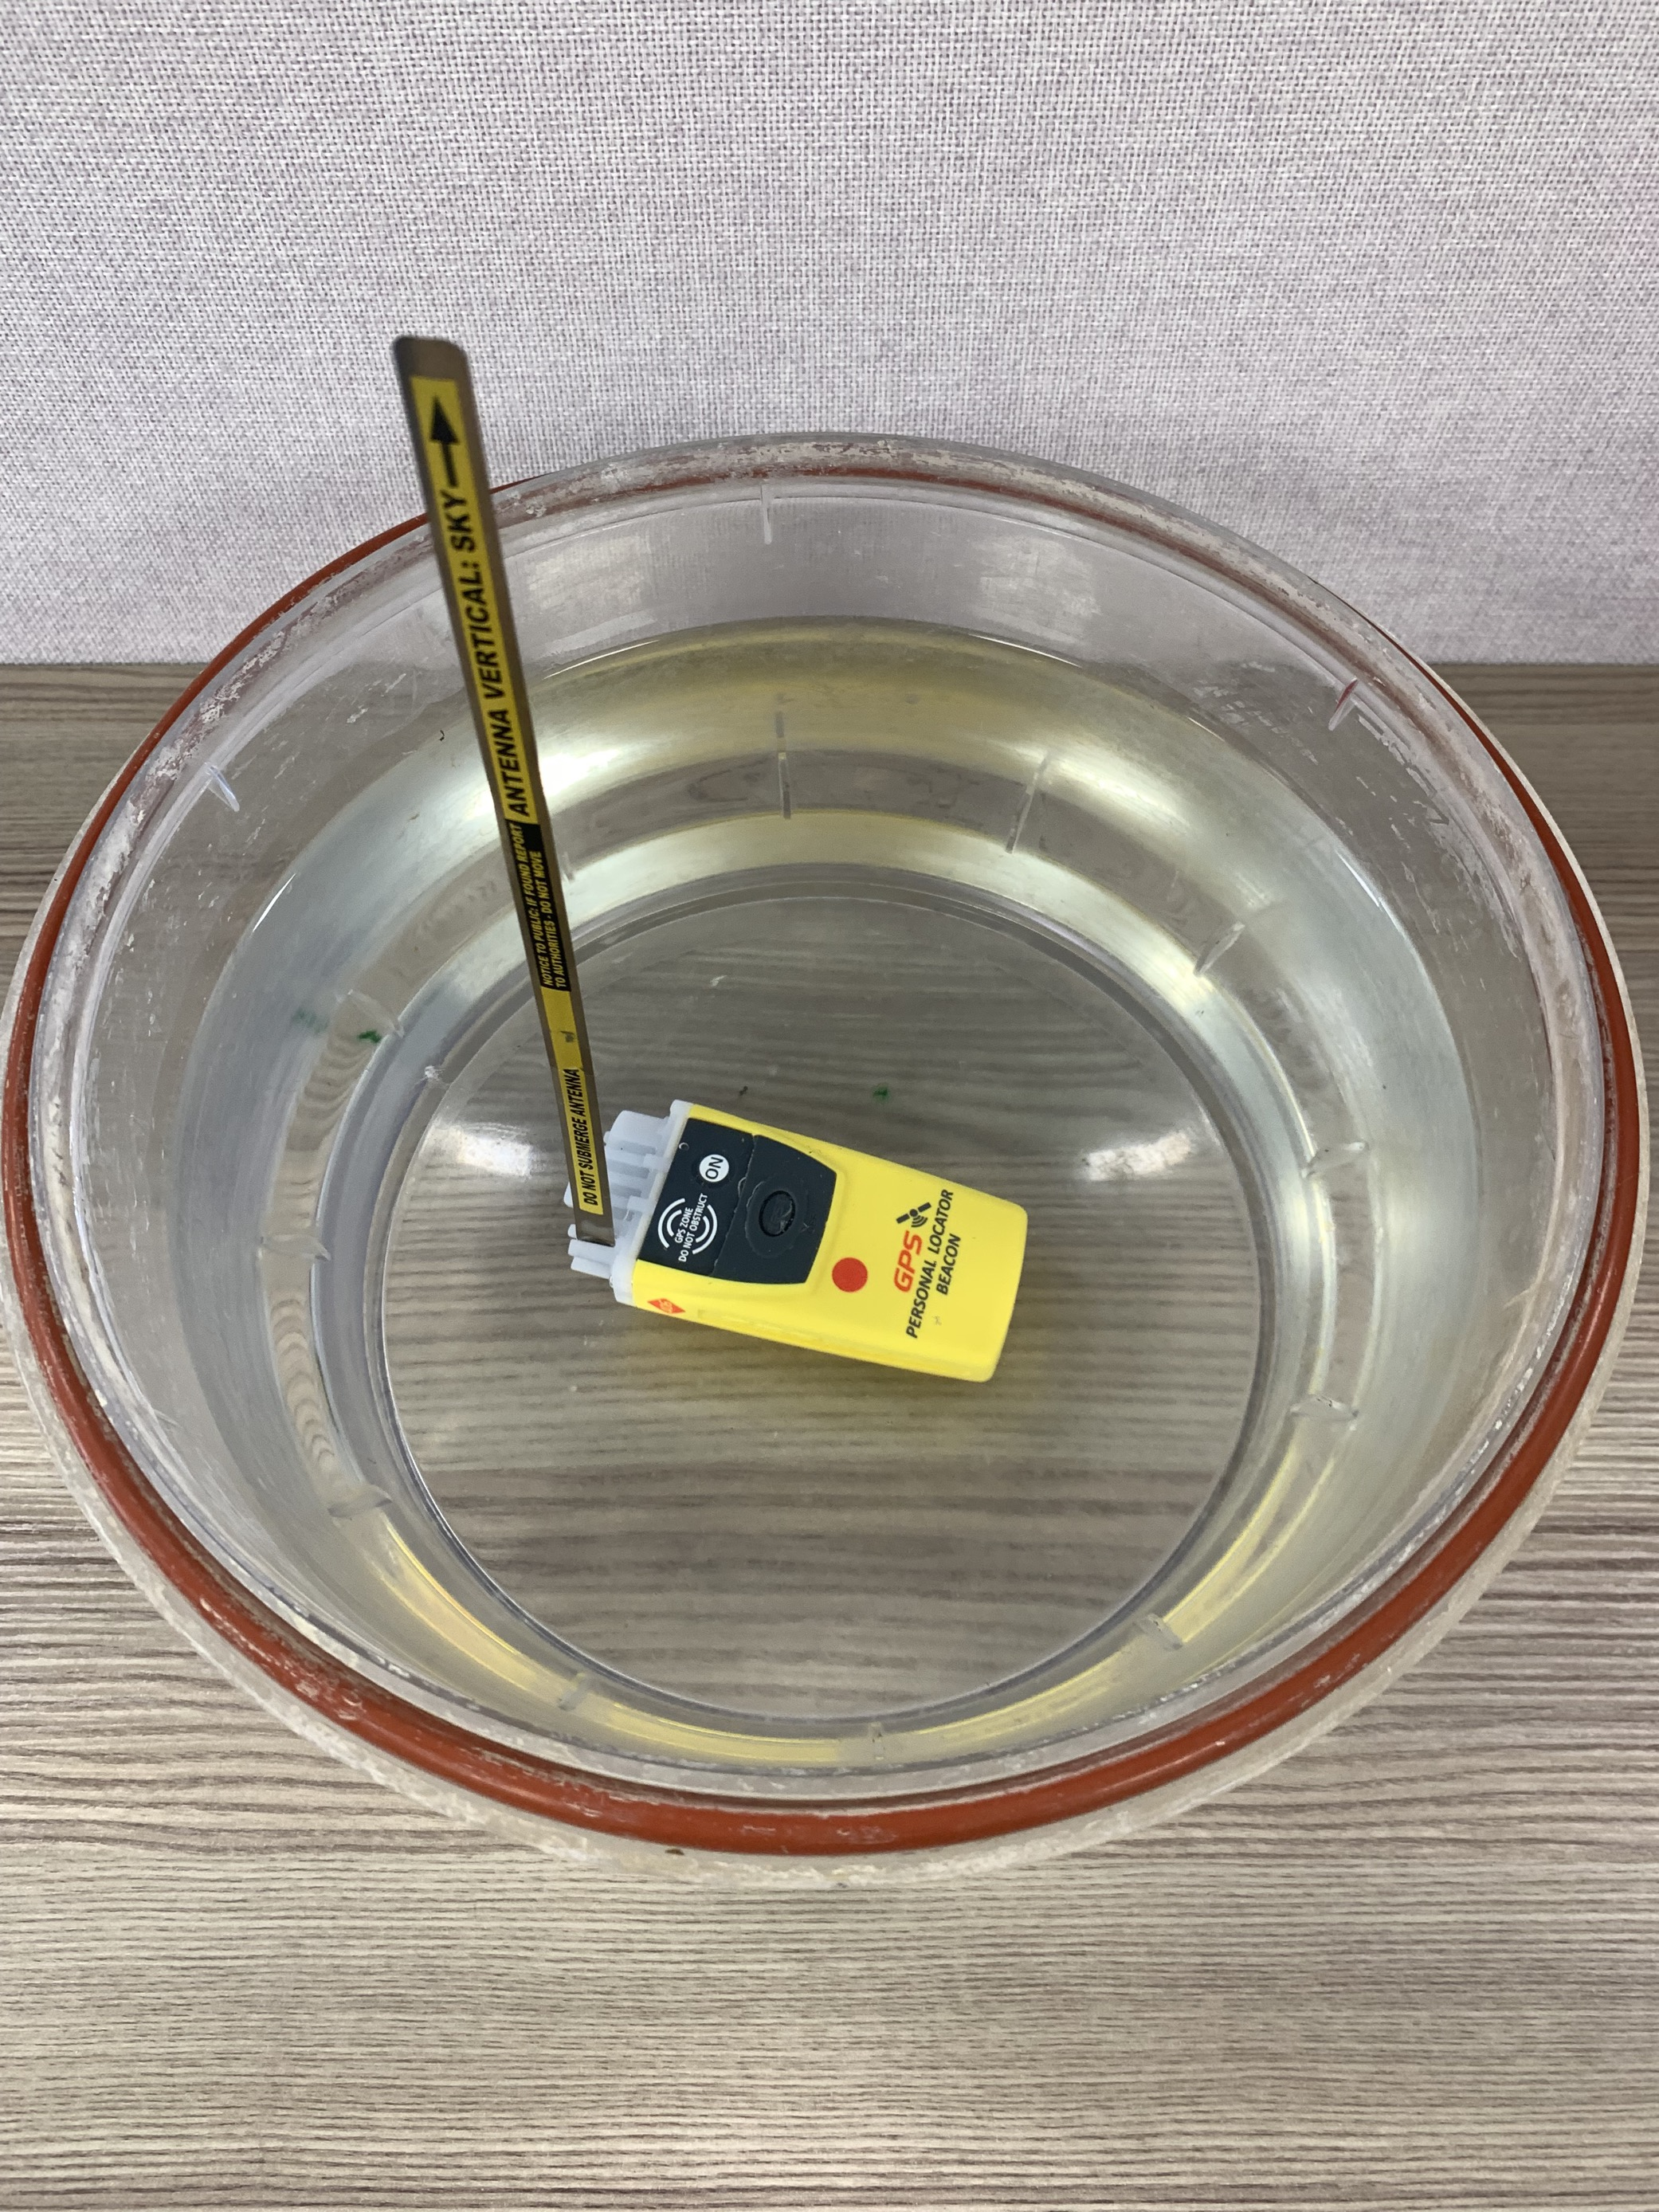
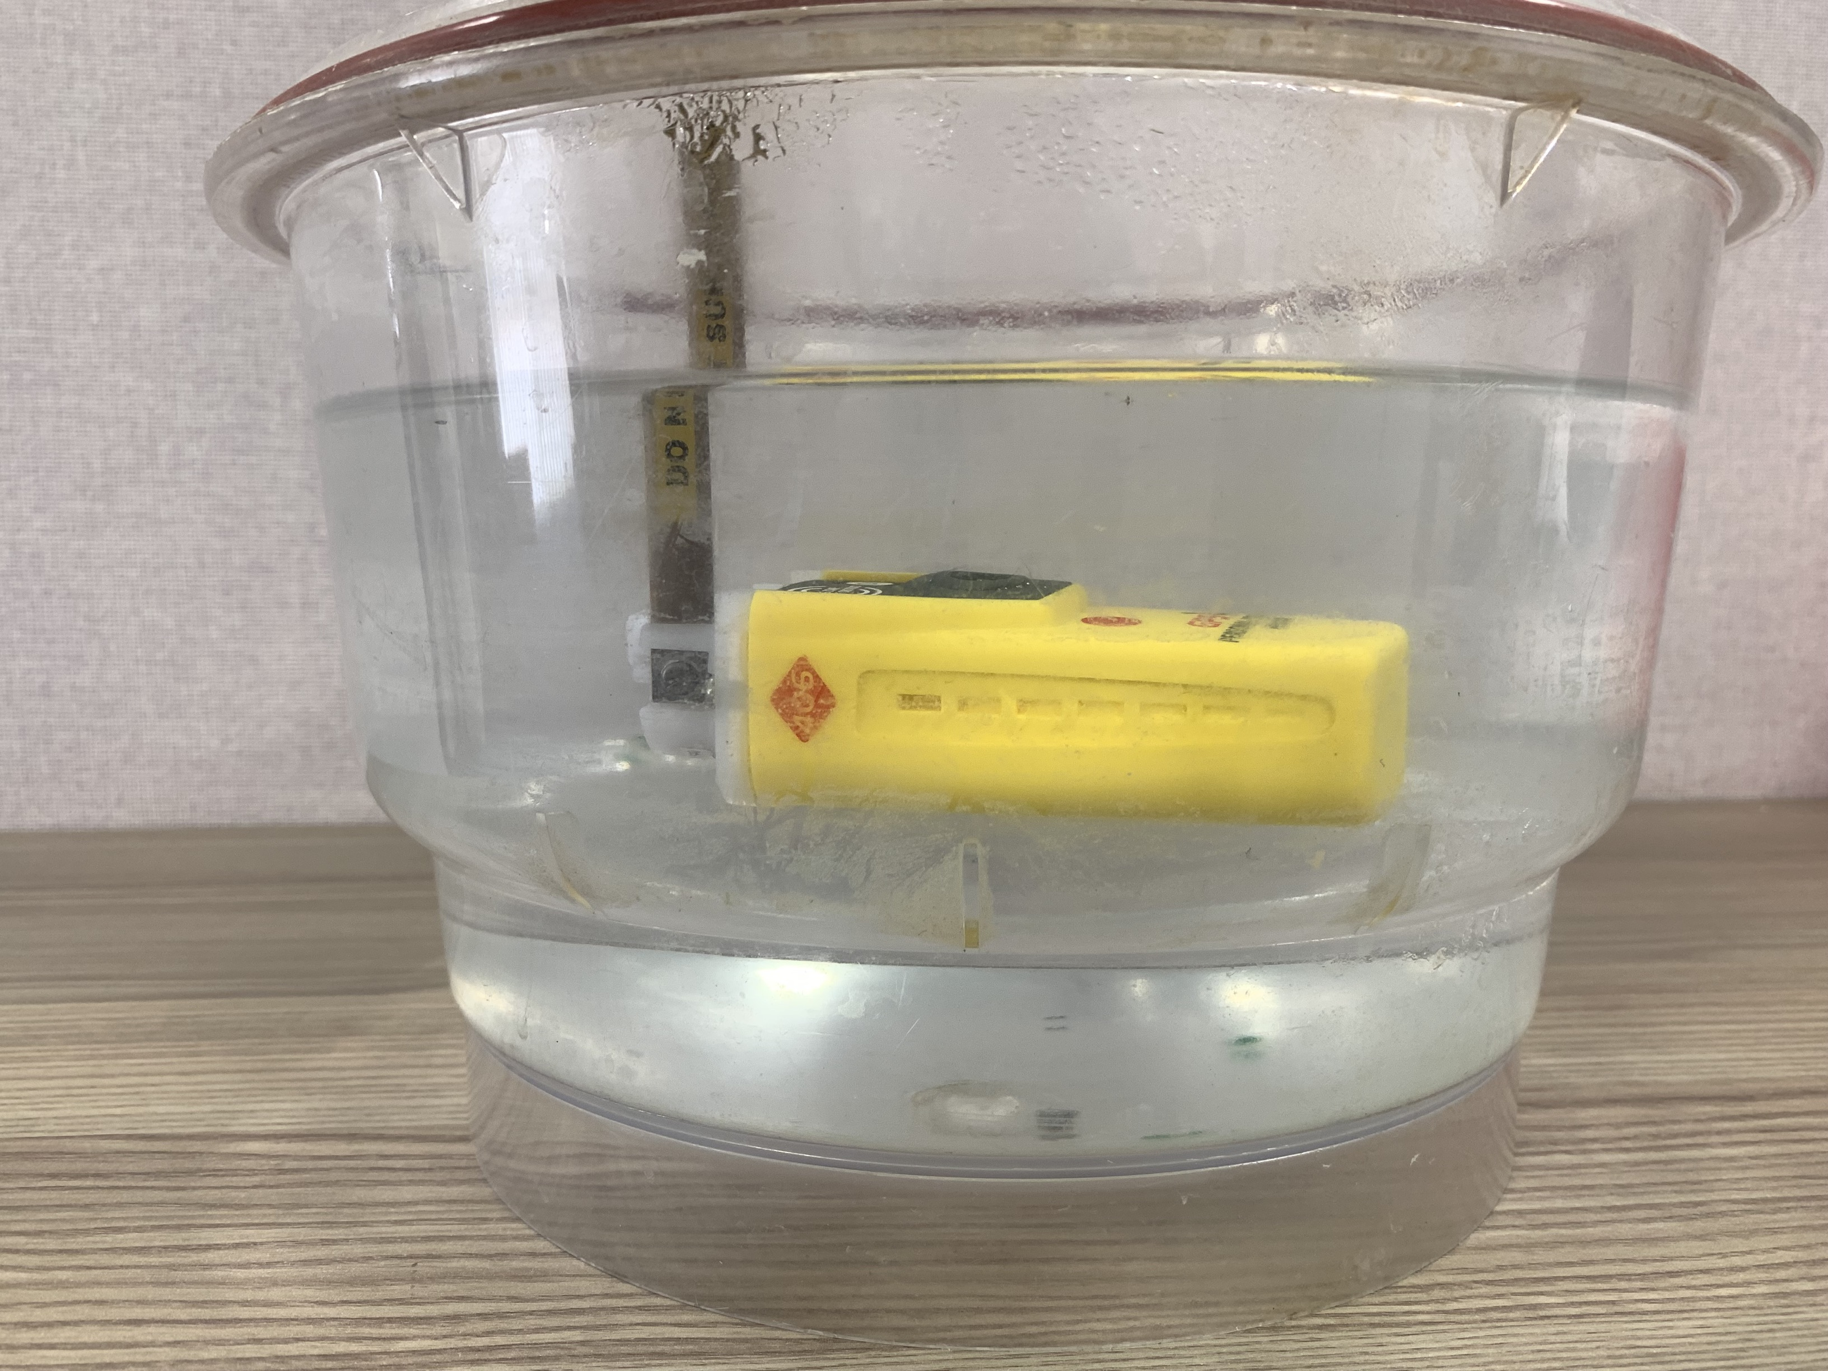
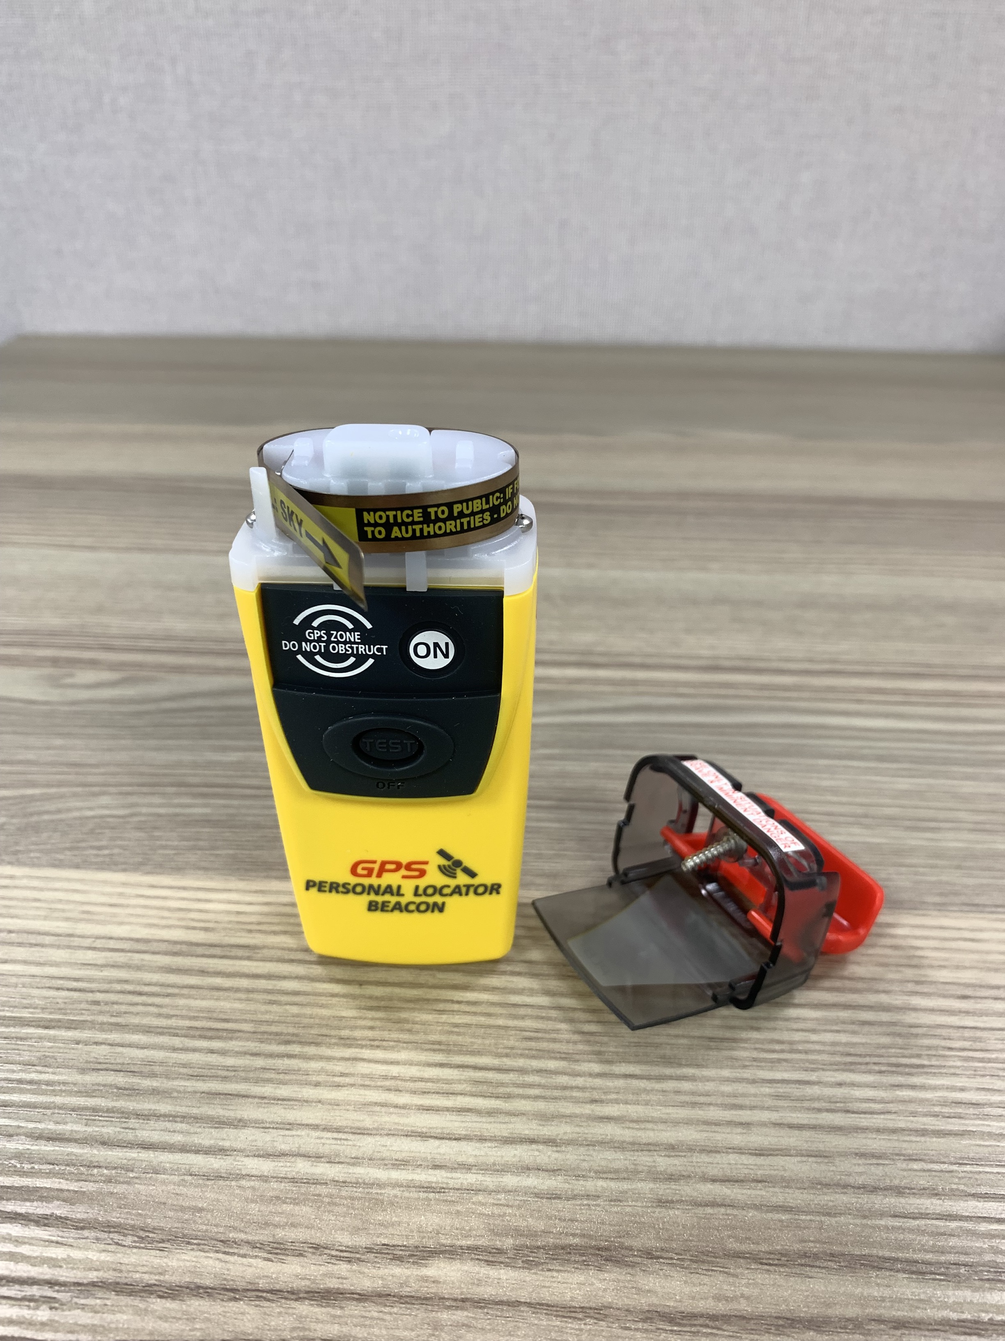
Leak testing Plb (Hot water Bath Method)
Step Eight
Setup a container containing Hot water at +60 Degrees Celsius (+/- 5 Degrees). Ensure the temperature is monitored with a Thermometer
Inspect the PLB to be tested. Ensure all seals and screws are correctly installed.
Place Sealed PLB into the water with the antenna pointing up (useful to extract PLB)
Dislodge any attached surface bubbles and watch for any “Bubbles Streams” that would indicate a leak.
If leak detected, remove immediately, dry and rework PLB to correct leak.
If no Leak detected, remove PLB after 5 minutes of submersion and ensure it is dried fully.
Once Dry, recoil antenna, ensuring blade is tucked behind the Antenna retaining post.
(a)
(b)
(c)
(d)
(g)
PLB Battery Replacement Guide
Feb-25

Slide 14
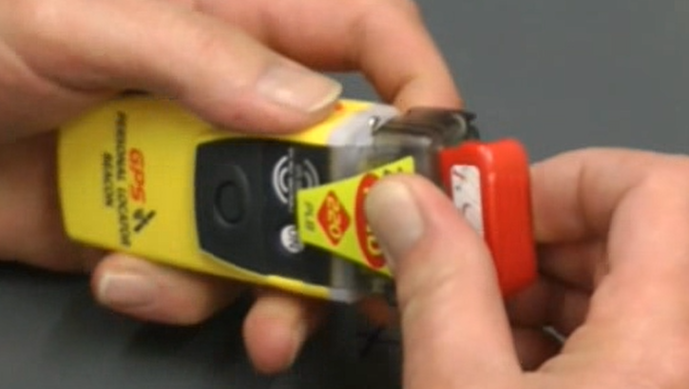
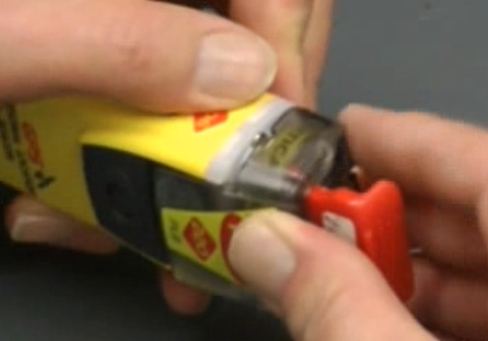
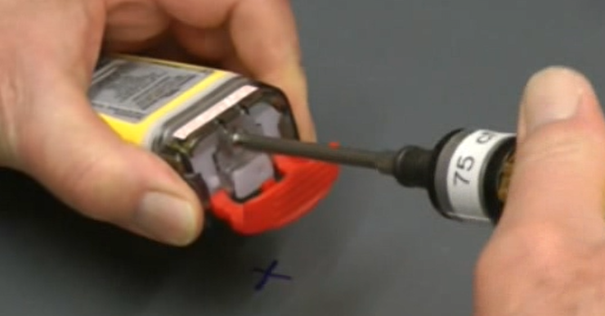
Replace Top-CAP
Step Nine
Ensure Antenna blade is coiled gently around the Top-Cover and tucked behind the Antenna retaining post. Do not Over tighten or Under tighten the coil as this could lead to deforming the Antenna Blade.
Carefully re-attach the Top-Cap to the top of the PLB. Ensure to tuck the Antenna Blade inside the Top-Cap.
Push the Top-Cap down onto the top of the PLB until it sits evenly and fully shields the ON button.
While firmly holding the Top-Cap, use a 75cNm torque driver to screw the retaining screw into position
(c)
(a)
(b)
(c)
(d)
PLB Battery Replacement Guide
Feb-25

Slide 15
Connecting to the PLB to update the Battery Expiry date
PLB Battery Replacement Guide
Feb-25

Slide 16
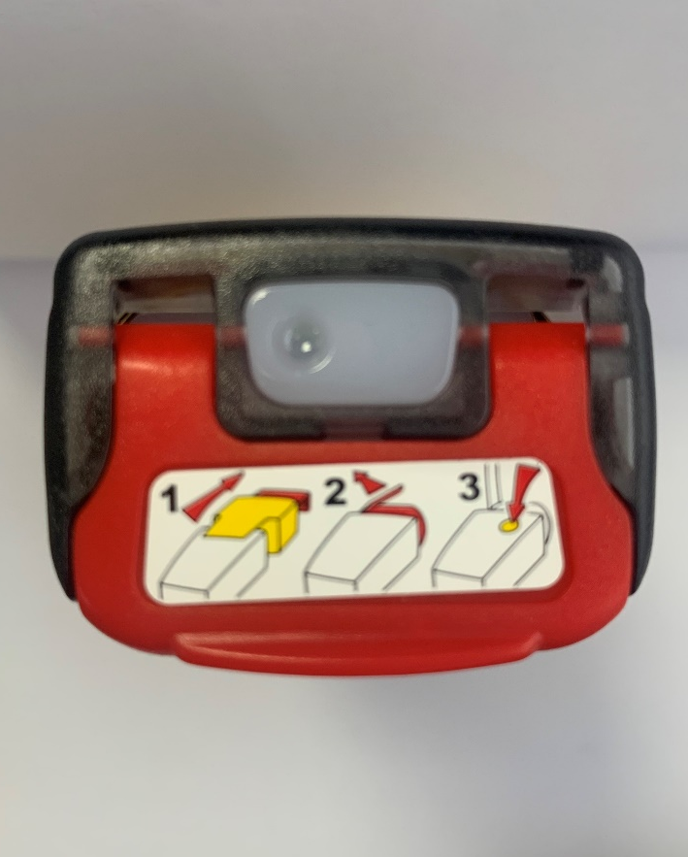
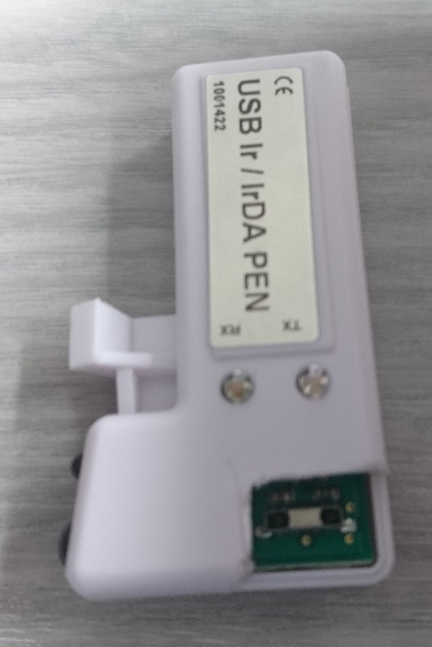
Connecting to the PLB
The USB Multi Pen must operate using IrDA programming protocol.
Place the programming pen in the mould base. There are multiple versions of this base (Solid Plastic and Plastic frame)
Ir point
IrDA point
IrDA point on the PLB beacon
PLB Battery Replacement Guide
Feb-25

Slide 17
Position the USB PEN (recommended)
Invert PLB and insert into base directly over the PEN
Ensure the TEST/OFF button is accessible.
This will make sure the two IrDA points on the Pen and on the PLB have the best opportunity of connecting through the case.
Once the connection is established the pen holder and pen must not be removed until the programming is complete and the PLB disconnected.
PLB Battery Replacement Guide
Feb-25

Slide 18
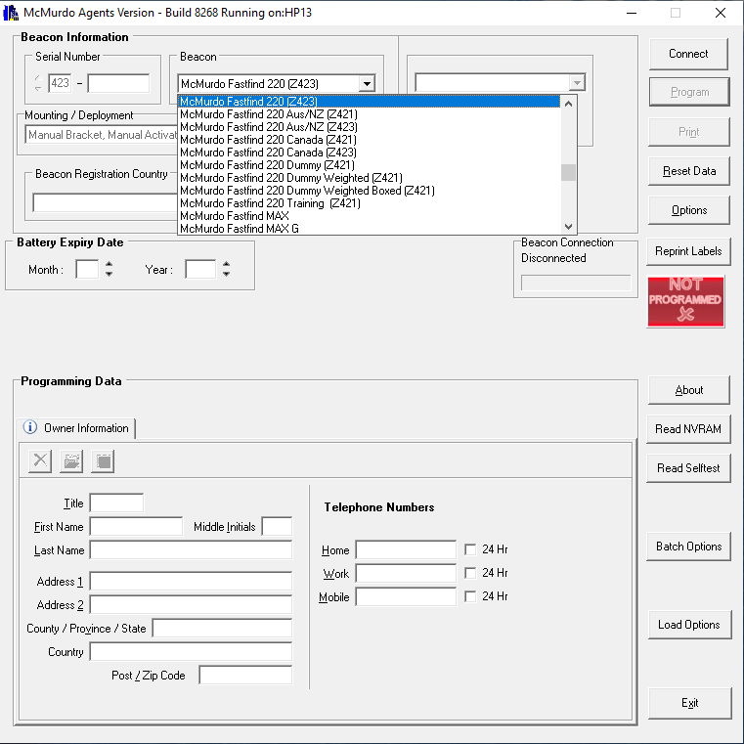
Connecting to the PLB
Once the pen and PLB have been lined up using the pen holder as shown on previous slide, open the FPROG 3 program.
Select the correct PLB from the Brand drop down list. The options for the new PLB is as follows:
McMurdo Smartfind 220
McMurdo Ranger
Kannad Solo
PLB Battery Replacement Guide
Feb-25

Slide 19
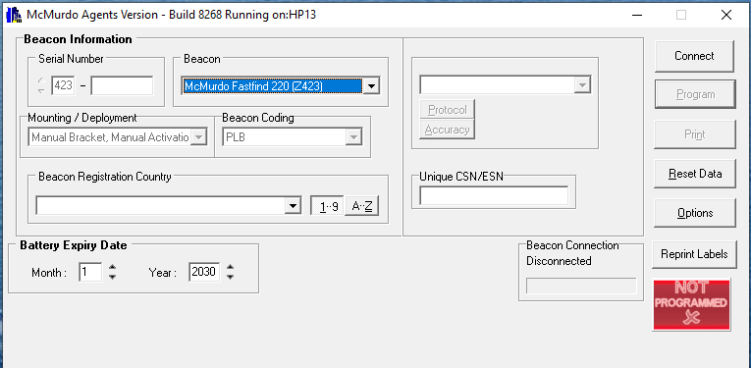
Connecting to the PLB
Confirm the correct model has been chosen
click Connect
The TX light on the programming pen will flash Red
It is important NOT to enter any additional information at this stage except the correct model. The Country code, battery expiry and unique CSN/ESN should be left blank at this stage.
PLB Battery Replacement Guide
Feb-25

Slide 20
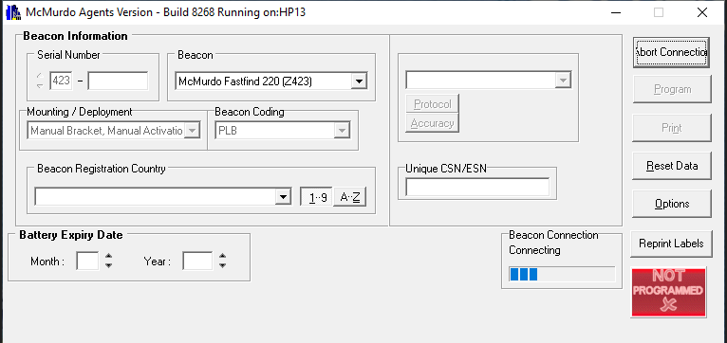
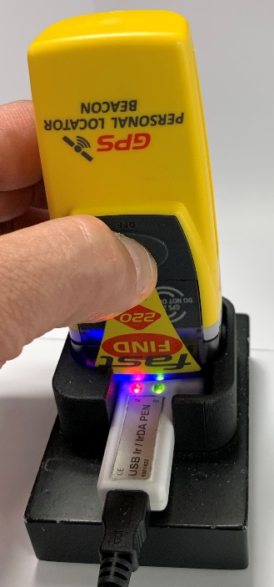
Connecting to the PLB
After clicking Connect, the Beacon Connection Bar will start to show progression
As soon as this happens, press and hold the Test/Off button for approximately 2 seconds, until blue led luminates. Use right hand to hold beacon in position when pressing the buttons.
Please note that the above process cannot happen the other way around. The FPROG program needs to tell the beacon that it wants to communicate first. This will then tell the beacon that it needs to go into programming mode when the selected buttons are pressed. If the Test and Off buttons are pressed before the Connect button on the program, the beacon will just go into test mode.
Once the PLB initiates the connection the green RX led on the programme pen will begin to flash.
Pen holder removed in photo to clearly show detail.
PLB Battery Replacement Guide
Feb-25

Slide 21
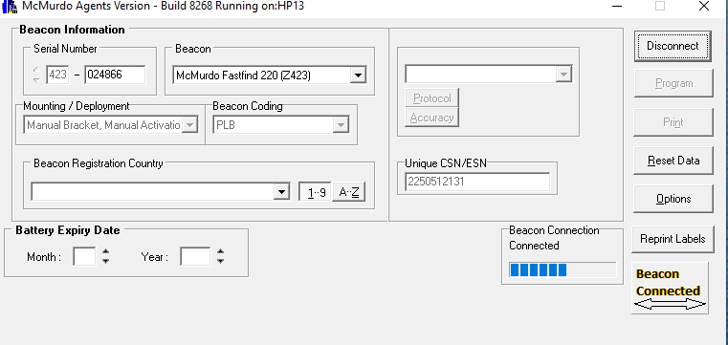
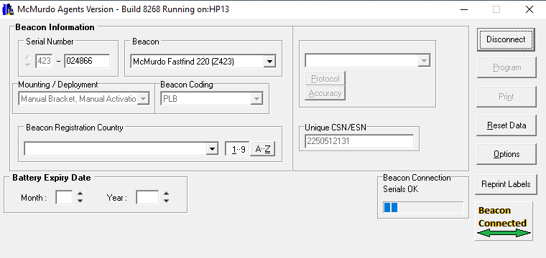
Connecting to the PLB
After the Blue LED illuminates, the Not Programmed button changes to Beacon Connected with a clear arrow. The program is now trying to connect to the PLB.
Please note that this doesn’t mean that a connection with the PLB has been established
When a connection with PLB has been established, the arrow on the Beacon Connected Button turns green. Additional information now shown are the Serial Number and the Unique CS number of the beacon.
If unit Serial number, CS number and arrow on the button doesn’t turn green, then the connection wasn’t successful. Please reset data and try establish connection again.
PLB Battery Replacement Guide
Feb-25
Notes:
If arrow doesn’t go green, then the connection is not in place – troubleshooting, raise point with Yannick.
Point about not moving the pen…what will happen if that does happen.

Slide 22
Updating Battery Expiry date on PLB
PLB Battery Replacement Guide
Feb-25

Slide 23
Programming the PLB
The first step is to select the Beacon Registration Country
Then select the relevant expiry date of the battery by Month and Year. If this information is not entered, then the Program and Print buttons will remain disabled, not allowing the PLB to be programmed or documents to be printed after programming
PLB Battery Replacement Guide
Feb-25
Notes:
Shouldn’t be able to change deployment. Cat 1 to cat 2 and visa versa – Yannick

Slide 24
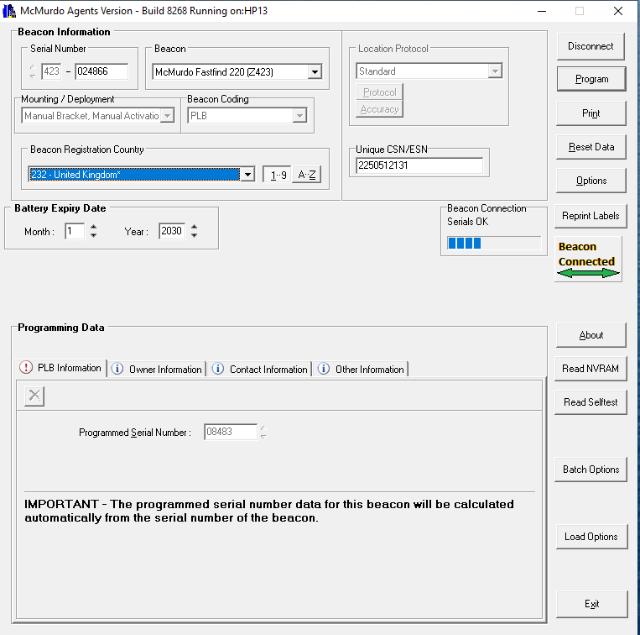
Programming the PLB
With the Battery expiry date now entered, the Program and Print buttons will now be enabled
Enter the relevant information in the following fields –
Coded Serial Number (will automatically be entered)
Confirmation of preferred registration type for Flag can be checked with either the flag administration of the country of registry or on the COSPAS SARSAT website if not sure.
PLB Battery Replacement Guide
Feb-25

Slide 25
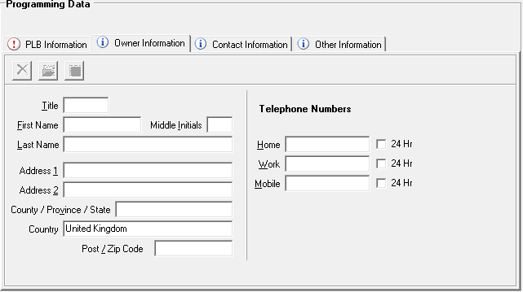
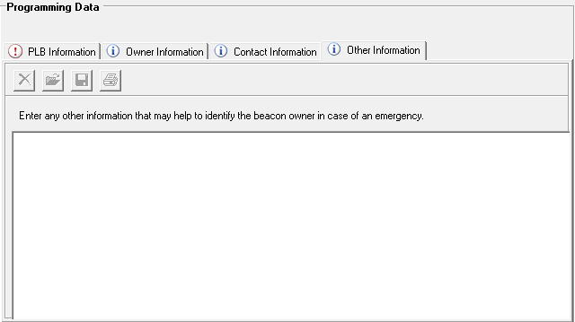
Programming the PLB
Enter any further information into the tabs Owner information, Contact Information and Other information. Please note that this information is not required to program the beacon, if it is given this information will appear on the printed warranty and registration forms. The registration forms must be sent to the Beacon registration Authority for the relevant country.
PLB Battery Replacement Guide
Feb-25

Slide 26
Programming the PLB
After all the relevant information has been entered, please go over the entered information to make sure all has been entered correctly.
Once the check has been done, click the Program button
The following window will appear to confirm information on the beacon. Once confirmed click program to continue
PLB Battery Replacement Guide
Feb-25

Slide 27
Programming the PLB
After the programming button has been clicked, the Beacon Connection block will change status to Start Program. Once the beacon has been programmed the Beacon Connection block will change status to Finished Program
The Beacon Connected button will change to Programmed with a Tick when successful
PLB Programming Guide
Feb-25

Slide 28
Programming the PLB
Once programming has been completed, click the Print button
The following window will provide option for documents to be printed.
If it is a new PLB, the following will need to be printed: -
Labels, Warranty Form, Registration Form and Programming certificate
If it is an existing PLB, the following will need to be printed:
Labels and Programming certificate only
PLB Battery Replacement Guide
Feb-25

Slide 29
Examples of printed documents
Labels x 2 copies and Programming Certificate
Outer box Label
Manual Labels & Alternate Rear Label
HEX ID
PLB Battery Replacement Guide
Feb-25

Slide 30
Examples of printed documents
Registration Form and Warranty Form
PLB Battery Replacement Guide
Feb-25

Slide 31
Applying the labels
PLB Battery Replacement Guide
Feb-25

Slide 32
Updating the Rear label on the PLB
Existing Rear Label
New Rear Label
Remove New Rear Label and stick it over the existing PLB Rear label, ensuring that the Old details are covered by the New details
Then cover with the clear over-stick label to ensure longevity of new label
PLB Battery Replacement Guide
Feb-25

Slide 33
Updating the label in Manual and exterior box
Cut out the External Box label from the printed Labels
Stick the Label on the side of the External box
Cut out the Rear label and over stick this into the Manual, over the Previous Programmed Label
PLB Battery Replacement Guide
Feb-25

Slide 34
Thank you
PLB Battery Replacement Guide
Feb-25

